Slide 1


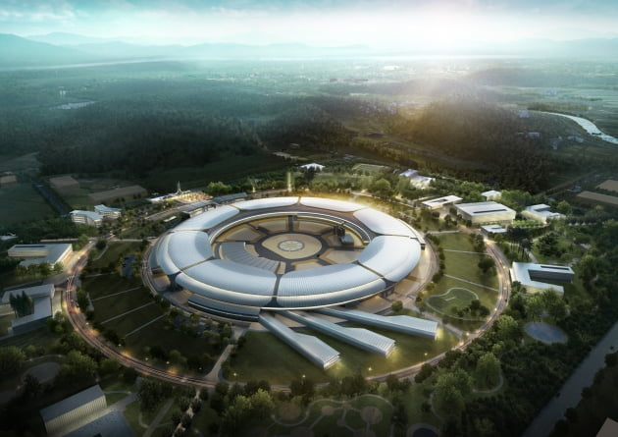


4th Korea-4GSR International Advisory Committee Meeting (Nov. 5-6, 2025)
Vacuum System
Taekyun Ha
On be half of Vacuum Group
Nov. 05, 2025

Slide 2

CONTENTS
I
I I
I I I
I V
Introduction
Linac & Booster Vacuum
Storage Ring Vacuum
Summary
Linac Vacuum System
Booster Vacuum System
Design Strategy
Change Log of Chamber Design
Overview
Design for Low impedance
Photon Absorber and Beam Handling
Vacuum Simulation
Vacuum Chamber Prototyping
Fabrication Schedule
2

Slide 3
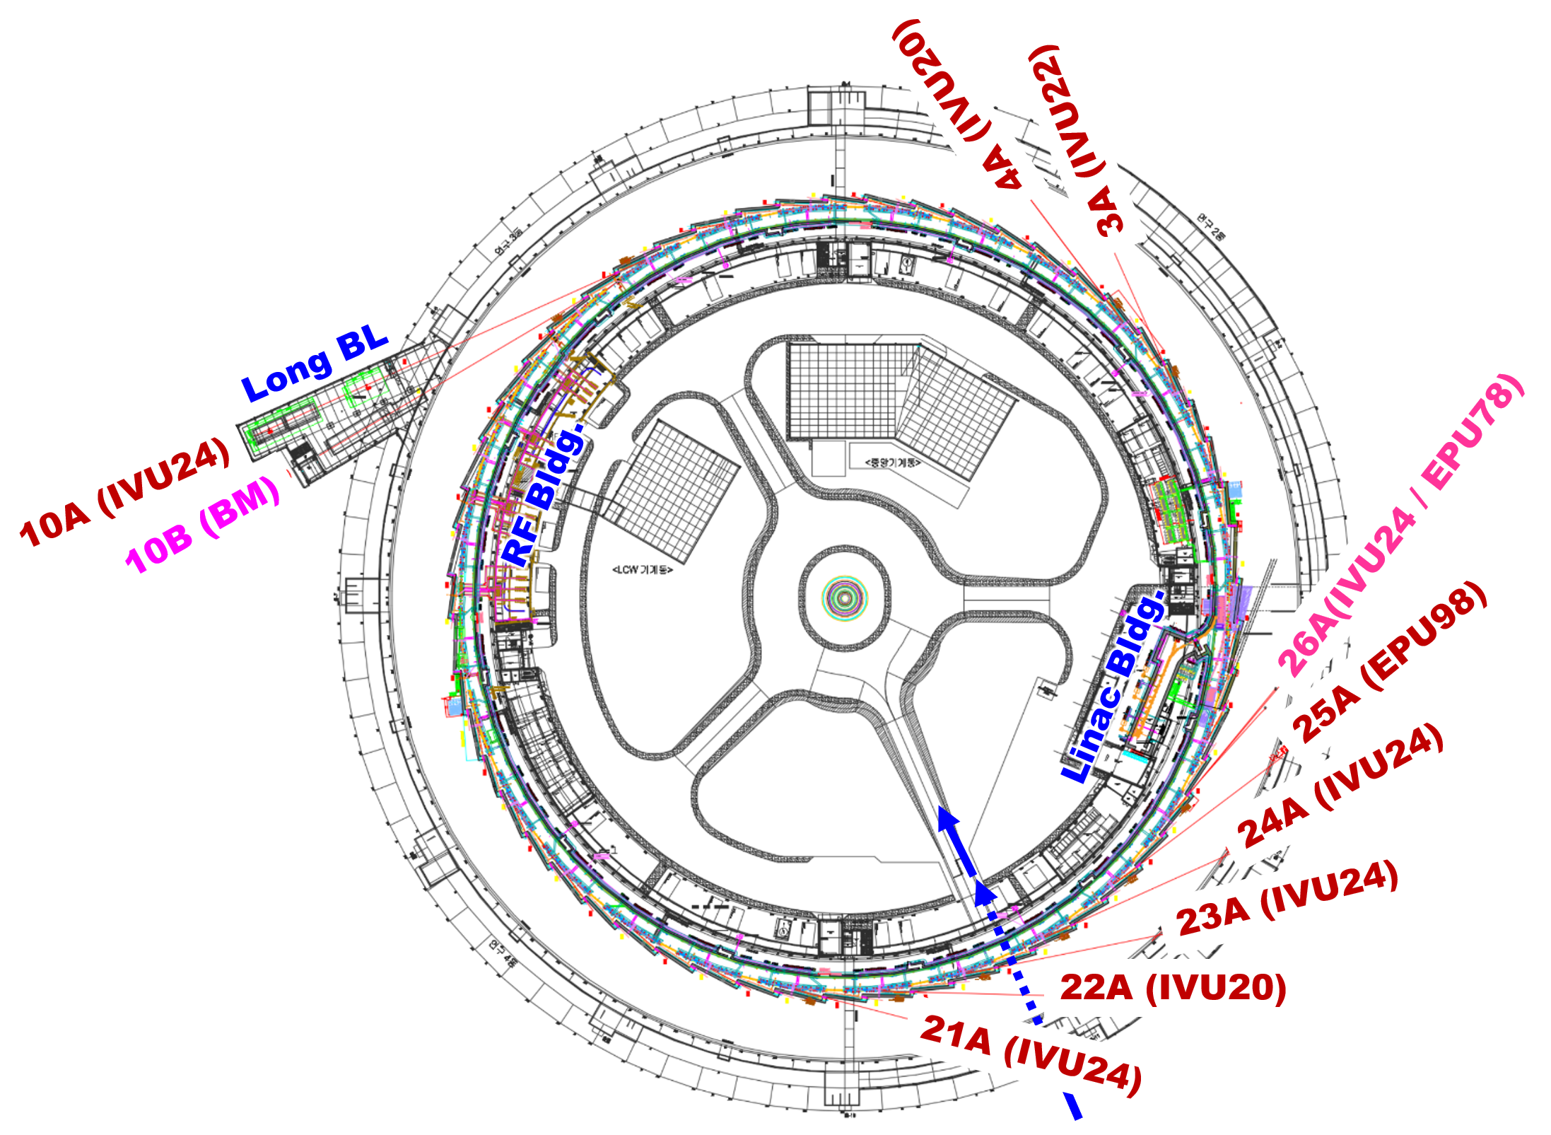
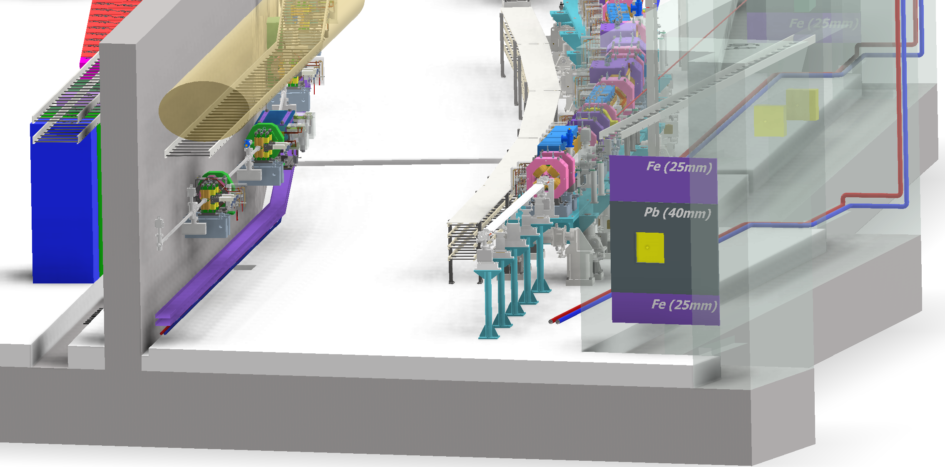
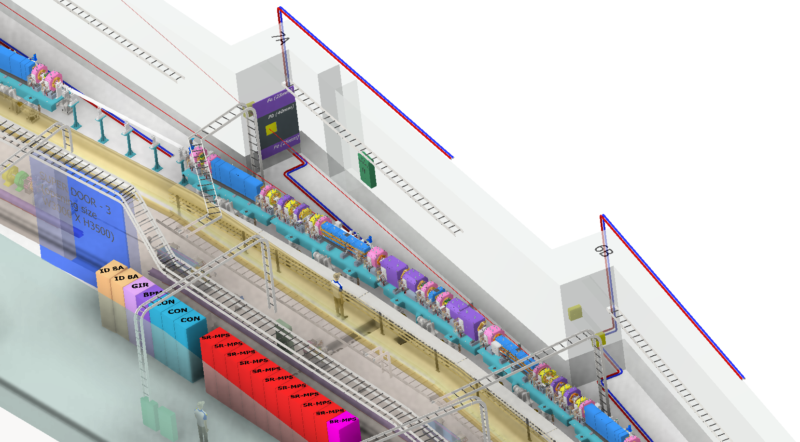
I. Introduction
Layout of Accelerator
Booster
Storage Ring
4 | GeV
400 | mA
800 | m Ring
3

Slide 4
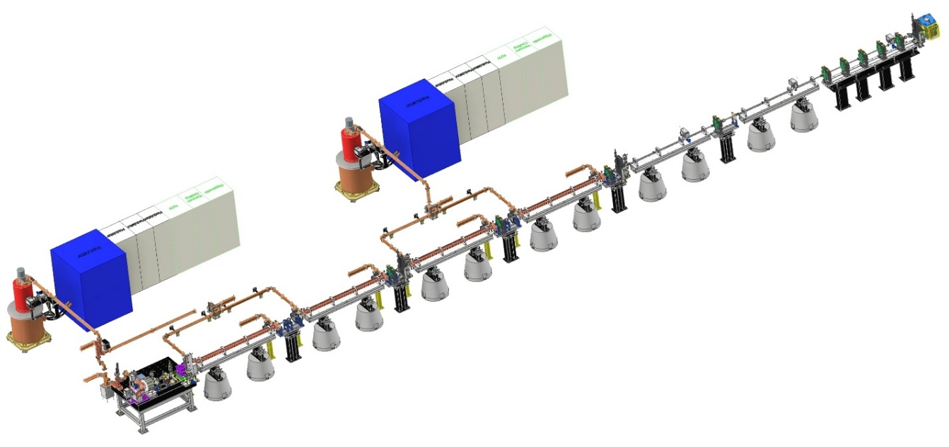
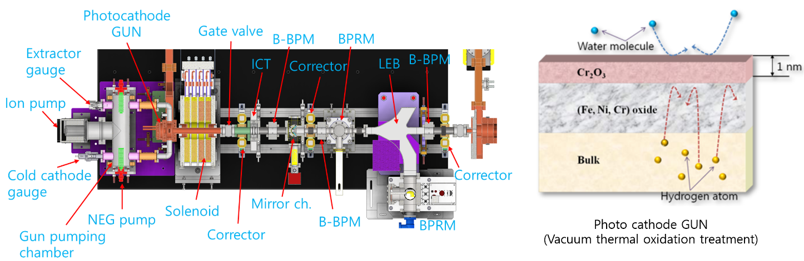
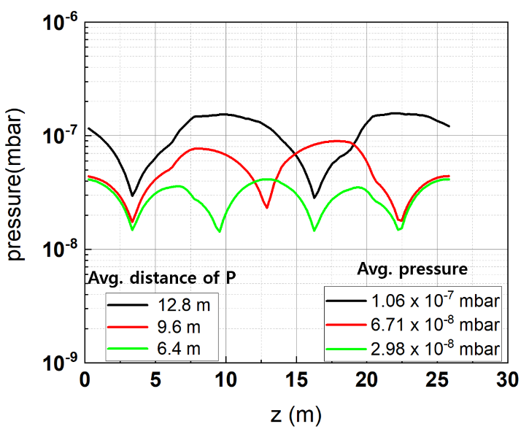
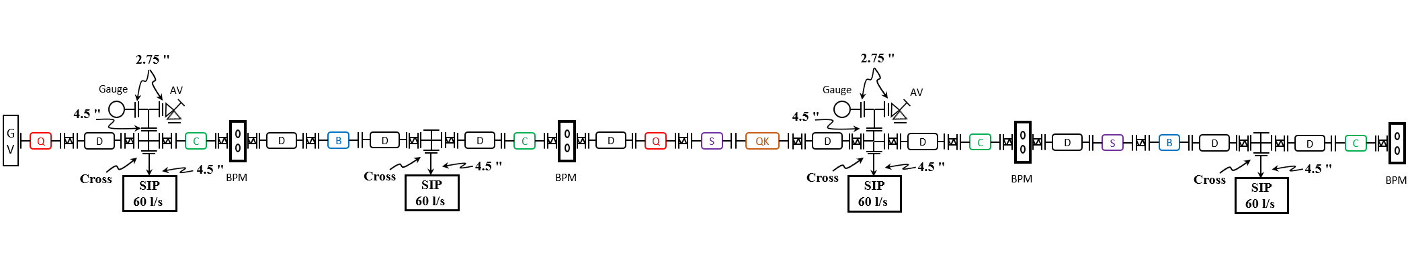
I. Introduction
Accelerator Vacuum System
Linac vacuum
Electron beam energy 0 → 200 MeV
Four S-band accelerating columns with two modulator-klystron stations
Photo-cathode E-gun (~10⁻¹¹ mbar), AC and wave guide (~10⁻⁸ mbar)
Booster vacuum
Electron beam energy 200 MeV → 4 GeV
Circumference ~770 m with 30 cells
Beam duct OD ∅22.6~32 mm, thickness 0.8 mm (low eddy current)
Chamber materials: SS316L (0.8 mm-thick) → Max. stress < 2.5 MPa
Vacuum requirement ~10⁻⁸ mbar
Storage ring vacuum
Electron beam energy 4 GeV & beam current 400 mA
Circumference ~800 m with 28 cells
Beam duct Inner diameter ∅18(V) x 24(H) mm
Vacuum requirement during operation ~10⁻⁹ mbar
※ Pressure distribution
w.r.t. pump distance
4

Slide 5

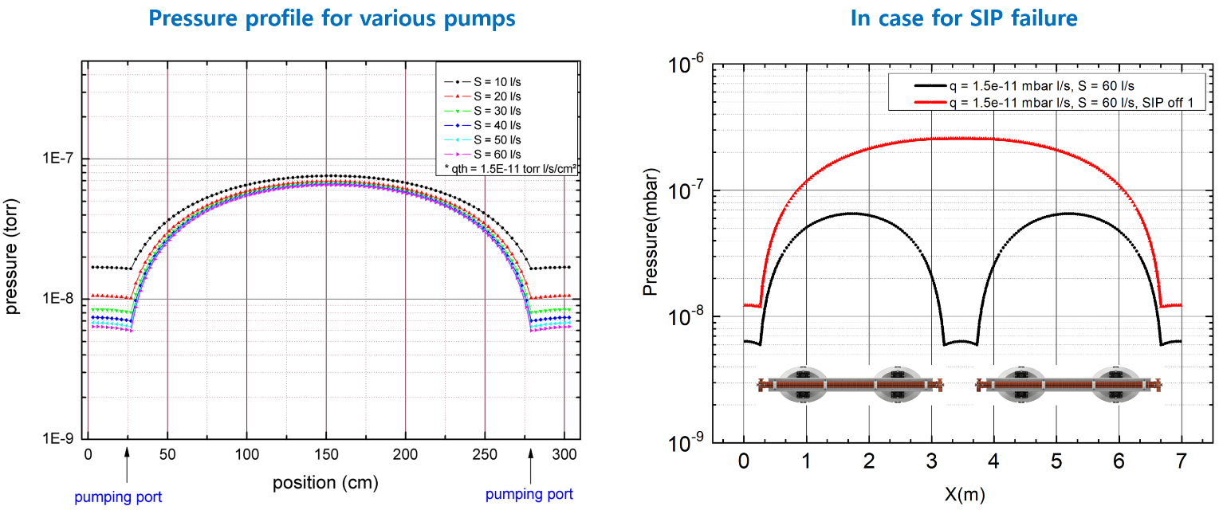
II. Linac & Booster Vacuum System
Linac Vacuum System
Photo-cathode E-gun:
Vacuum requirement during operation ~ 10⁻¹¹ mbar
Low outgassing vacuum chamber with SIP(1 ea, 60 L/s), NEG cartridges(2 ea, 400 L/s)
Accelerating columns and wave guides
Four S-band accelerating columns with two modulator-klystron stations
Vacuum requirement during operation ~ 10⁻⁸ mbar
Five SIPs per module (60 L/s), vacuum interlock with CCG signal
Linac to Booster (LTB): Vacuum requirement during operation ~ 10⁻⁸ mbar
5

Slide 6
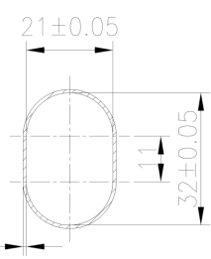
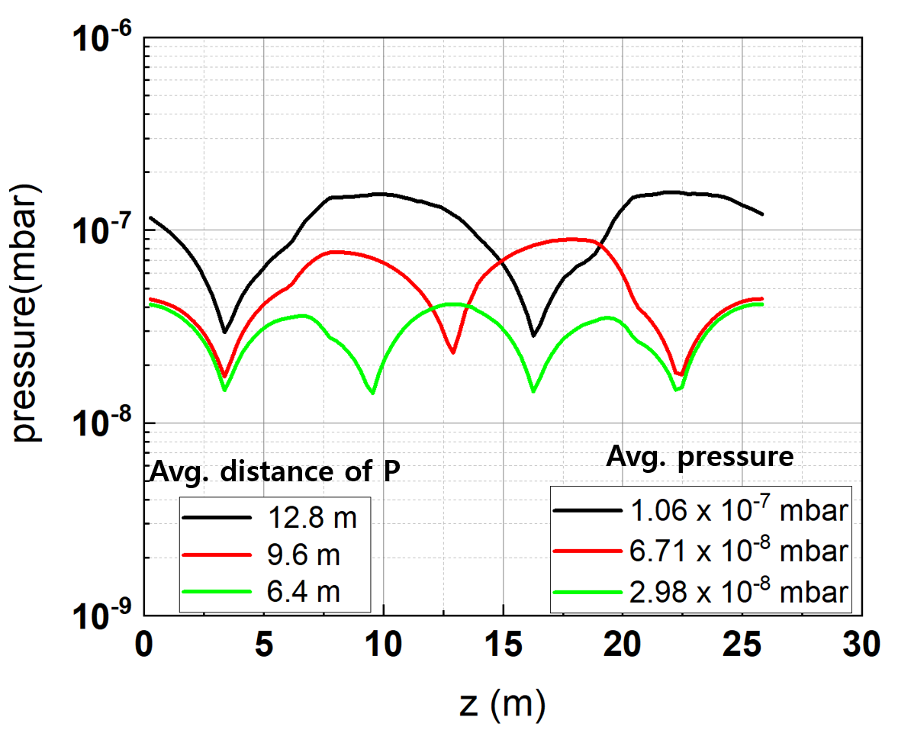
II. Linac & Booster Vacuum System
0.8 mm
Booster Vacuum System
※ One cell layout of booster vacuum system
※ Chmber crosssection
※ Pressure distribution w.r.t. pump distance
Circumference ~770 m with 30 cells
Racetrack type beam duct with 33.6 mm (H) x 22.6 mm (V) for magnets
Chamber materials: SS316L (0.7 mm-thick) → Max. stress < 2.5 MPa
Eddy current heating effect < 1 mW/cm² → Negligible temperature rise
Outgassing rate < 1.5x10⁻¹⁰ mbar l/s cm² → Avg. pressure < 5x10⁻⁸ mbar
6

Slide 7
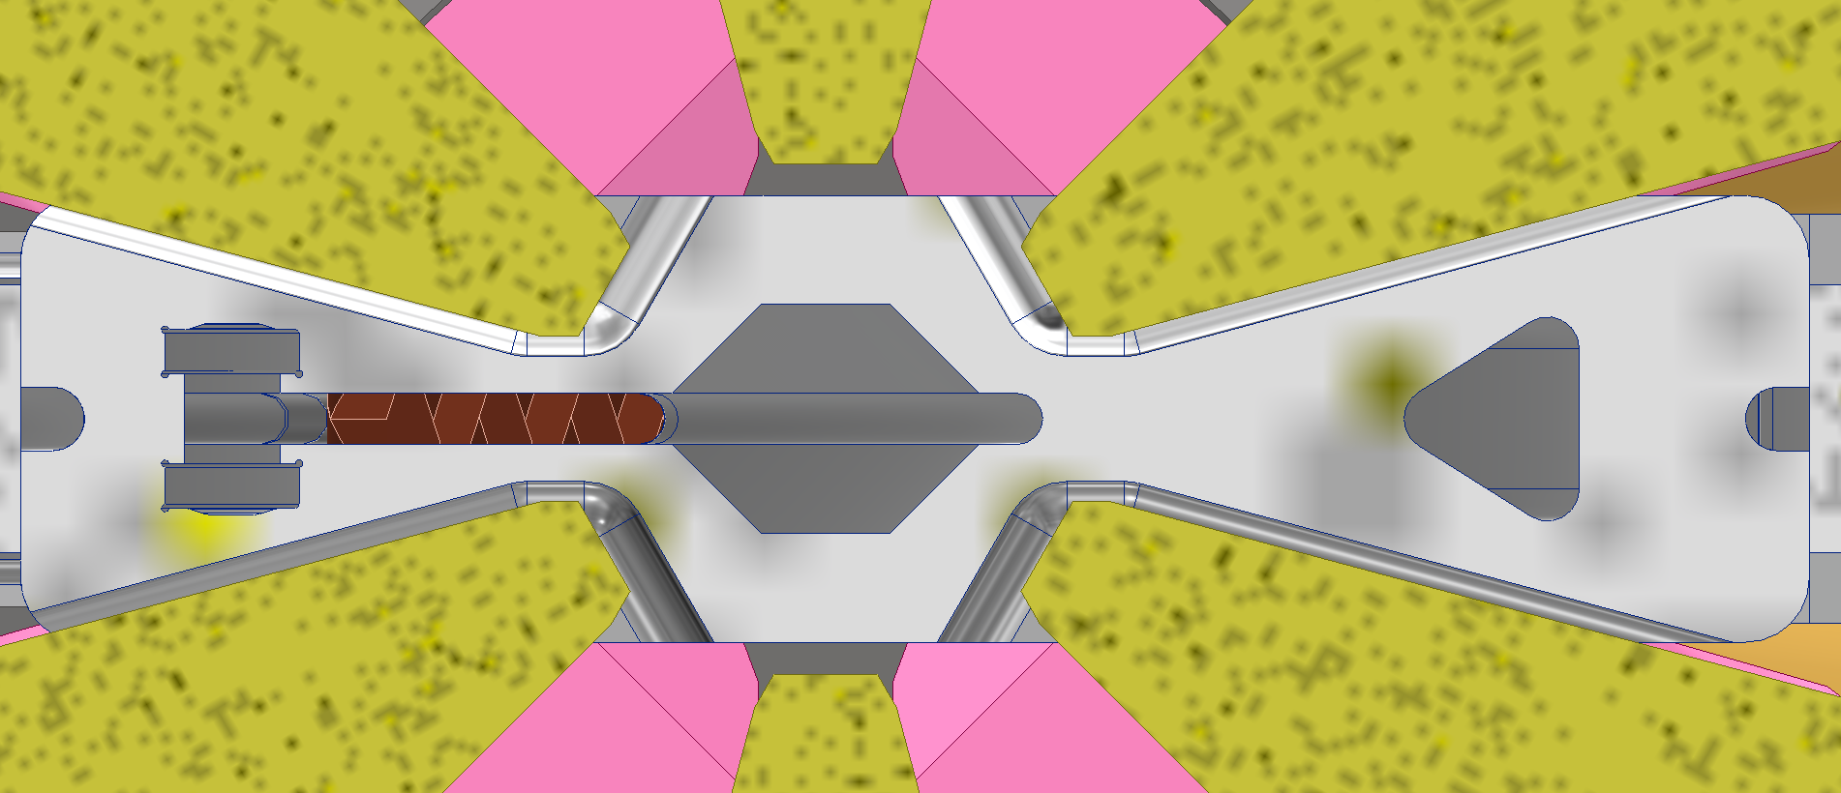
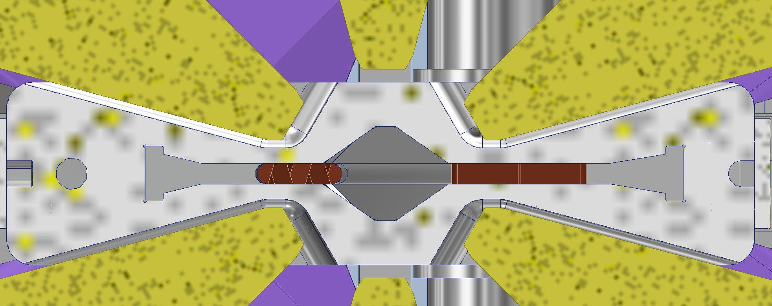
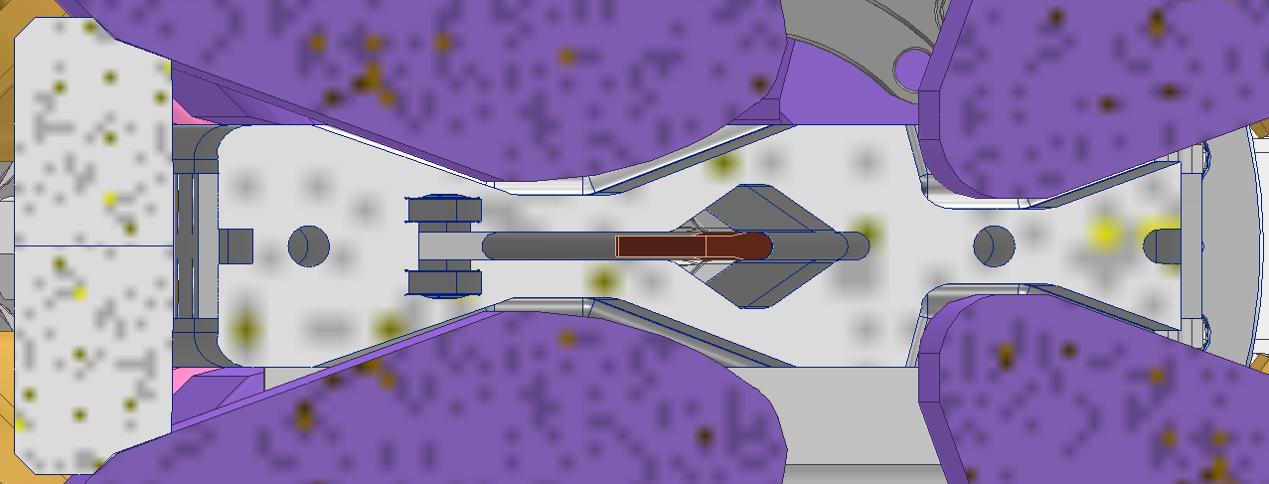
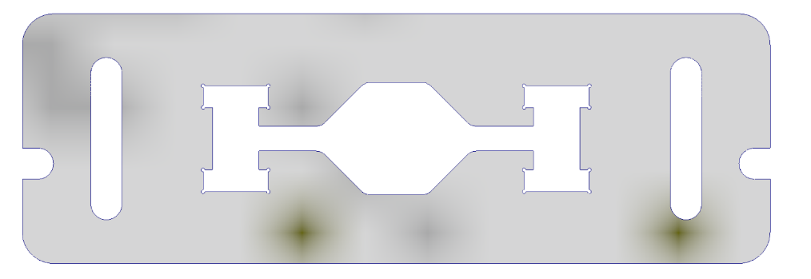
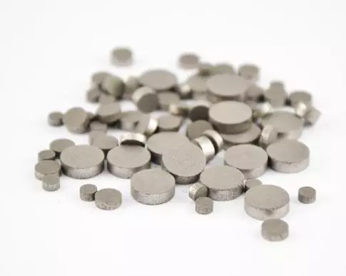
III. Storage Ring Vacuum System
Design Strategy
Cooling water
e⁻
SR
Distributed pumping system using “Pill-type Getters”
Bake-out & NEG activation in the tunnel (“In-situ bake-out”)
Maximize the exposure of the chamber wall to synchrotron radiation for rapid beam cleaning
Two step installation:
Pre-assemble magnets and vacuum chambers on a girder outside the tunnel
Connect the chamber between the two girders using bellows in the tunnel
Low impedance design:
24x18 octagon-shaped e-beam channel with 4 mm high winglet for synchrotron radiation handling
Try to make the transition angle less than 1:10
Bellows and gate valve having RF-shielded finger which is made of thin copper plate with slots
No components penetrate into the beam channel (cross section change only in the winglet)
Sheath heater
Pill-NEG
7

Slide 8
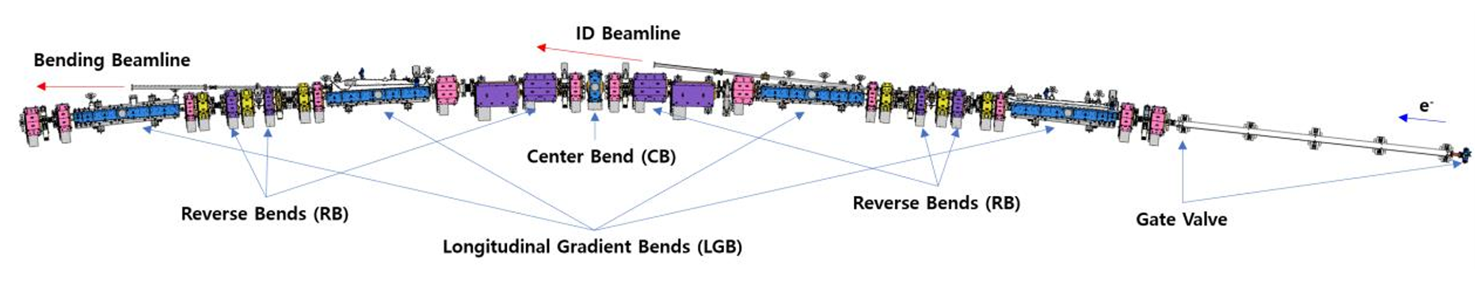
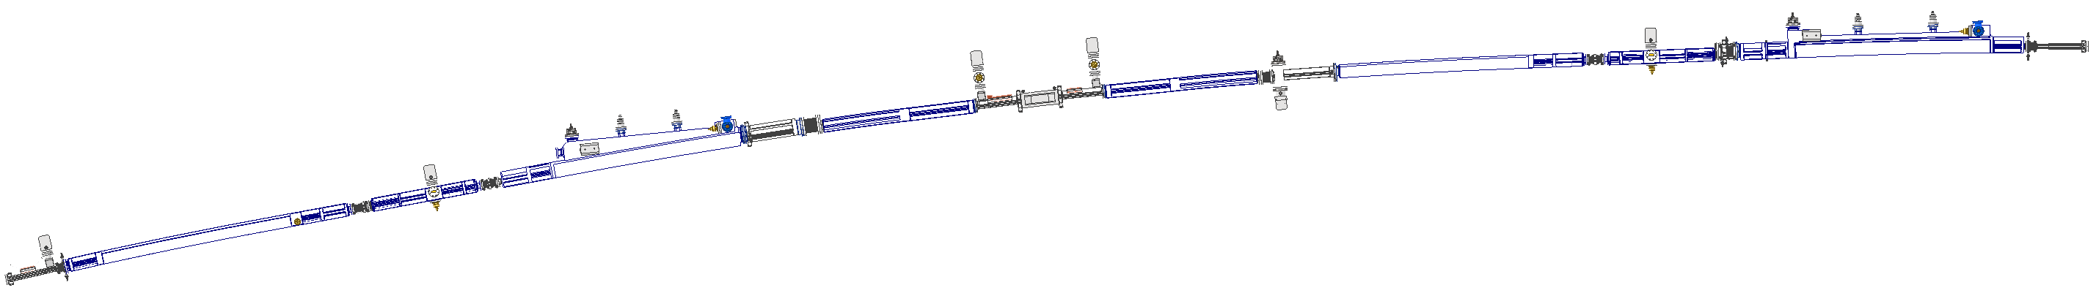
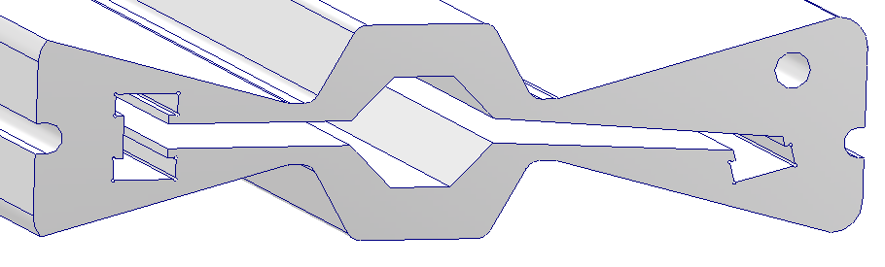
III. Storage Ring Vacuum System
Overview
SR one cell layout
※ Arc-section length: 22.3 m
※ Bending angle (1 Cell): 12.857°
※ 28 cells (800 m)
SR one cell vacuum chambers
e⁻
Photon beam (ID)
CN04
CN03
CN02
CN01
Photon beam (BM)
CN07
CN06
CN05
CN09
CN08
Beam chamber
24(H)×18(V)
CN10
Cooling water
CN11
e⁻
SR
CN12
Vacuum chamber cross-section
CN13
※ 13 vacuum chambers per arc-section
Pill-NEG
8

Slide 9
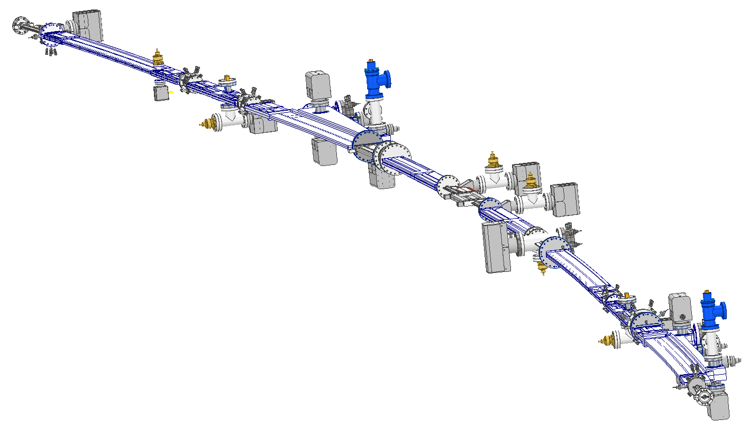
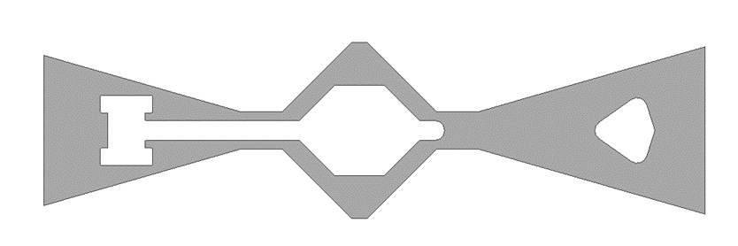
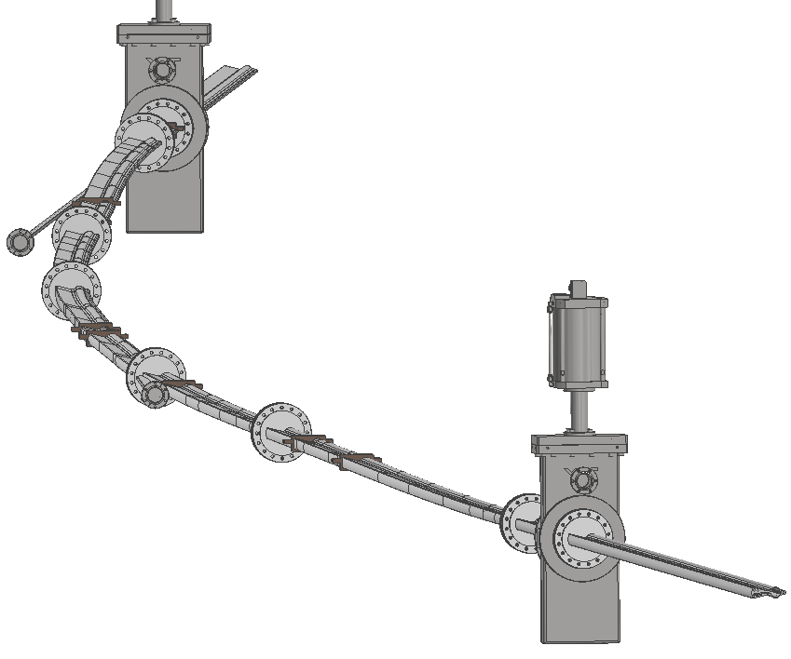
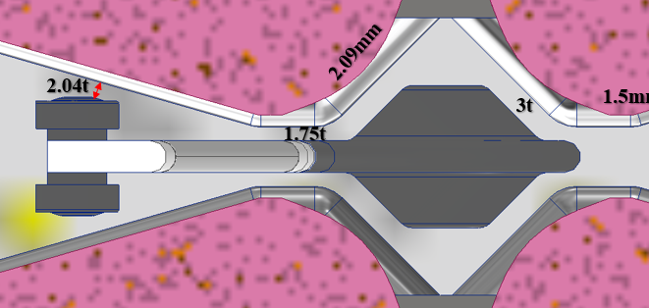
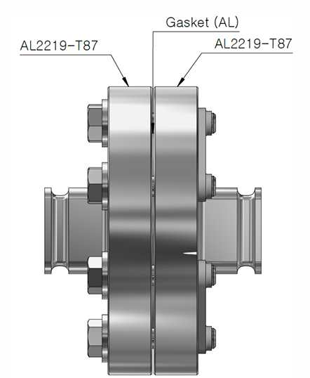
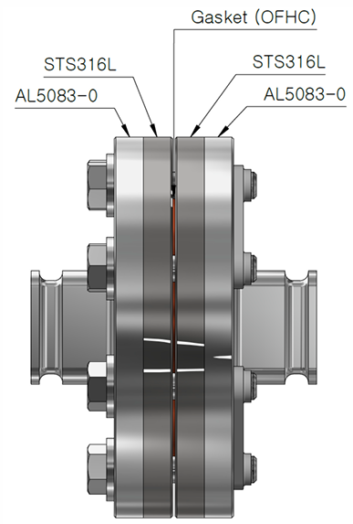
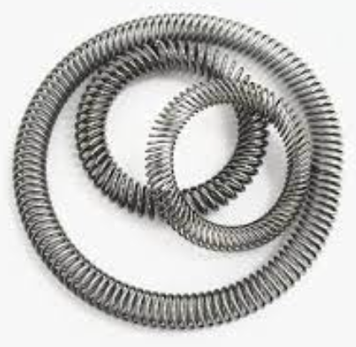
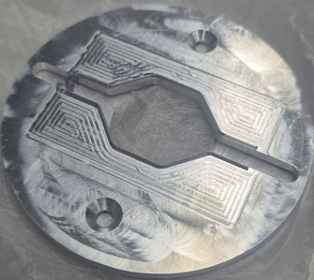
III. Storage Ring Vacuum System
Bending
beam
Design Change of the Vacuum Chamber
Beam chamber
24(H)×18(V)
Cooling water
e⁻
SR
e⁻
SR
Pill-NEG
Sheath heater
Pill-NEG
Cooling water
ID beam
Sheath heater
e⁻
SR
ID beam
Bending beam
Conceptual Design (Ver. 1)
Modified Design (Ver. 2)
Current Design (Ver. 3)
9

Slide 10
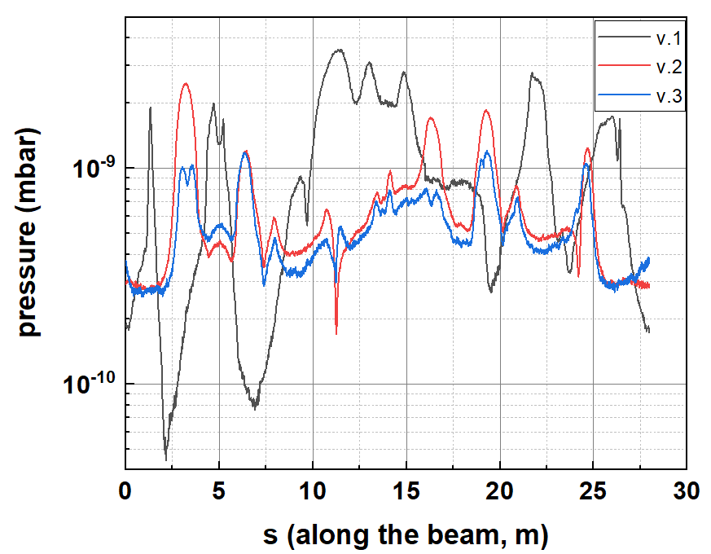
III. Storage Ring Vacuum System
Bending
beam
Improvement of Dynamic Pressure
Beam chamber
24(H)×18(V)
Cooling water
e⁻
SR
e⁻
SR
Pill-NEG
Sheath heater
Pill-NEG
Cooling water
ID beam
Sheath heater
e⁻
SR
ID beam
Bending beam
Conceptual Design (Ver. 1)
Modified Design (Ver. 2)
Current Design (Ver. 3)
10

Slide 11
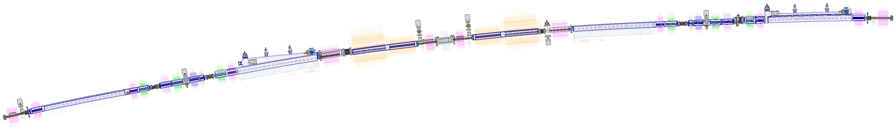
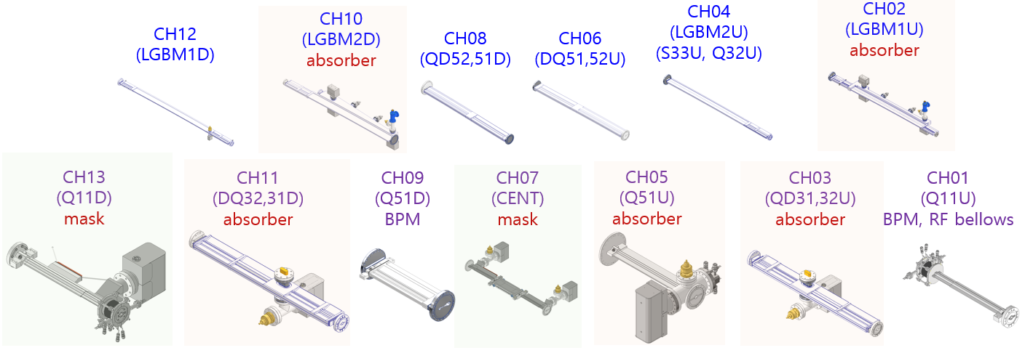
III. Storage Ring Vacuum System
Main Components of the SR Vacuum System
CH04
CH03
CH02
CH01
CH08
CH07
CH06
CH05
Sputter Ion Pump (11 ea, 60 L/s)
NEG Pump (10 ea, 400 L/s)
Ion Gauge (5 ea)
RGA (2ea)
All-metal Angle Valve (2 ea)
RF-shielded Gate Valve (2 ea)
CH10
CH09
BPM (10 ea, STS316)
RF-shielded Bellow (10 ea)
Photon absorber (4 ea, OFHC)
Photon mask (3 ea, OFHC)
CH12
CH11
Stainless steel (4 ea)
Aluminum (6 ea, extruded)
Aluminum (3 ea, machined)
CH13
11

Slide 12
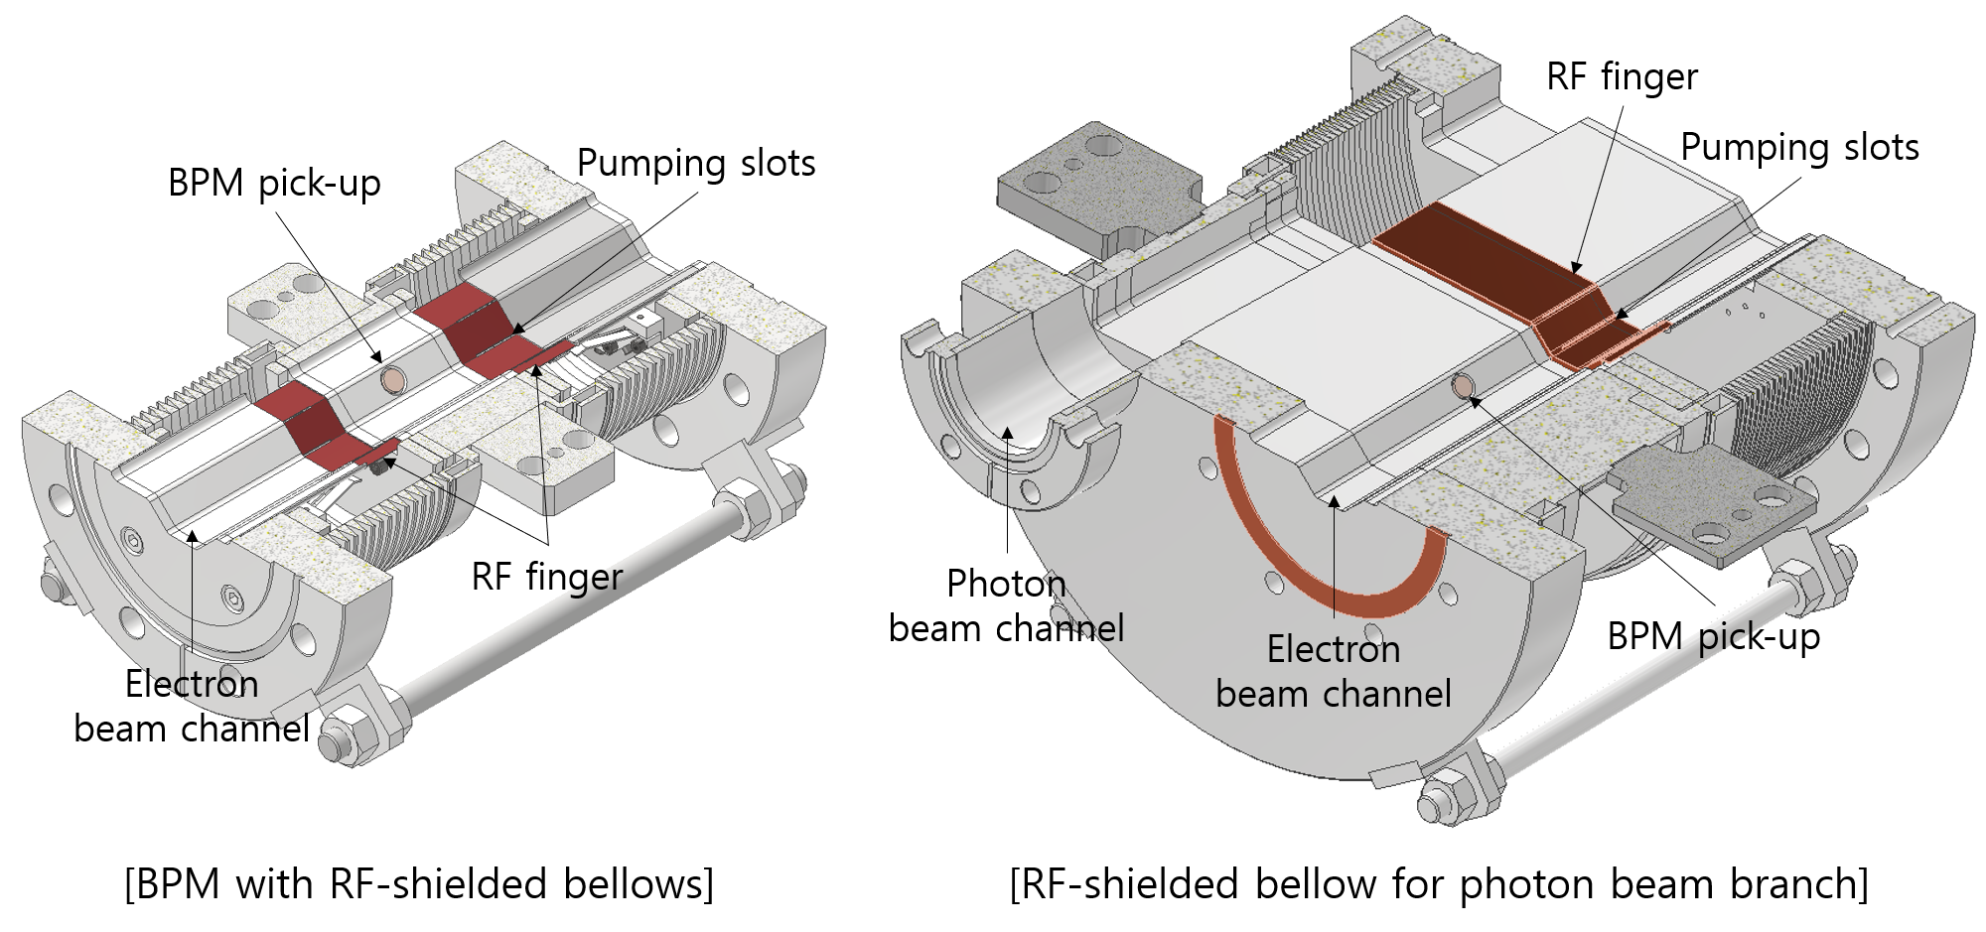
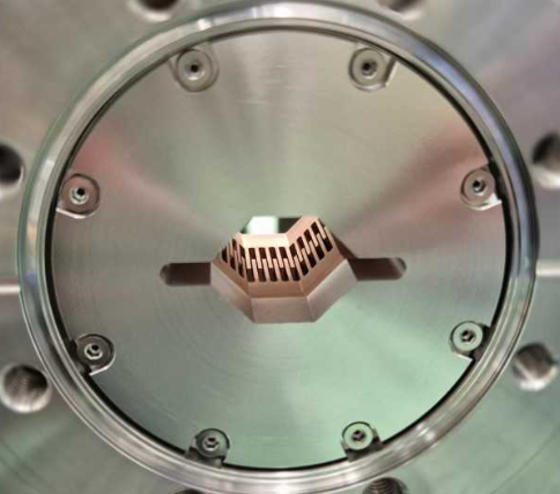
III. Storage Ring Vacuum System
Design for Low Impedance (RF Shielding)
[Comb-type RF shield for gate valve]
12

Slide 13
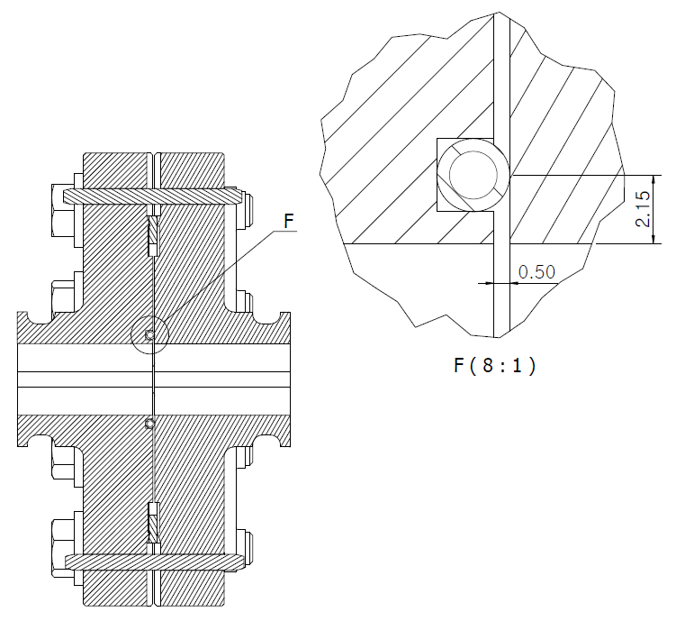
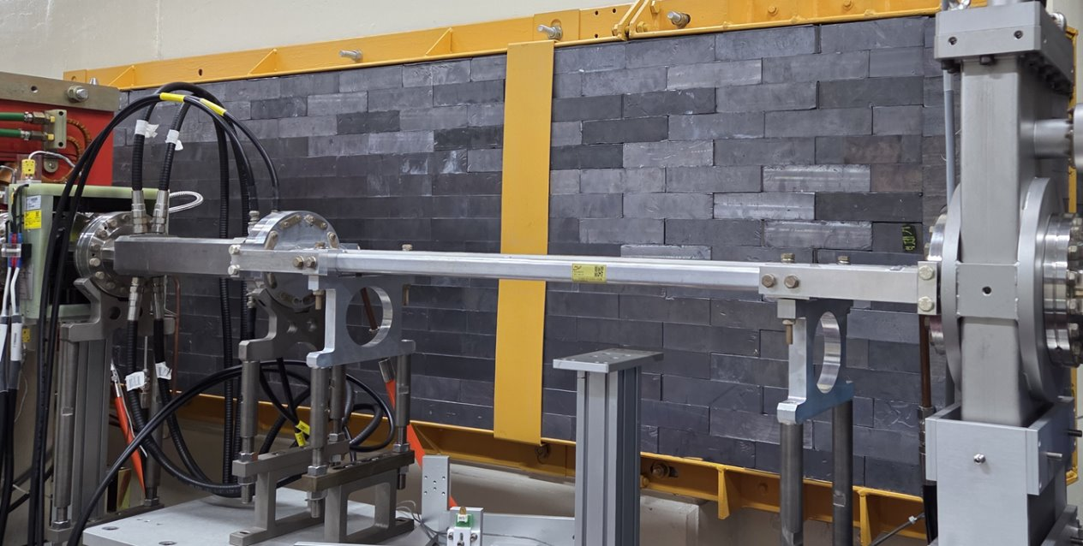
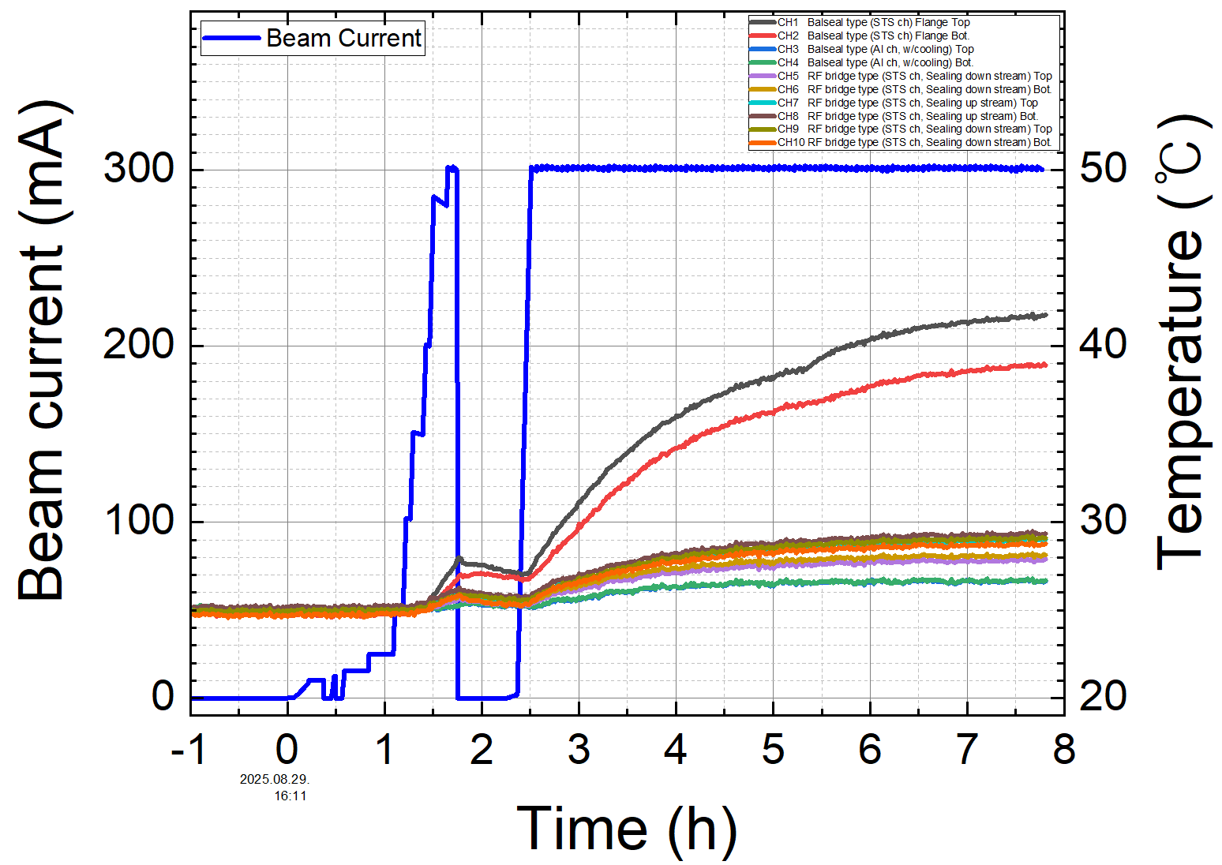
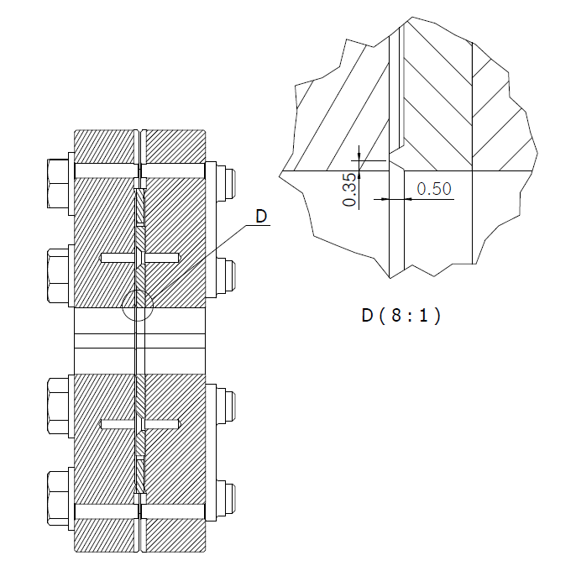
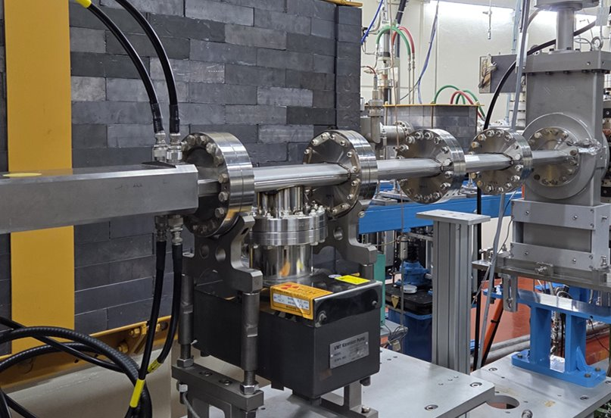
III. Storage Ring Vacuum System
Design for Low Impedance (RF Contact)
RF heating test at PLS-II Storage ring
Bal seal
Bal seal type
Beam current
Bal seal
RF bridge
RF bridge type
RF-bridge
13

Slide 14
III. Storage Ring Vacuum System
Impedance Budget
 |  | Single Component |  | Sum
Components | Number | k_{z} [V/pC] | Zn_{z} [mOhm] | k_{z}T [V/pC] | Zn_{z}T [mOhm] | Zn_{z}T [mOhm]
Resistive Wall | 1 | 14.78 | 158.20 | 14.78 | 158.2 | 158.2
Main RF cavity | 10 | 1.17 | 5.98 | 11.65 | 59.80 | 59.80
LGBM1U chamber | 28 | 2.34E-02 | 0.16 | 0.65 | 4.37 | 4.37
LGBM2D chamber | 28 | 3.42E-02 | 0.34 | 0.96 | 9.39 | 9.39
BPM | 176 | 2.30E-02 | 0.17 | 4.05 | 30.62 | 30.62
Gate valve | 112 | 3.38E-02 | 0.30 | 3.79 | 33.82 | 33.82
ID taper | 26 | 2.56E-03 | 0.89 | 0.07 | 23.17 | 23.17
Bellows | 224 | 7.09E-03 | 0.07 | 1.59 | 15.19 | 15.19
BPM-Bellows 1 | 56 | 2.72E-02 | 0.23 | 1.52 | 12.94 | 12.94
BPM-Bellows 2 | 56 | 2.50E-02 | 0.23 | 1.40 | 12.94 | 12.94
Flange | 840 | 3.00E-05 | 0.02 | 0.03 | 15.96 | 15.96
RF taper | 6 | 7.70E-02 | 1.89 | 0.46 | 11.32 | 11.32
LFS | 1 | 1.58E+00 | 6.30 | 1.58 | 6.30 | 6.30
RF transition chamber | 5 | 8.50E-02 | 0.75 | 0.43 | 3.76 | 3.76
Pump tee | 56 | 5.16E-03 | 0.13 | 0.29 | 7.45 | 7.45
TFS (vert-) | 1 | 1.82E-01 | 0.67 | 0.18 | 0.67 | 0.67
TFS (hori-) | 1 | 1.82E-01 | 0.67 | 0.18 | 0.67 | 0.67
Center bend chamber | 28 | 3.52E-03 | 0.21 | 0.10 | 5.88 | 5.88
CH08 entrance | 56 | 7.90E-04 | 0.03 | 0.04 | 1.68 | 1.68
CH08 exit | 56 | 1.82E-04 | 0.01 | 0.01 | 0.73 | 0.73
Collimator | 4 | TBD |  | TBD
Total |  |  |  | 44 | 415
Loss factor Effective
impedance
14

Slide 15
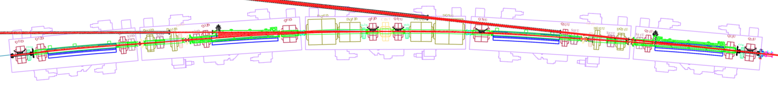
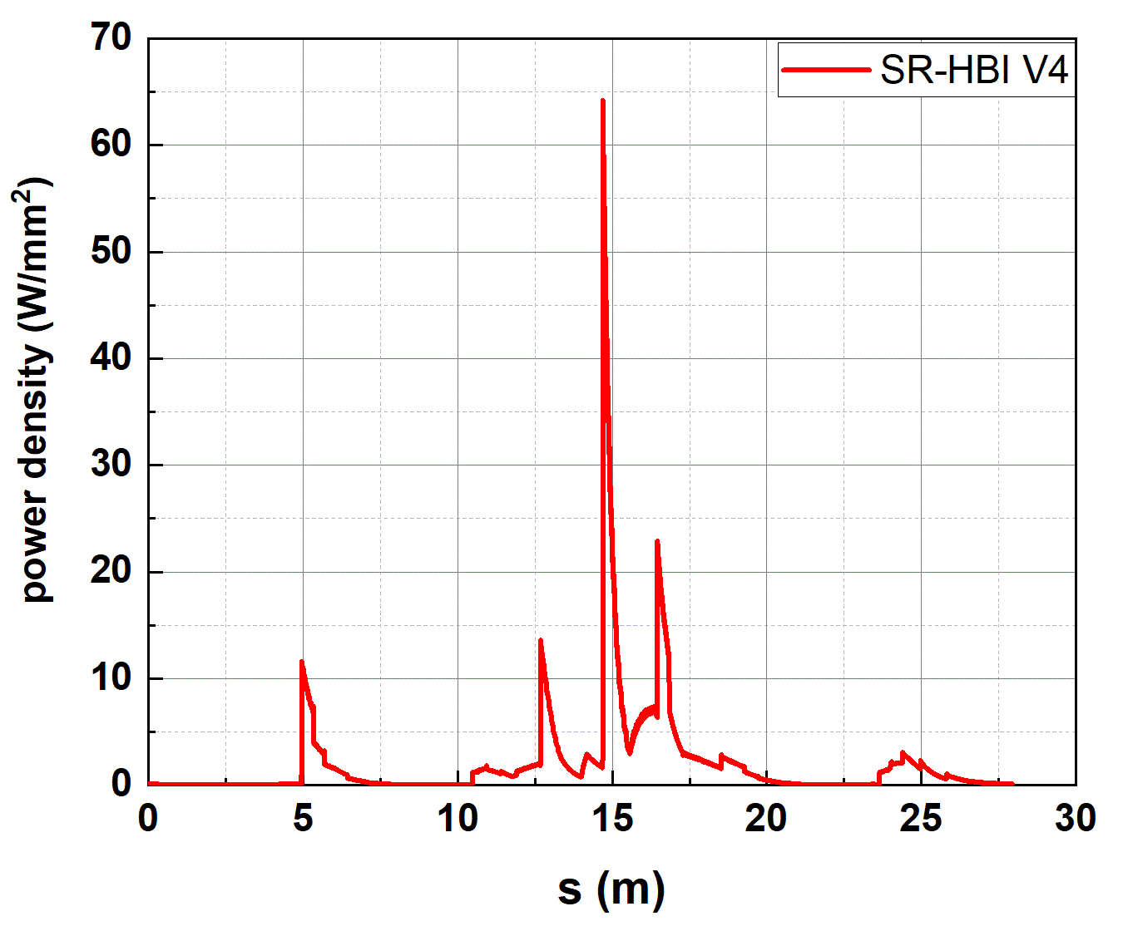
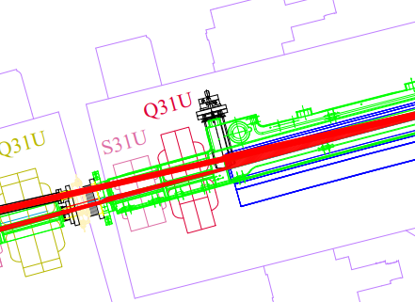
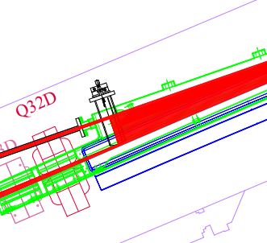
III. Storage Ring Vacuum System
Photon Fan and Beam Branch Chamber
Photon absorber (mask)
※ SR power density along the ring
(for Φ24 mm uniform beam pipe)
Crotch absorber for the bending beamline
Crotch absorber for the ID beamline
15

Slide 16
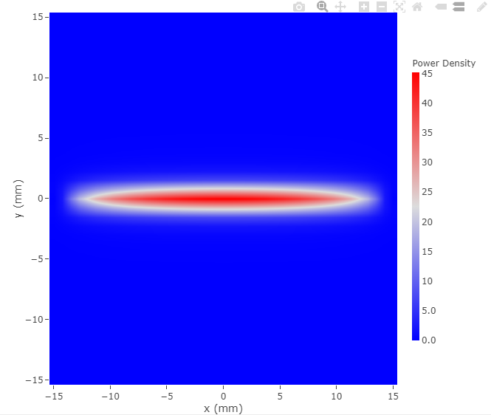
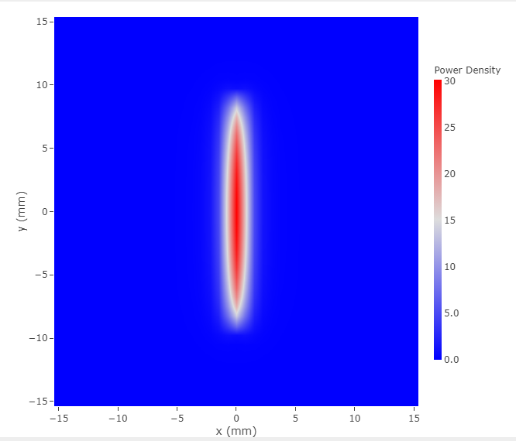
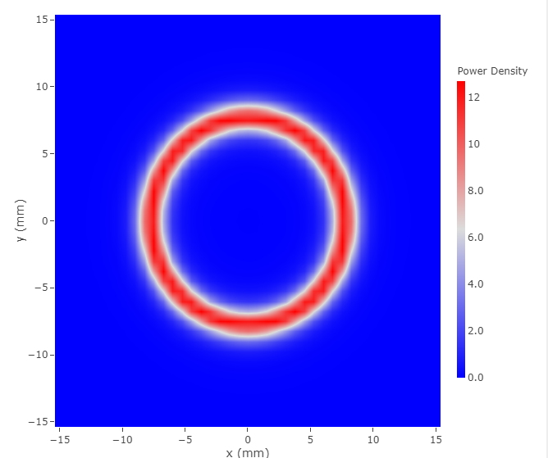
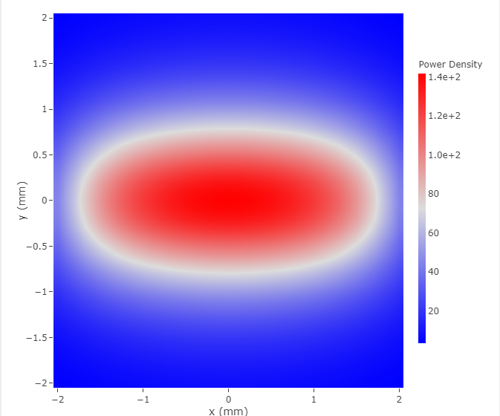
III. Storage Ring Vacuum System
Photon Fan and Beam Branch Chamber
※ Parameters for typical IDs
ID | Gap (mm) | λ_{u} (mm) | L (m) | B [x/y] (T) | K [x/y/⊥] | Max. Power density (kW/mrad²) | Max. Divergence (mrad)
IVU20 | 5 | 20 | 3 | 0.8867 | 1.6558 | 142 | ± 0.2 (H)
EPU98 | 15 | 98 | 3.6 | H: 0/1.2020 | 0/11/11 | 45 | ± 1.5 (H)
 |  |  |  | V: 0.8015/0 | 7.335/0/7.335 | 30 | ± 1.0 (V)
 |  |  |  | C: 0.6667/0.6675 | 6.1/6.108/8.633 | 12 | ± 0.8 (H,V)
※ Orbit interlock condition of e-BPMs for the ID
±0.1 mrad ± 400 μm offset
(Rms orbit error ~ 150 μm)
※ Power density profile @ 10 m from the ID center
IVU20
EPU98 (H mode)
EPU98 (V mode)
EPU98 (C mode)
± 1.0 mrad
± 0.8 mrad
± 0.2 mrad
± 1.5 mrad
± 0.8 mrad
16

Slide 17
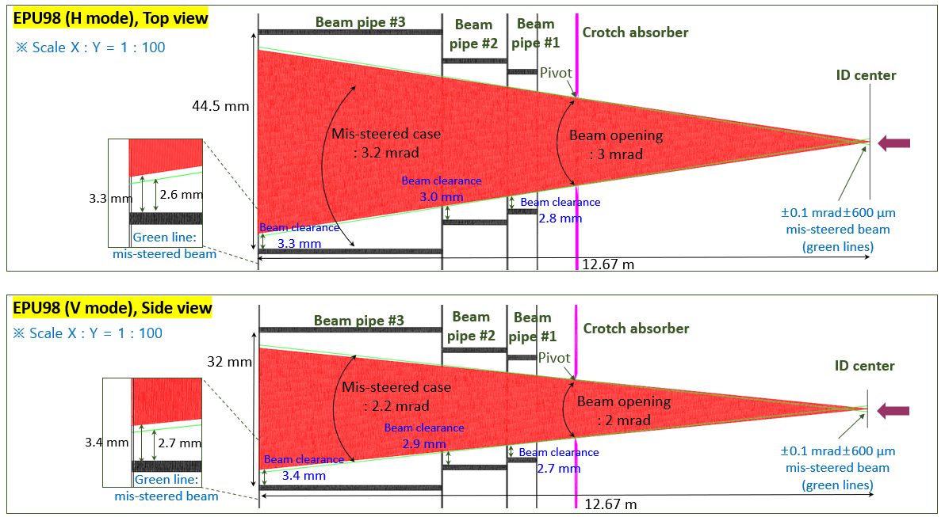
III. Storage Ring Vacuum System
Photon Beam Aperture and Clearance
17

Slide 18
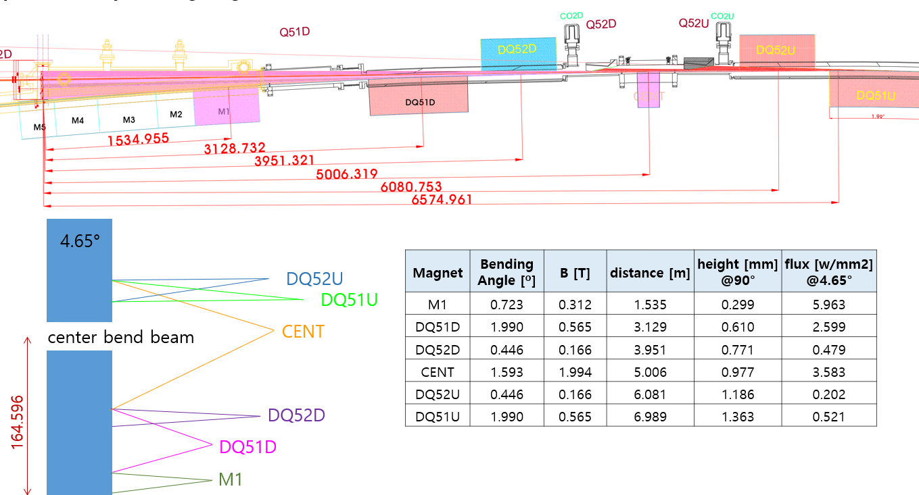
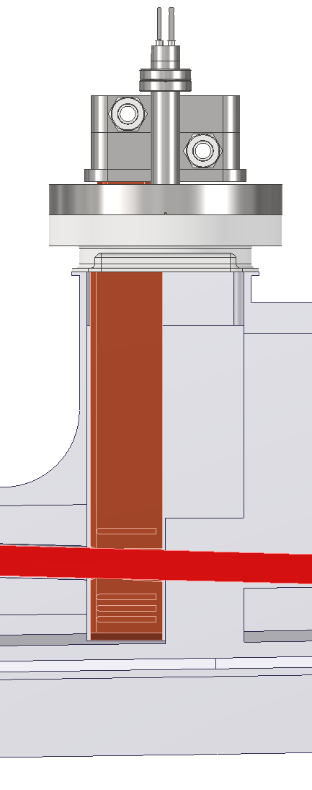
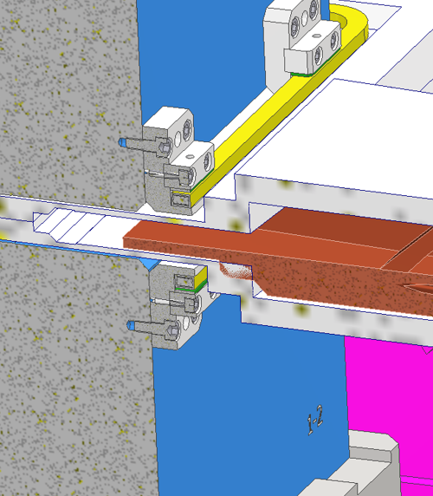
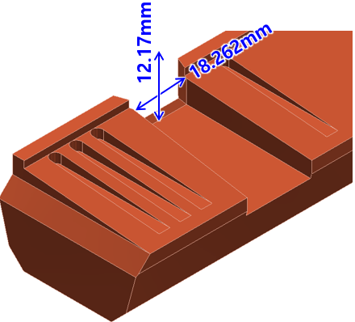





III. Storage Ring Vacuum System
Thermo-mechanical Analysis
Crotch absorber 1 (for the ID beamline)
Crotch absorber 2 (for the bending beamline)
[Beam opening]
±1.0 mrad (H)
SD = 6 m
EPU98 beam
[PA LGBM1U]
[Beam opening]
±1.5 × ±1.0 mrad (H×V)
[Photon fan from upstream bending magnets]
[Photon fan from upstream bending magnets]
118℃
[Max. Temperature for EPU98 (Hor. mode)]
[Max. Temperature for EPU98 (Ver. mode)]
[Max. Temperature]
※ Max stress ~ 70 MPa
18

Slide 19



III. Storage Ring Vacuum System
Vacuum Profile Simulation (Ver. 2)
Synrad & Molflow simulation
We assumed the PSD yield of 1E-6 (H₂) and 2E-7 (CO)
Average pressure after fully cleaned ~1×10⁻⁹ mbar
Commisioning stage
Fully cleaned stage
Average pressure (1.38 x 10⁻⁹ mbar)
1E-9 mbar
19

Slide 20


III. Storage Ring Vacuum System
Vacuum Profile Simulation (Ver. 3)
5E-11 mbar
20

Slide 21









III. Storage Ring Vacuum System
Vacuum Chamber Prototyping (1)
3. Curvature test
4. Machining
Dipole magnet chamber (extruded type, CH12)
2. Bending
1. Extrusion
※ Error < ±0.5 mm
5. Chemical cleaning
7. Welding
6. NEG insertion
8. Assemble & alignment
※ He leak rate < 10⁻¹⁰ mbar l/s
21

Slide 22





III. Storage Ring Vacuum System
Vacuum Chamber Prototyping (2)
Beamline branch chamber (machined type, CH02)
2. Chemical cleaning
3. Welding
1. Machining
4. Assemble & vacuum test
※ He leak rate < 10⁻¹⁰ mbar l/s
22

Slide 23



III. Storage Ring Vacuum System
Vacuum Test of Prototype Chamber
Al extruded chamber with Pill-NEGs (2 lines)
Baking at 180℃ for 48 h
Base pressure measured at 3 points
Base pressure at the center of the chamber
P2 < 5×10⁻¹¹ mbar
P3
P2
Sheath heaters
P1
Measurement set-up
23

Slide 24

III. Storage Ring Vacuum System
Displacement Test of Prototype Chamber
24

Slide 25

III. Storage Ring Vacuum System
Displacement Test of Prototype Chamber
25

Slide 26

III. Storage Ring Vacuum System
Fabrication Schedule (Original)
※ Delayed by 8 months from the original schedule
26

Slide 27
III. Summary
Vacuum system design optimization completed
Estimated vacuum profile: average pressure < 1×10⁻⁹ mbar
Photon absorber thermal analysis completed
Vacuum chamber prototyping and testing completed
First article fabrication initiated for all chamber types
27

Slide 28

4th Korea-4GSR International Advisory Committee Meeting (Nov. 5-6, 2025)
Thank You
Notes:
이것으로 기반시설 구축과 관련된 발표를 마치겠습니다. 감사합니다.
발표내용과 관련하여, 질의사항이나 추가 코멘트가 있을 시 말씀해주시면 감사하겠습니다.

