Slide 1



Magnet, Insertion Devices, and MPS Program for K-4GSR
Dong-Eon Kim on behalf of Magnet, ID team,
4GSR Research Division,
Pohang Accelerator Laboratory,
POSTECH, KyungBuk, Republic of Korea
Nov. 5 2025

Slide 2

Contents and Background
Magnet System for K-4GSR
Short summary of “routine” magnet
PM based LGBM development
Single sided dipole quadrupole (DQ51) development.
Booster Combined Dipole Development
ID development status for K-4GSR.
MPS system status for K-4GSR
Summary
1

Slide 3
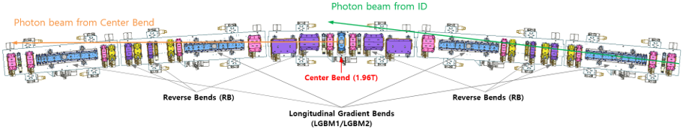
Magnet | Required Number | Remark
Central BM | 28 | 1*28
Long. BM | 112 | 4*28
Reverse Bend | 168 | 2*3*28 (should have B, B’)
Quad Bend | 56 | 2*28 (should have B, B’)
Quadrupoles | 344 | 6*2*28+8
Sextupoles | 168 | 6*28 (should have B”, H/V Corr, Skew Quad)
Octupole | 56 | 2*28
Fast Corr. | 112 | 4*28 (H/V combined corrector)
Magnets/Sec | 35 | 31+4 (fast Corr.)
Total | 1,044 | Total number of magnets
Magnet Summary for Booster and SR
Magnet | Required Number | Remark
Combined Dipole | 60 | 56 (6.07deg)+4(5.02deg)
Quadrupole | 66
Sextupoles | 60
Corr. | 240 | H120, V120
Total | 426+ | Total number of magnets
Booster Magnet Summary
SR Magnet Summary

Slide 4
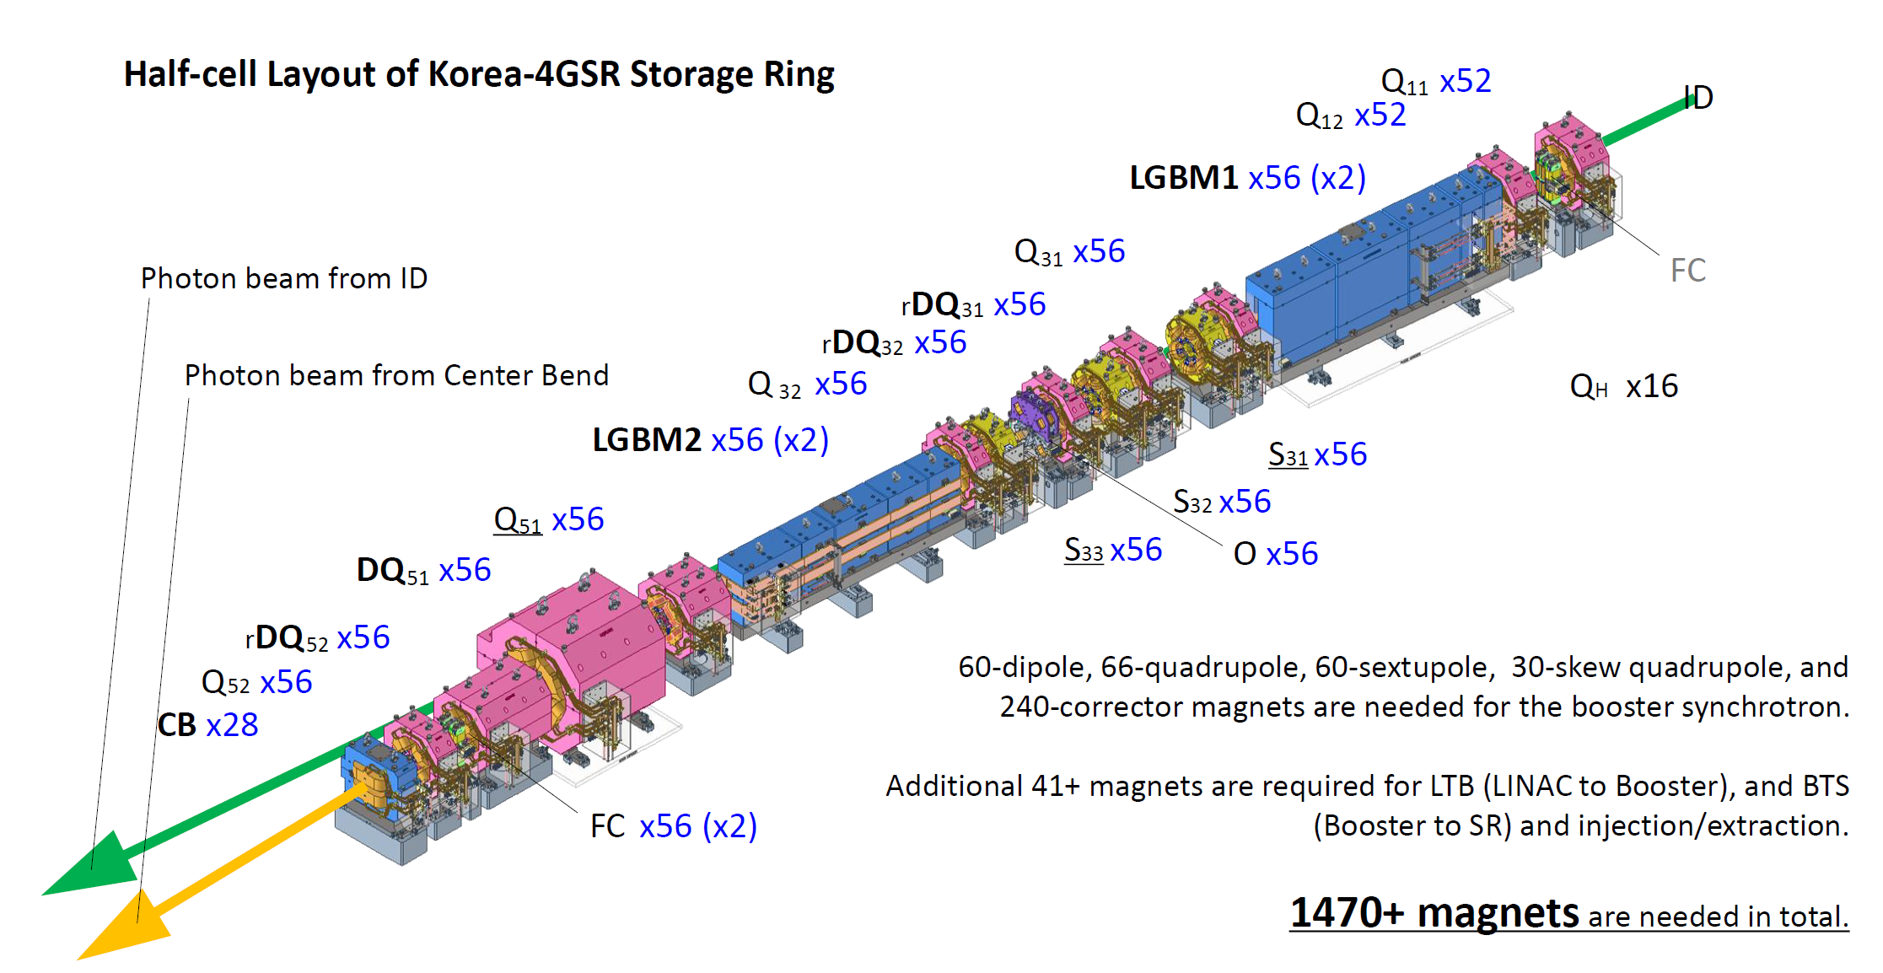
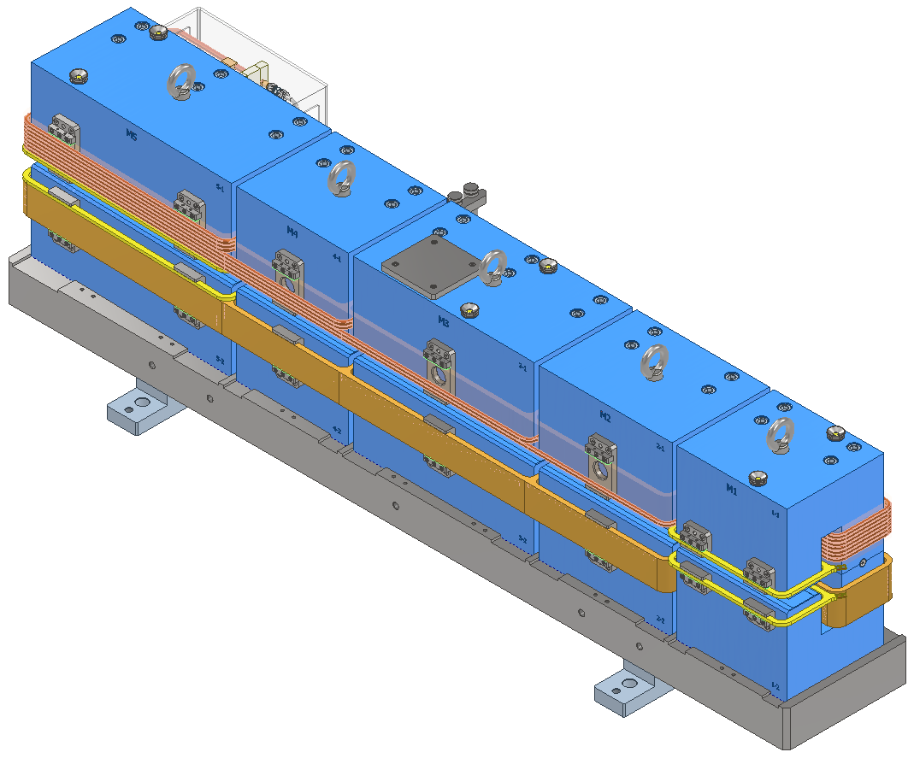
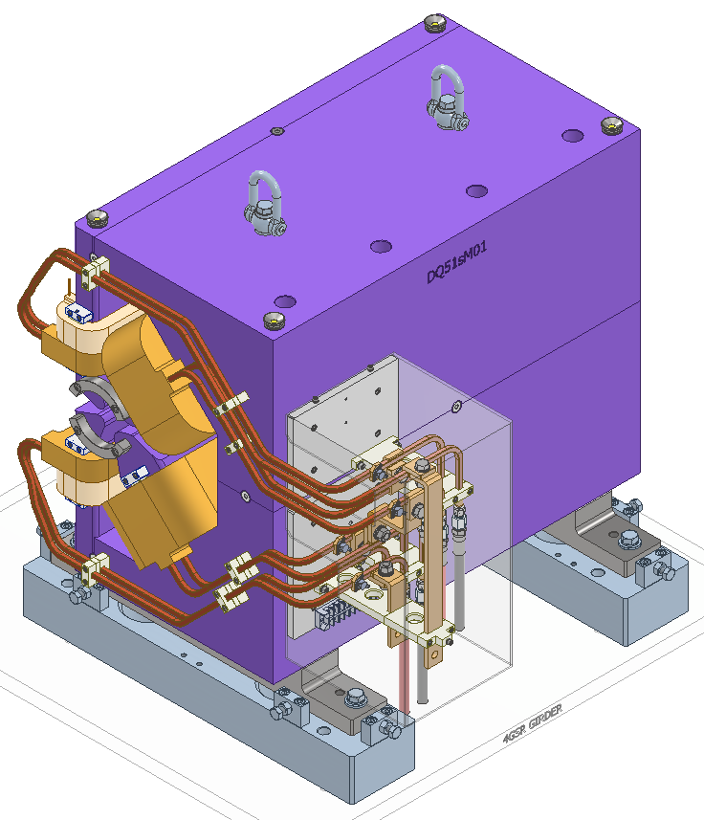
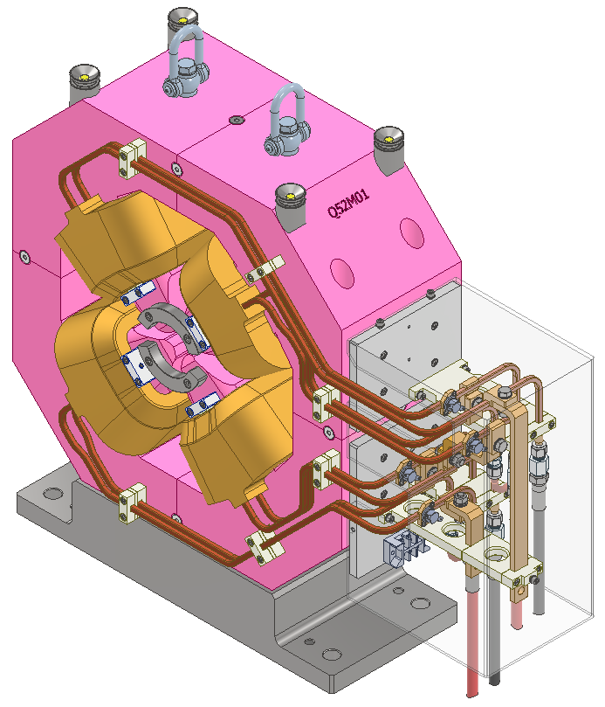
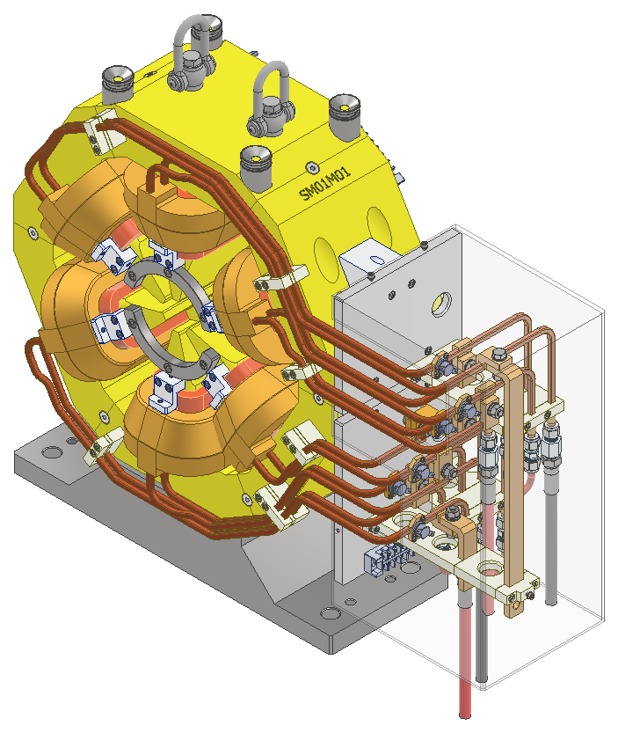
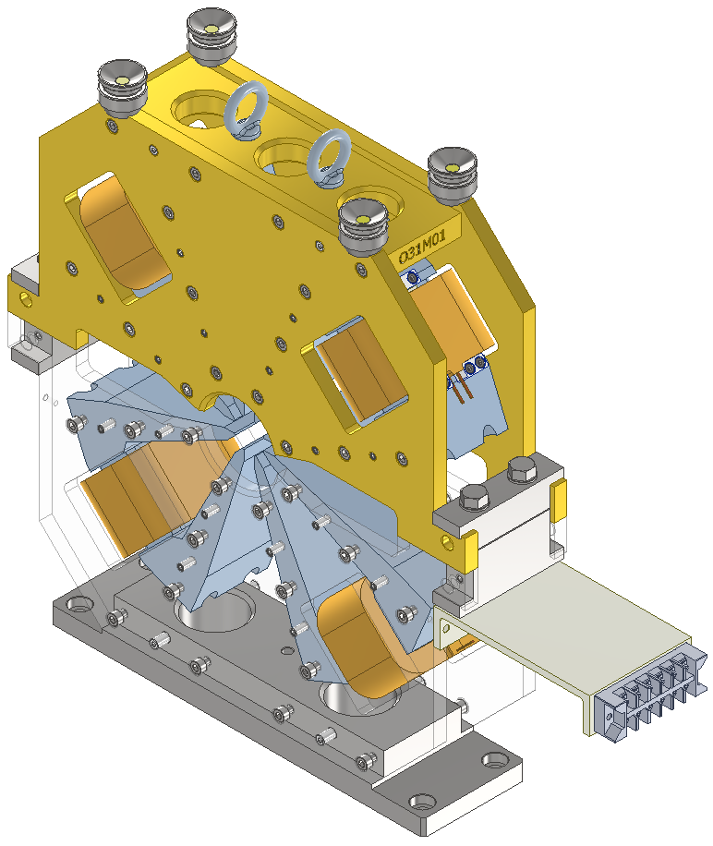
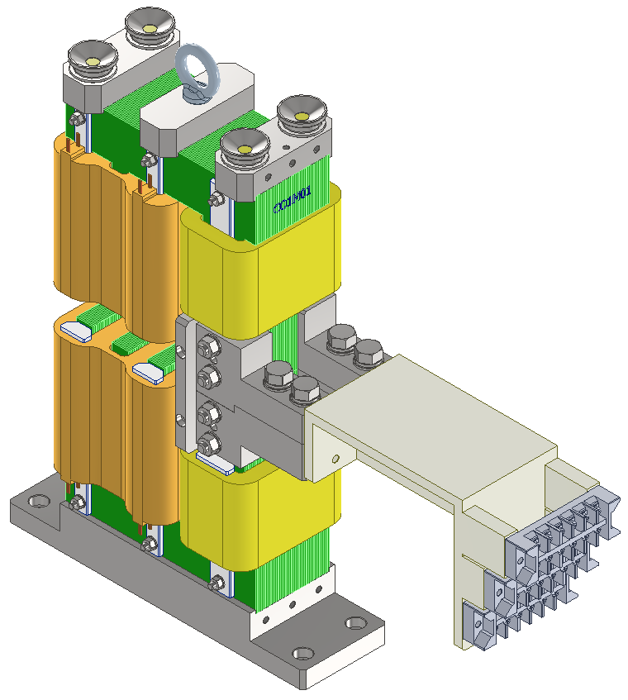
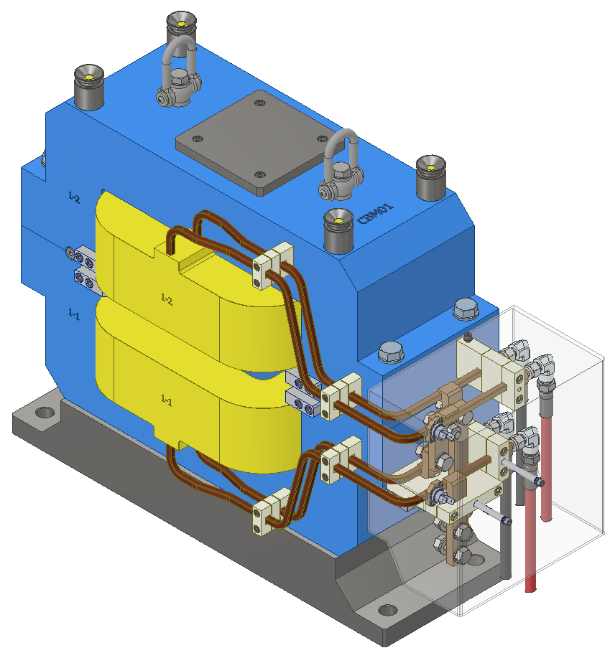
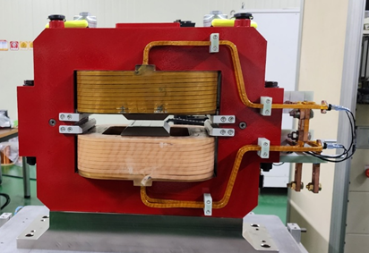
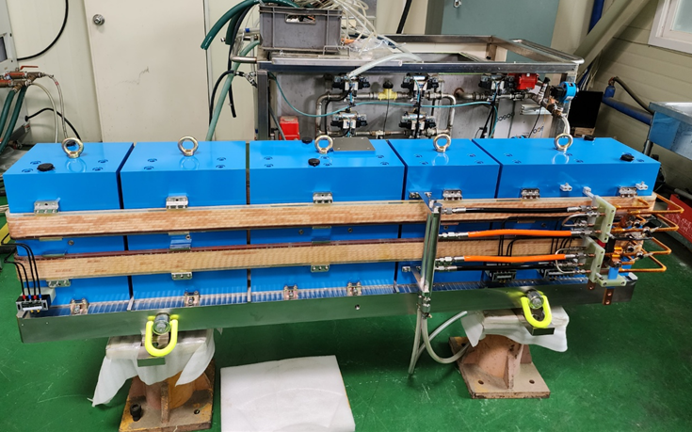
Magnet System – Storage ring
Magnets | Required Number | Remark
Center BM (2T) | 28 | 1*28
Long. BM | 112 | 4*28
Reverse Bend | 168 | 2*3*28 (should have B, B’)
Quad Bend | 56 | 2*28 (should have B, B’)
Quadrupoles | 344 | 6*2*28+8(QH)
Sextupoles | 168 | 6*28 (should have B”, H/V Corr, Skew Quad)
Fast Corr. | 112 | 4*28 (H/V combined corrector)
Octupole | 56 | 2*28
SUM | 1044 | Total number of SR magnets
(456 magnets for booster)
1576+
Dipole-Quadrupole
(DQxx, 56ea)
Quadrupole
(Qxx, 344ea)
Sextupole
Sxx, 168ea)
Octupole
(Oxx, 56ea)
H/V/S Corrector
(Cxx, 112ea)
CB
LGBM

Slide 5
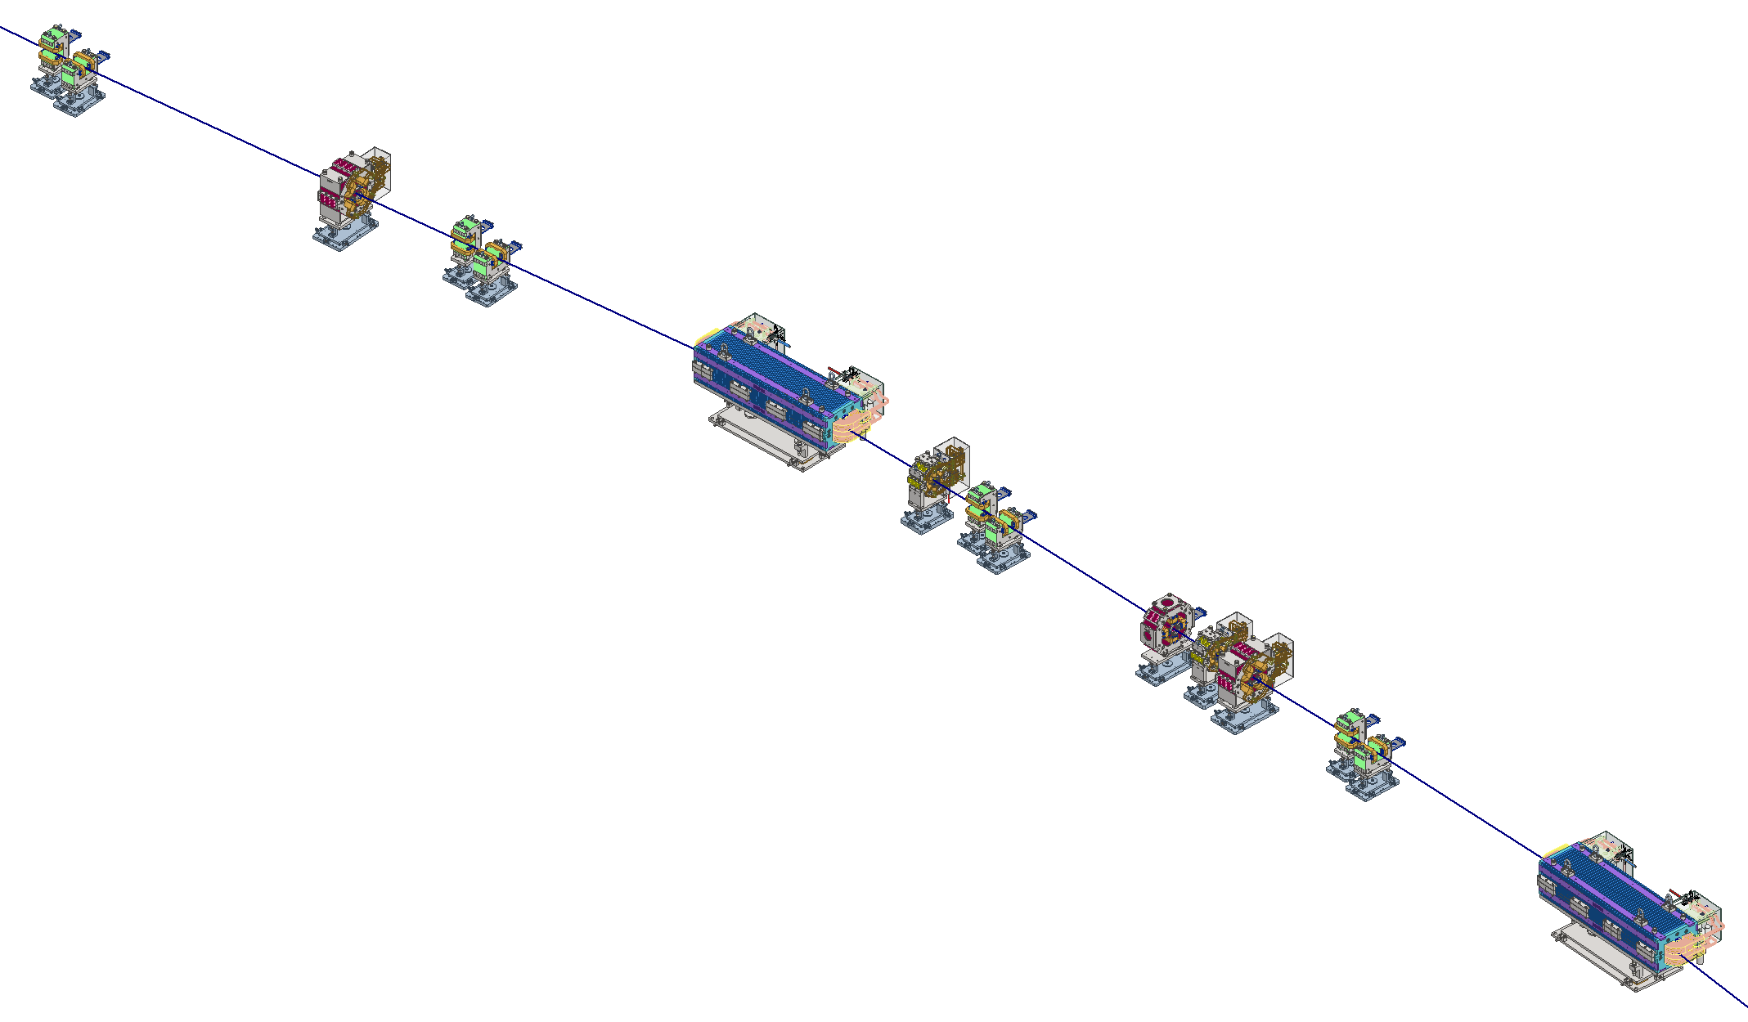
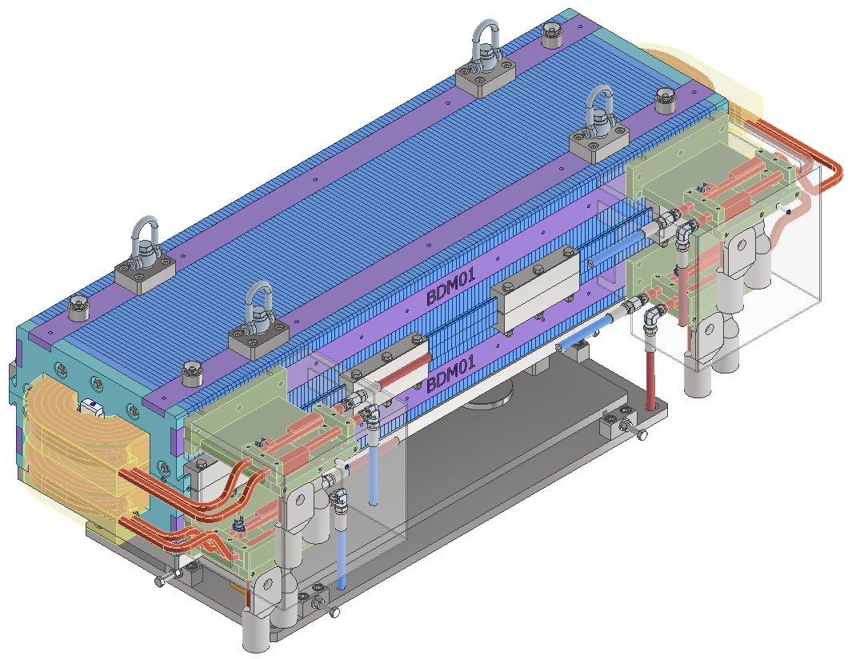
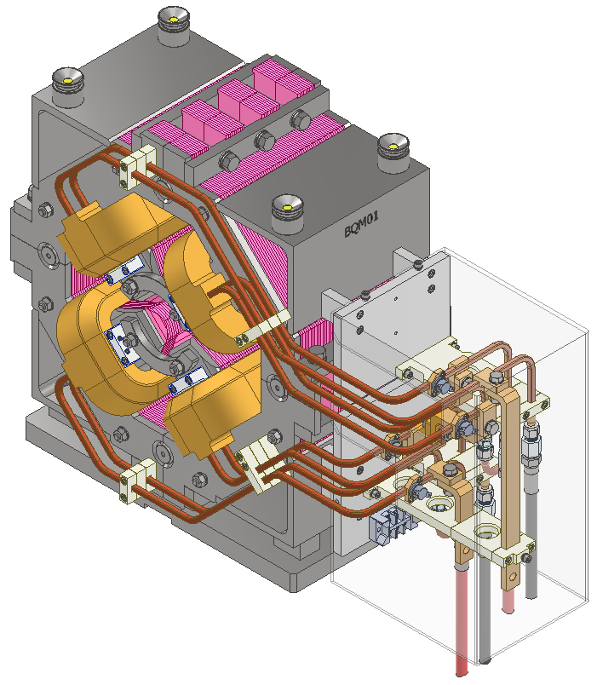
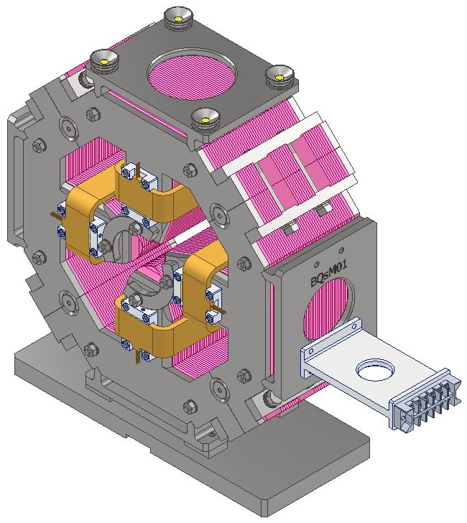
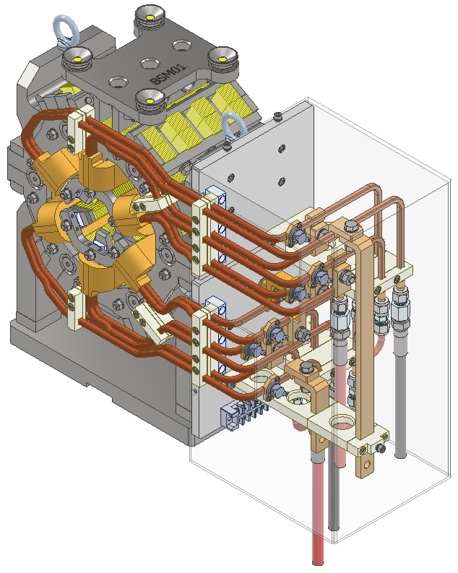
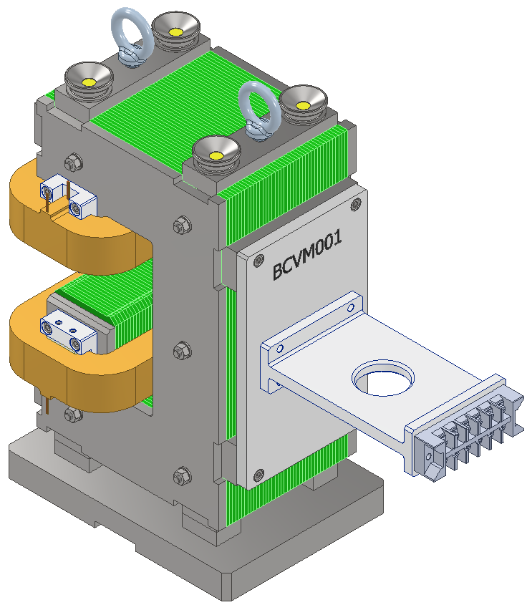
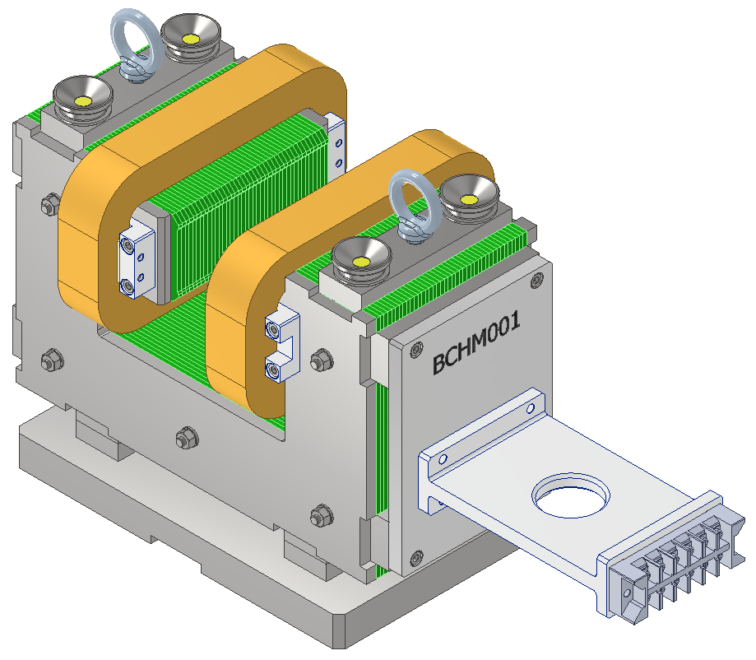
Booster Ring Magnet System
Magnets | Required Number | Remark
Combined Dipole | 60 | 56 (6.07deg)+4(5.02deg)
Quadrupole | 76 | Normal 66, Skew 10
Sextupoles | 60
Corr. | 240 | H120, V120
Sum | 436+ | Total number of magnets
BC H/V
BQ
BC H/V
BD
BS
BC H/V
Circumference : 772.893 m
If separate function dipole is used, the cost of magnet will increase significantly due to the length of the booster.
(Answer to the Dr. Chen’s advice)
BQs
One-cell Layout of Korea-4GSR Booster ring
BS
BQ
BC H/V
BD
Combined Bending Magnet
(BD, 60ea)
Quadrupole
(BQ, 66ea)
Quadrupole Skew
(BQs, 10ea)
Sextupole
(BS, 60ea)
Corrector
(BCH, 120ea)
Corrector
(BCV, 120ea)
5

Slide 6
Booster Magnet Overall Summary
Mechanical designs are fixed with specified I, V.
Voltage rating is for DC excitation and depend on the operation/connection scenarios.
Dipole is straight core, parallel faced to facilitate manufacturing and magnetic measurements.
Initially, 4 multi-filar connection is assumed, to ease the timing issues. But it changed to serial connection of 14 magnets after Dr. Chen’s advice.
Dipole coils can be 2 pancakes/coil (24 turns), or 1 wound coils/coil ( ~23 turns). It depends on the manufacturing concept.

Slide 7
General Design Requirements
LGBMs mirror symmetric in longitudinal direction with respect to center bend.
Dipole Quadrupole (DQ) series operational range is 95% to 105% of the nominal value.
Quadrupole operational range is 75% to 110% of the nominal value.
Sextupole magnets operational range is 50 to 120% of the nominal value.
More than 98% magnetic efficiency for sextupole for min cross-talk btw the H/V/SQ coils.
DQ, Quads should have 90% min efficiency.
Coolant pressure drop is 6bar (or 90 psi) with inlet temperature of 25C.
Coolant temperature rise is limited to less than 20 K.
Min H/V apertures are decided based on BD simulation and vacuum requirements.
Typical Quad aperture radius is 15 mm with good field radius of 10.0 mm except DQ51, DQ32.
DQ51 ro/rc=7 mm/30 mm, DQ32 ro/rc=7 mm/20 mm, Good Field Radius is at offsetted position.
For Quadrupoles, multipole requirements are < 1.0E-3 at good field radius.
For Sextupoles ro/rc=10 mm/20 mm with multipole < 1.0E-3 at good field radius.
For Dipoles, the uniformity requirement is DB/B < 1.0E-3 for +-13.0 mm.
Vertical half gap for center bend, LGBMs are 7.0/12.5 mm, respectively.
Fast correctors need about 0.370 H/V mrad kick.

Slide 8
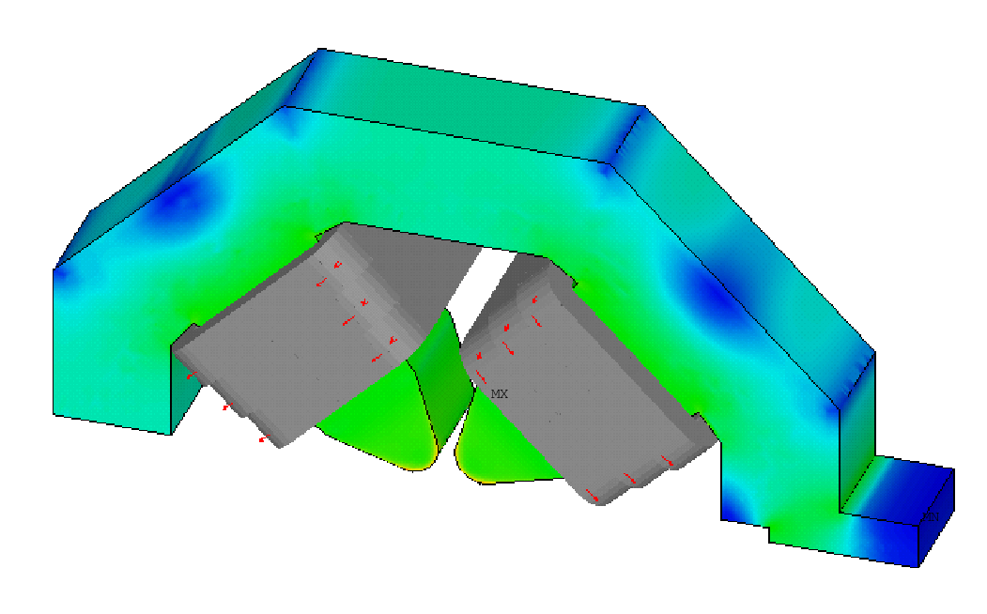
DQ and Quadrupole Magnet
Δy=2.0057Δz
r_{c}=15 mm
Tan(63.5º)=2.0057
Δz=r_{c}/3
B’ along the magnet
3D FEM Model
Quad, and DQ magnets are similar design. Two DQ types have longer effective length and decided to be arc shape. Other quad, DQs have straight core shape.
Apertures are all 15 mm for quad, and 15, 20, 30 mm for DQ magnets.
The fundamental component, and two first allowed harmonics B6, B10 along the magnet is calculated for each 1 mm slices which were well within requirements.
Pole shape is optimized in 2D, end chamfering is optimized for 3D effects.
Each quadrupole and DQ types have different photon exit slot size.
B6, Before (black), Red (after) end chamfering

Slide 9
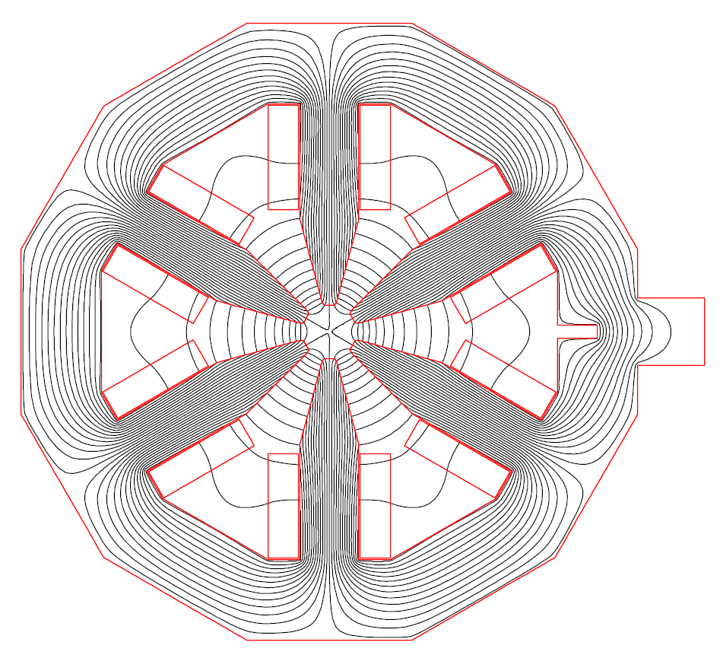
Sextupole Magnets
Cross talk between Sextupole components and other components
Vacuum requires minimum 13.0 mm gap between the poles.
This seriously restricts pole width and therefore increases multipole errors.
Unlike quadrupole, tangential shims are introduced in real plane resulting flat pole shape to achieve maximum b9 corrections.
Max B”=2084 T/m2, with effective length 200 mm, 180 mm. Aperture is increased to 20 mm to accommodate the vacuum requirements.
All sextupoles should have H-corr/V-corr/Skew Quad windings.
H/V correctors should be able to kick 0.6 mrad@4Gev
Skew Quadrupole larger than 1.0 T/m.
The impact of the interference between the components are shown in the above graph. Even at full excitation, we can expect 96% strength.

Slide 10
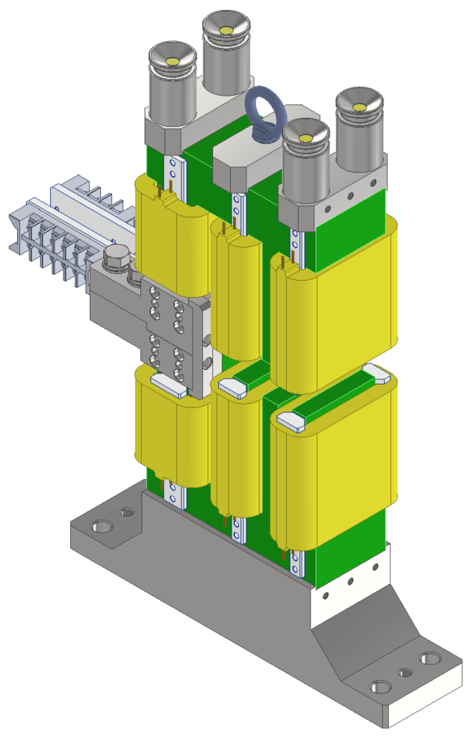
H/V Corrector Magnet
 | Unit | H-Corrector | V-corrector
max kick | rad (DC) | 3.70E-04 | 3.70E-04
B0= | T | 4.11E-02 | 3.01E-02
Leff= | m | 1.22E-01 | 1.20E-01
Req. BL= | Tm | 4.93E-03 | 4.93E-03
Center hgap | mm | 16.0 | 16.0
Right hgap | mm | 12.5 | 12.5
Left hgap | mm | 12.5 | 12.5
NI/pole= | A | 574.4 | 1217.7
core_len= | m | 0.070 | 0.070
Ac= | m2 | 8.55E-06 | 8.550E-06
jmax= | A/mm2 | 1.56 | 2.13
I= | A | 13.3 | 18.1
N/coil= | turns | 43 | 67
Ncoil= |  | 2 | 4
P (total)= | Watts | 9.4 | 46.4
V= | Volts | 0.70 | 2.55
R= | Ohm | 0.053 | 0.140
L = | Henry | 0.0078 | 0.0081
Major Parameters and 3D drawings
Inductances minimized for FOFB. (Thick conductor, less turns)
Maximum DT ? Since air cooling and high Jc~ 2.07 A/mm2.
Recent prototype DT test showed about ~20K DT.

Slide 11
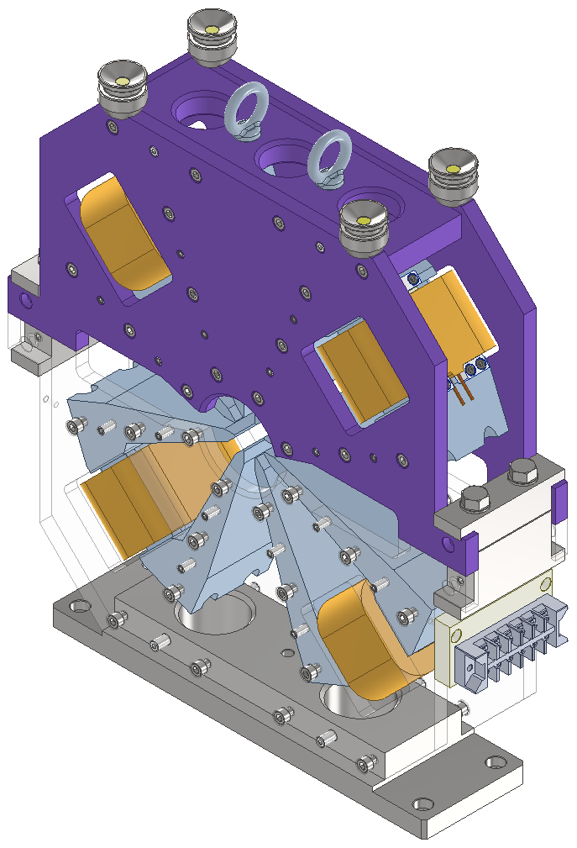
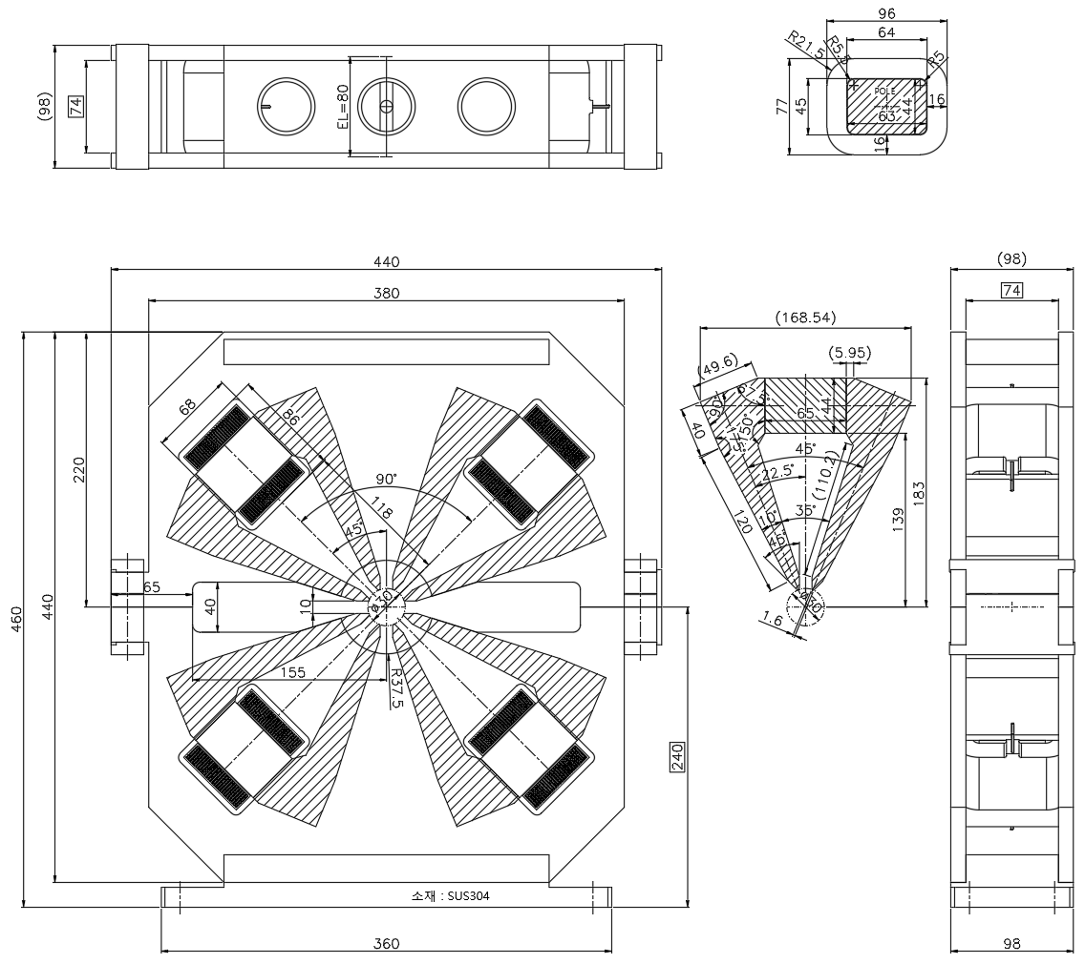
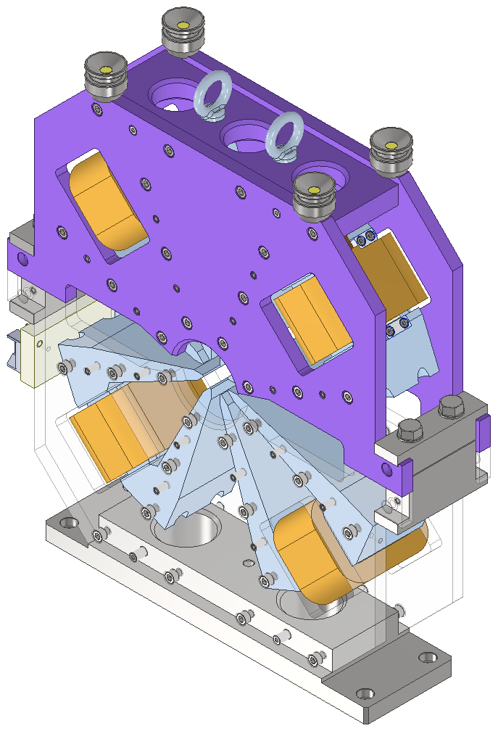
O31

Slide 12
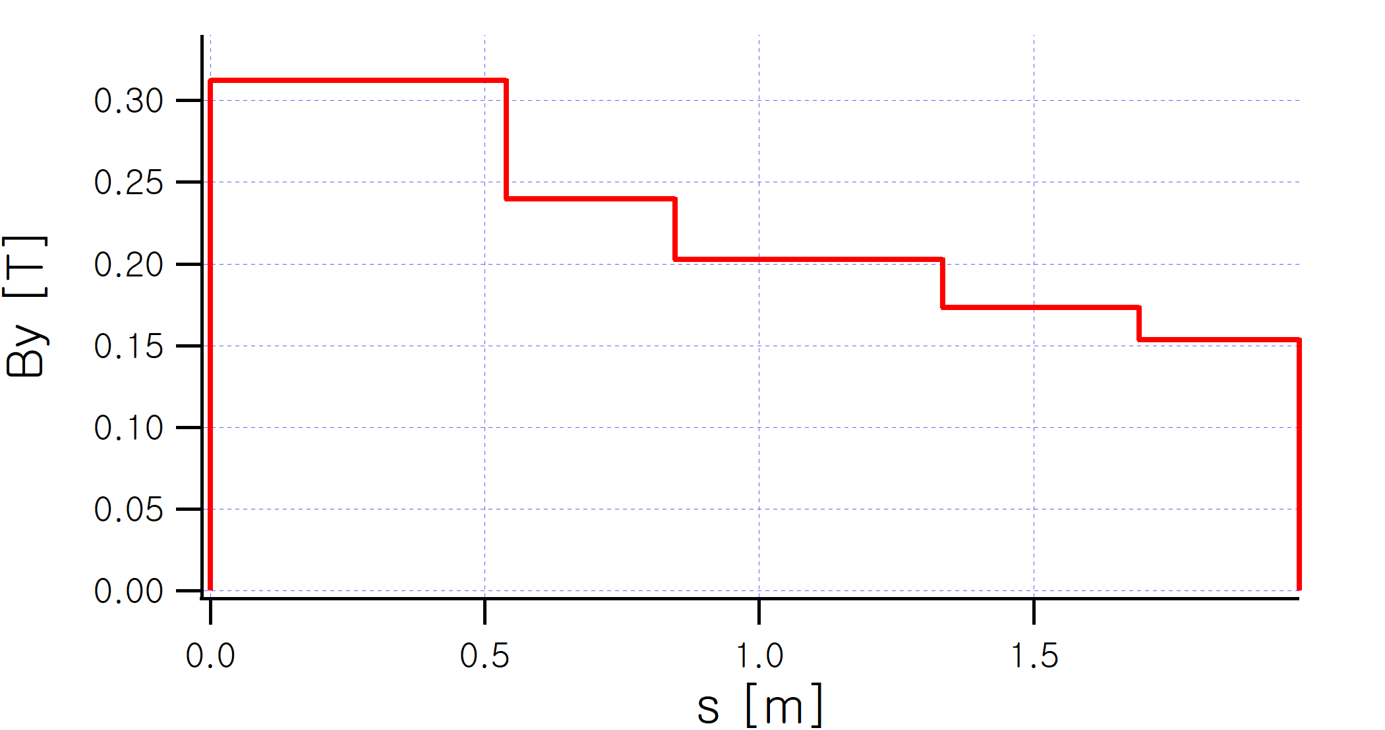
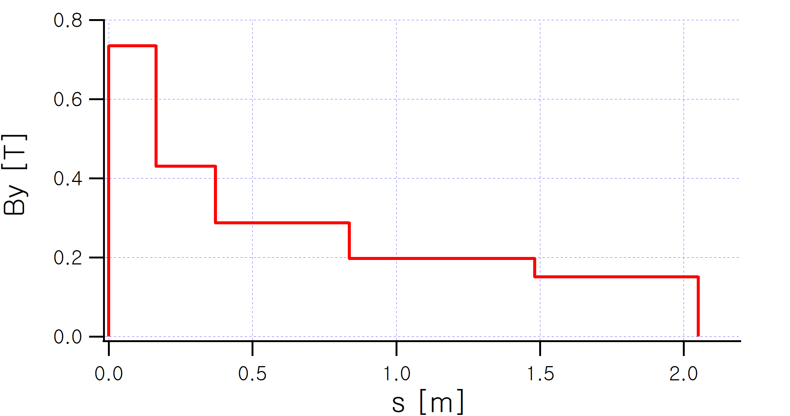
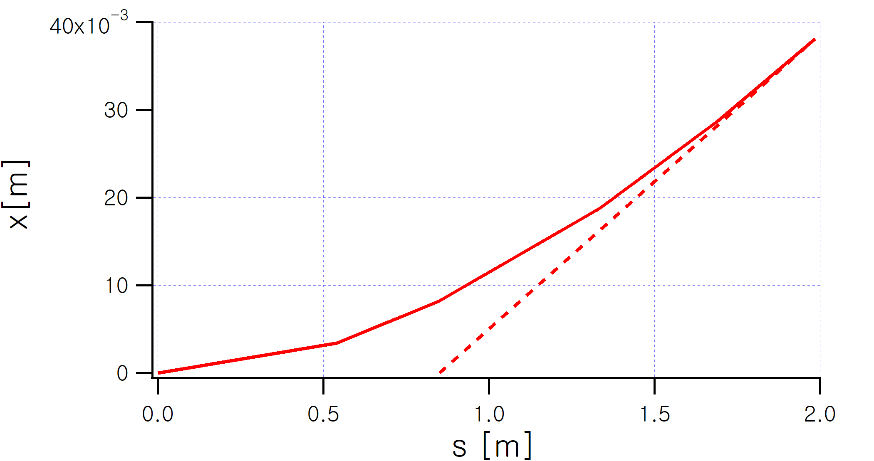
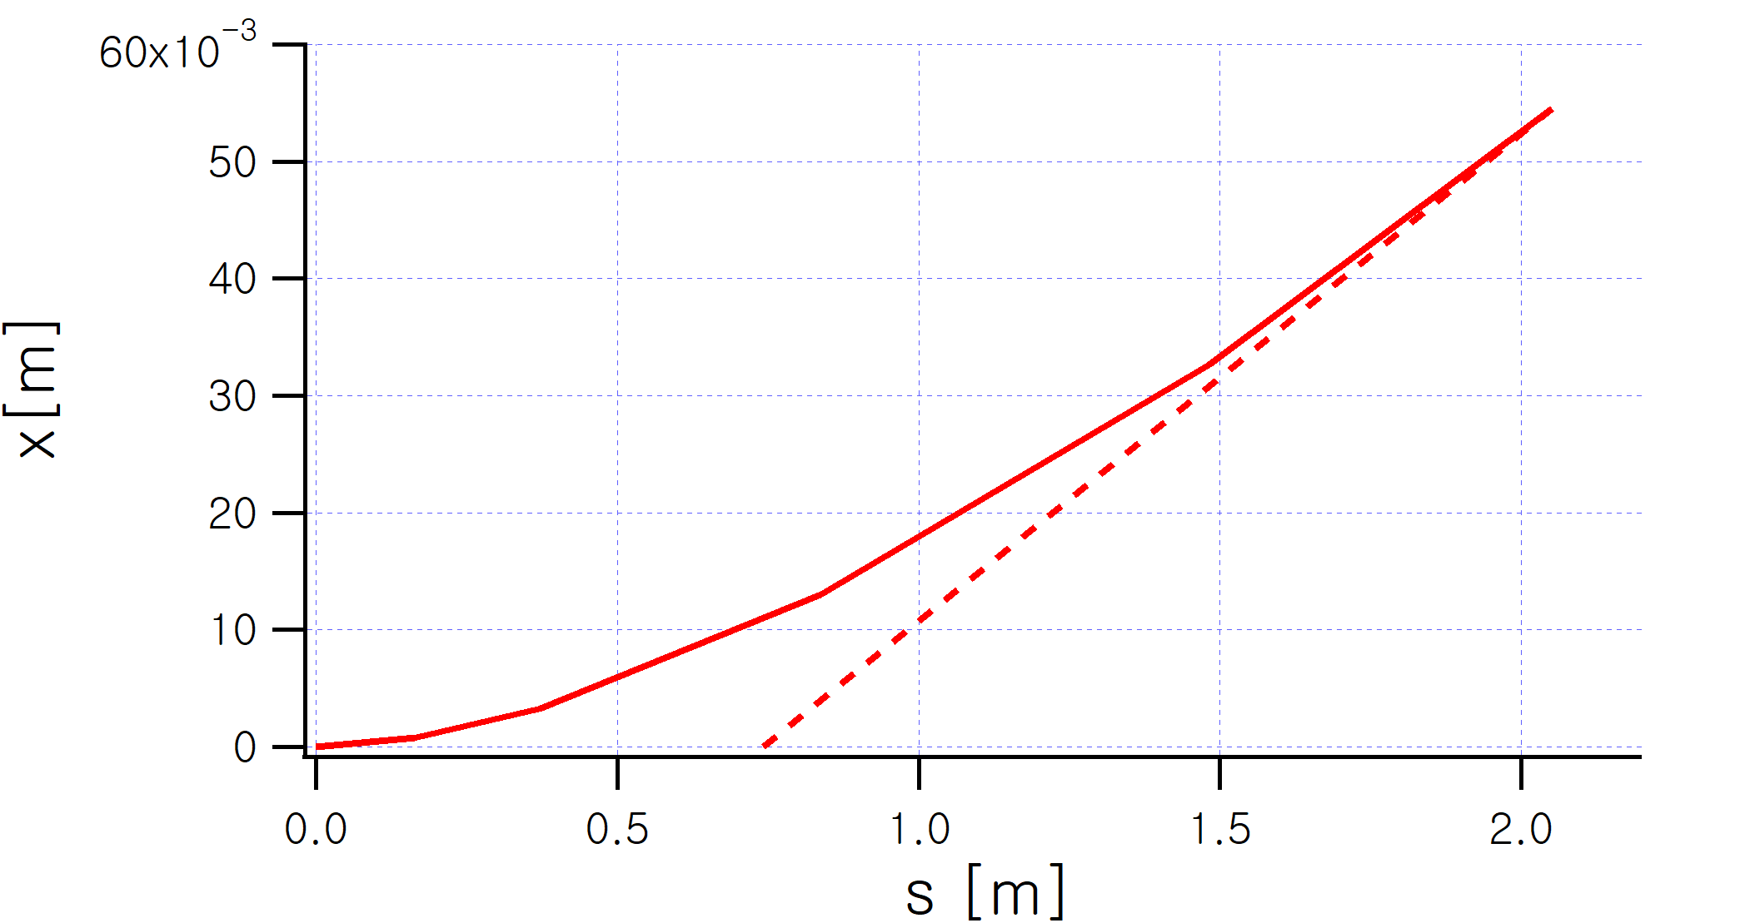
Ideal Field profile, Apex points of LGBM1, LGBM2
LGBM2
LGBM1
Orbit
Orbit
θ=3.3564 mrad
θ=4.1690 mrad
Apex s₀=0.850037 m
Apex s₀=0.742563 m
Actual magnets should satisfy the total bending angle, and apex points to meet the lattice requirements

Slide 13
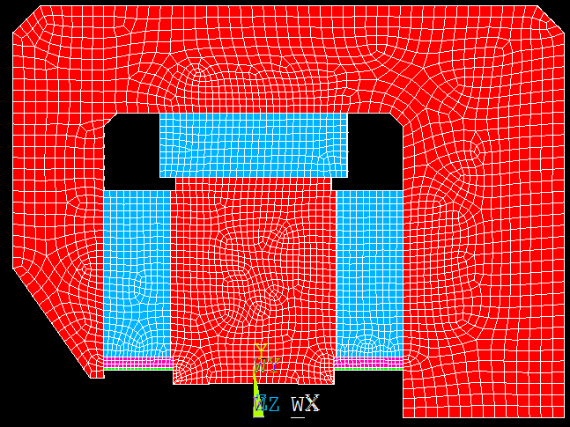
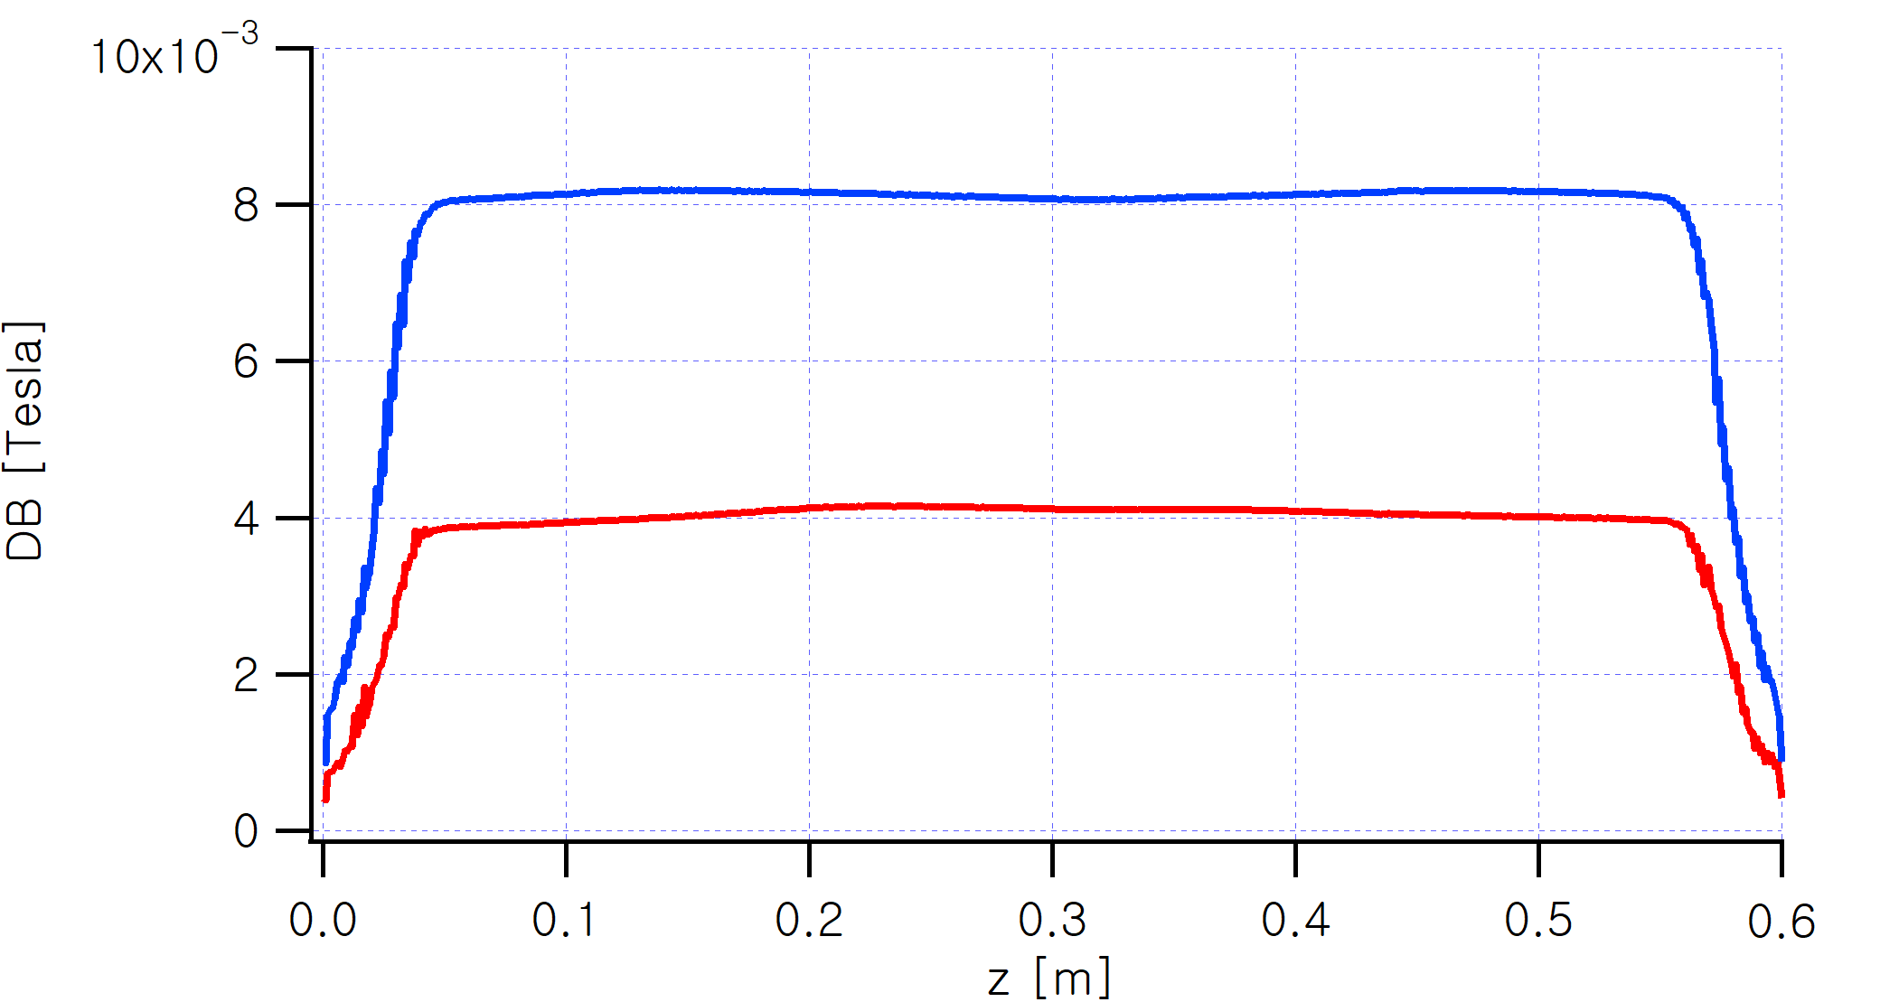
Field tuning using FeSi (sheet, bolt), and Temperature Compensation scheme
FeNi for DT compensation
ΔB for two FeSi Contact Area (Two bolts, 4 bolts)
Sm2Co17 Magnet
FeSi for field tuning
FeNi (DT compensation), FeSi (Field level adjustment) plate, bolts are used.
FeNi material property from VAC for T=23, 28 C are applied to assess the temperature compensation.
Magnetic property of Sm2Co17 Br=1.10 T is used conservatively. Thus M1 is designed slightly more than the specification, presuming negative tuning.
Field tuning experiments using FeSi shunts. DB is proportional to the FeSi contact area (sheet, or bolts).
Also for last modules (M1, M5) slidable flux shunts is installed for additional tuning.

Slide 14
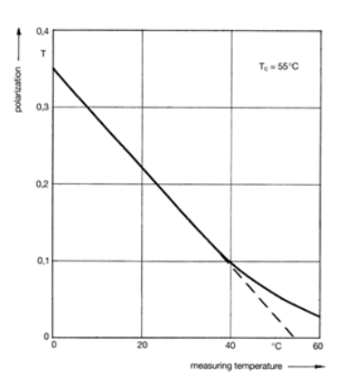
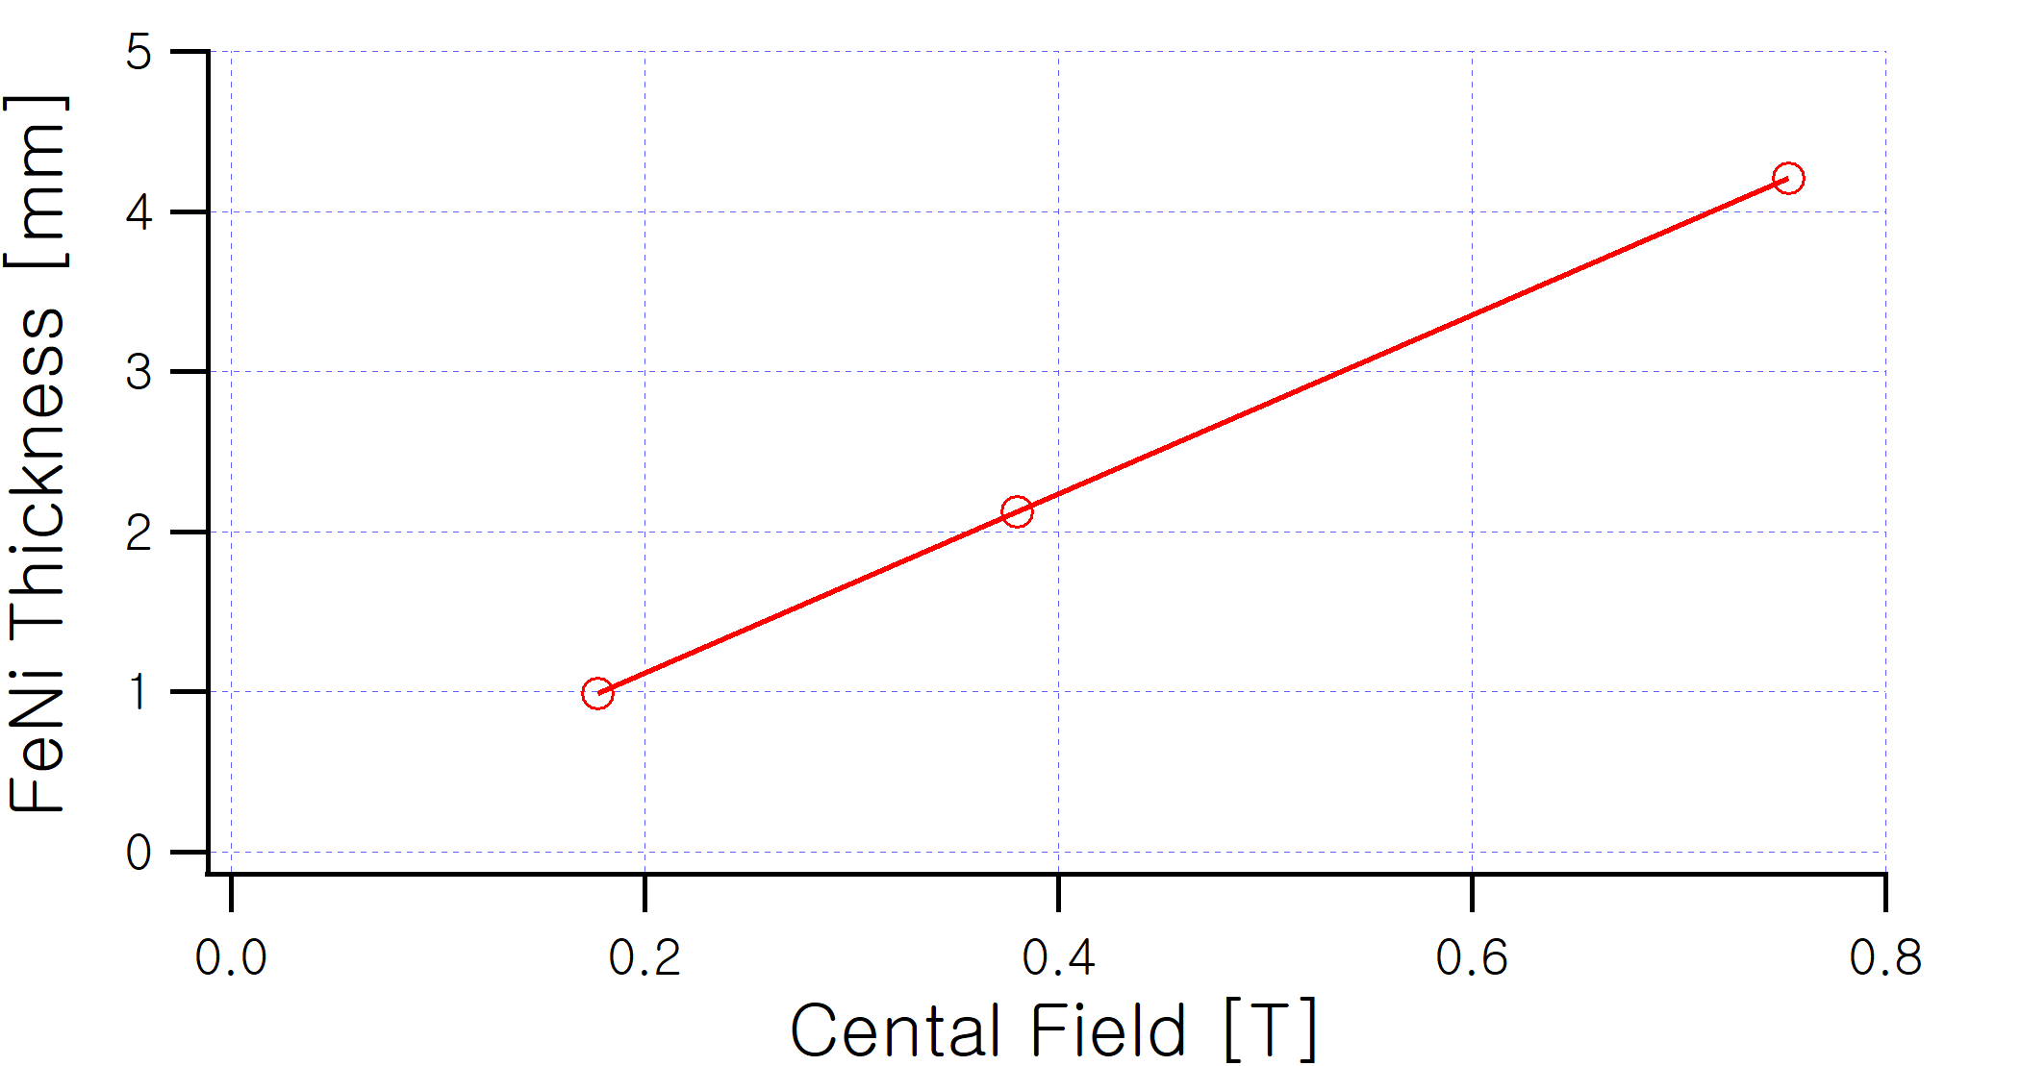
T Compensation of Sm2Co17, Calculation of the Required FeNi Thickness
T dependence of BH curve of Thermoflux55/100-G (FeNi)
Curie Temp=55 ºC, Flux density at 20ºC=0.22 T
Polarization T curve of Thermoflux 55/100-G
Optimum FeNi thickness depending on the central peak field.
Mechanism for DT compensation of FeNi (Thermoflux)
Higher Temperature >> Reduction in Sm2Co17 magnet Br (-3.30E-4/K)
>> Reduced FeNi saturation>>Smaller flux shunts->> Increase Field Strength

Slide 15
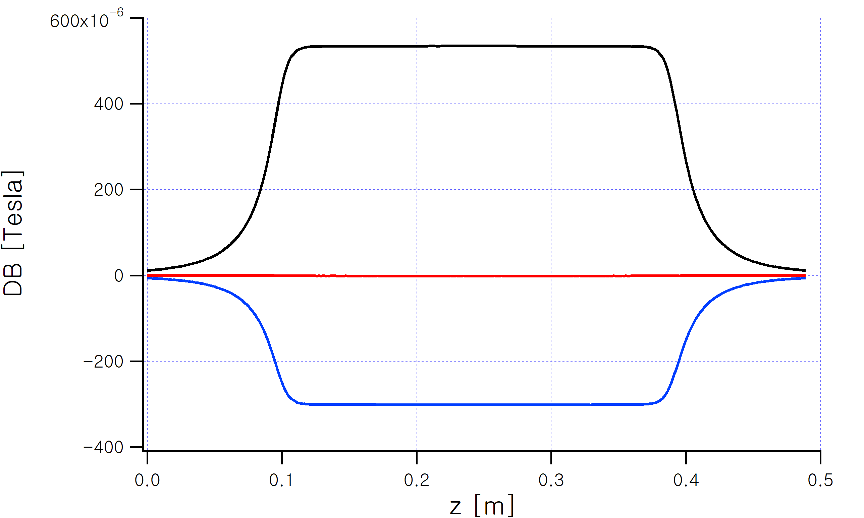
Example of Optimal FeNi thickness simulation
With given thickness of FeNi, three cases are calculated.
1) ΔT=0 K, FeNi BH table@23C
2) ΔT=5 K, FeNi BH table@23C
3) ΔT=5 K, FeNi BH table@28C
FeNi thickness for same field for (1),(3) are determined for optimum thickness.
The thickness of FeNi should be proportional to the main field for optimal compensation
Since we have only 1.0 mm, 2.0 mm thick FeNi, average thickness will be used for actual experiments, maintaining the total required FeNi volume.
Black :ΔB without Δ T compensation
Blue : ΔB for overcompensated case
Red: ΔB for optimal compensated case

Slide 16
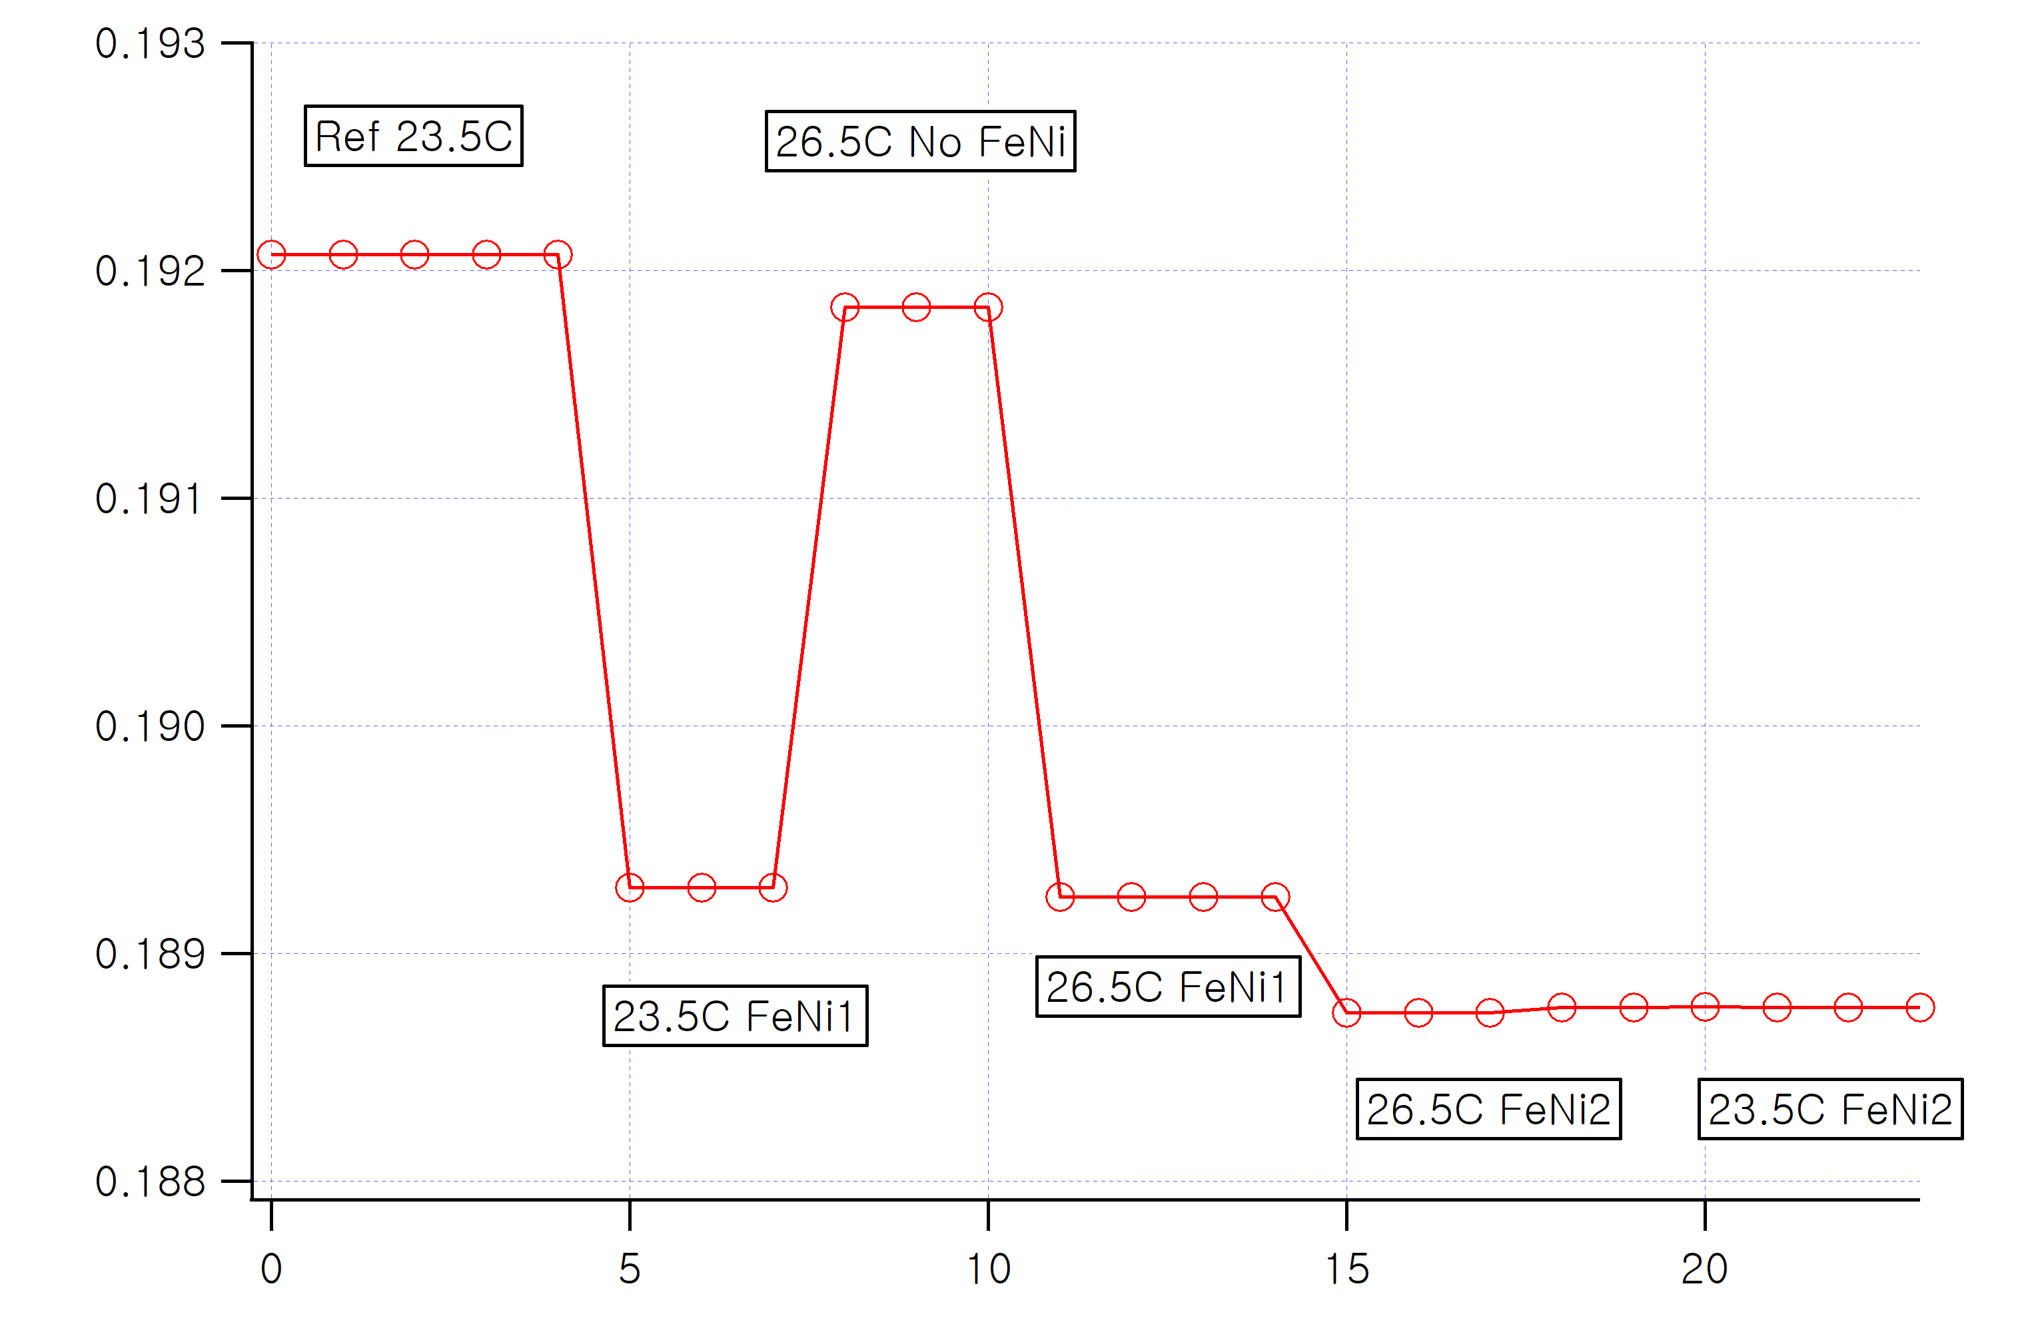
Temperature Impact Test : LGBM2 M3 case
-400 ppm/K
Temperature Dependence of the Sm2Co17 is ~-350 ppm/K.
FeNi plate is placed on the magnet to reduce the temperature dependence.
NMR probe with precision fixture is used to measure the central field of the each module.
Measurement reproducibility is better than 0.05 G.
Temperature of the measurement room changed from 23.5C to 26.5 resulting ΔT= 3.0 K.
for ΔT= 3.0 K, uncompensated ΔB ~ 2.0 G
Uncompensated measurement showed ~-400 ppm/K.
1st try showed ~-70 ppm/K.
2nd try showed -36 ppm/K
Requirements are < 50 ppm/K.
Confirmed temperature compensation mechanism and estimated FeNi quantity agrees with expectations.
-70 ppm/K
-36 ppm/K

Slide 17
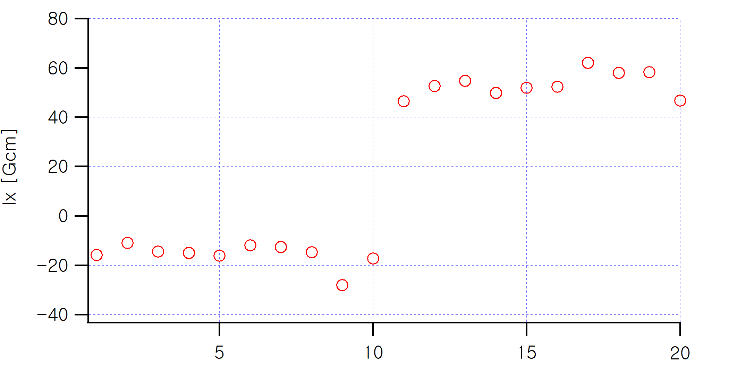
Tilting Experiment : LGBM2 M3 case
To check the roll angle of a magnet, LGBM M3 module is measured with 1.0 mrad tilting.
The By integral is about 71,800 Gcm.
1 mrad tilting should results ΔIx= 71 Gcm.
The difference of 10 measurement average is 69 Gcm which is close to the estimation.
Standard deviation of the Ix measurement about 5 Gcm, which translates to angle measurement error of 0.074 mrad (in rms).
The measured field integral Ix=-20 Gcm is already low enough.
HEPS is measuring the full length magnet (since it’s a straight magnet). What’s the roll angle alignment tolerances? Our BD requires about something like 0.5 mrad.

Slide 18
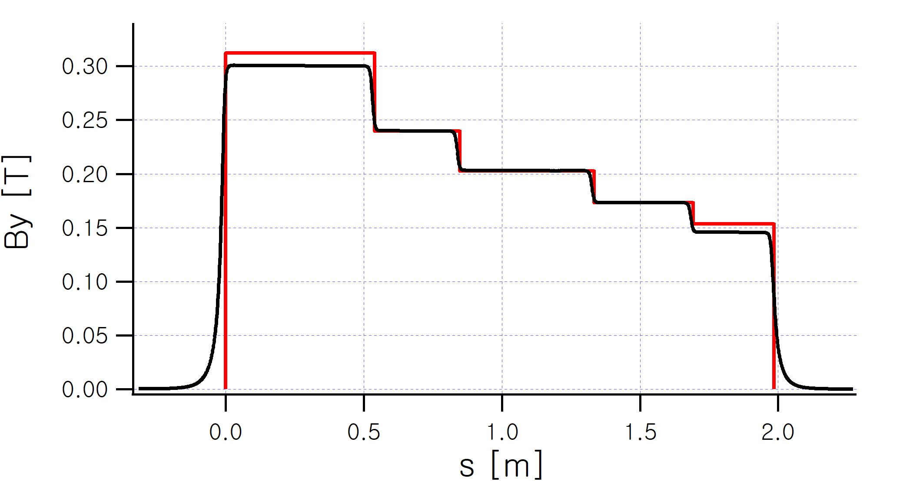
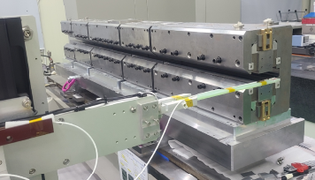
LGBM2 Hall probe scan
LGBM2 prototype on the measurement bench.
Hall probe is Senis 3axis integrated sensor.
Measured (black), lattice (red) field profile. The fields are tuned using FeSi plate, and tuning bolts.

Slide 19
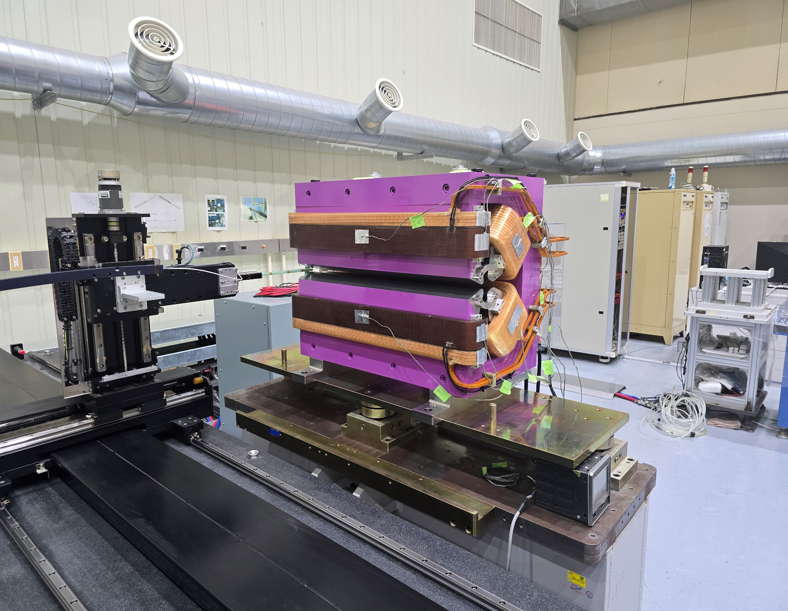
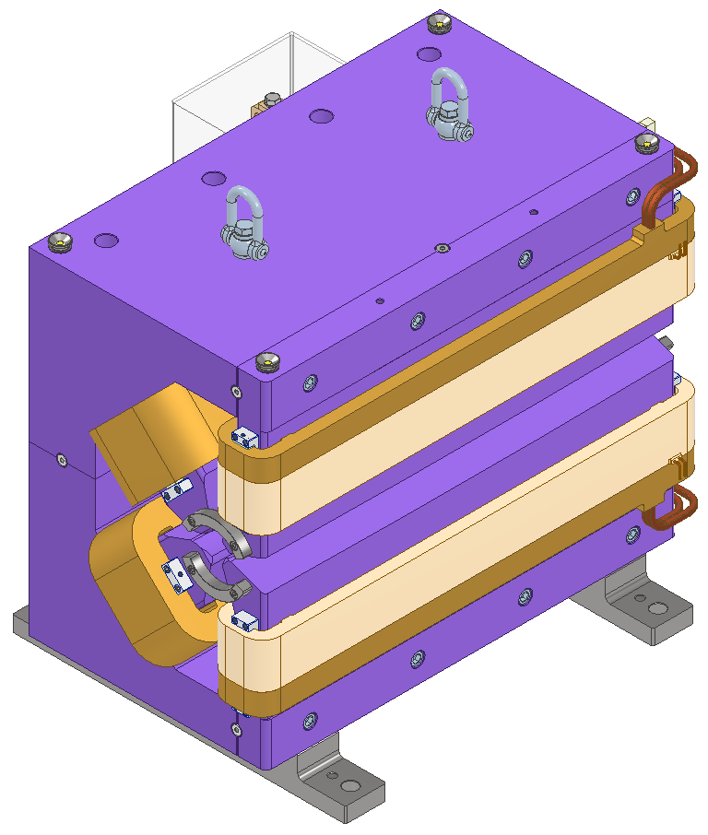
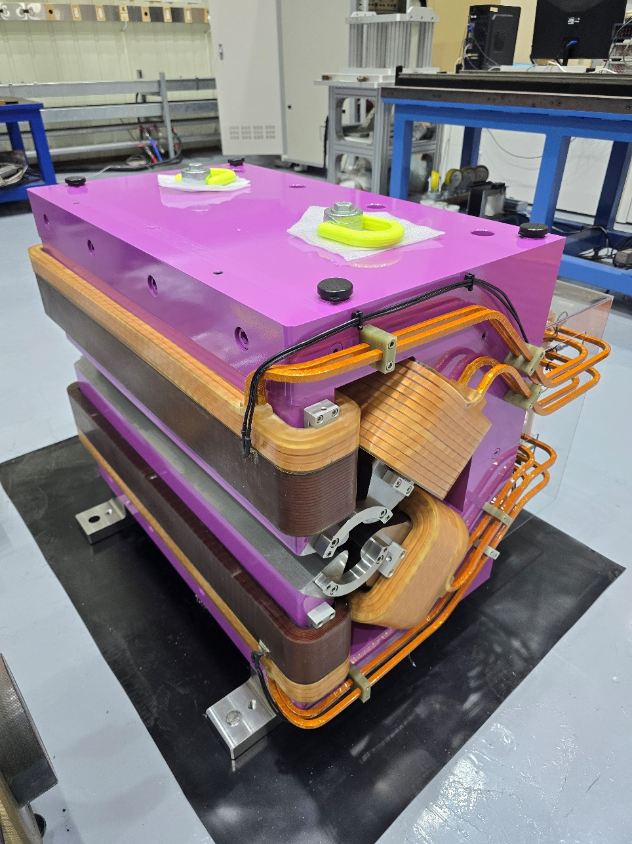
Assembled Single Sided DQ51, and DQ51 on the Hall bench

Slide 20
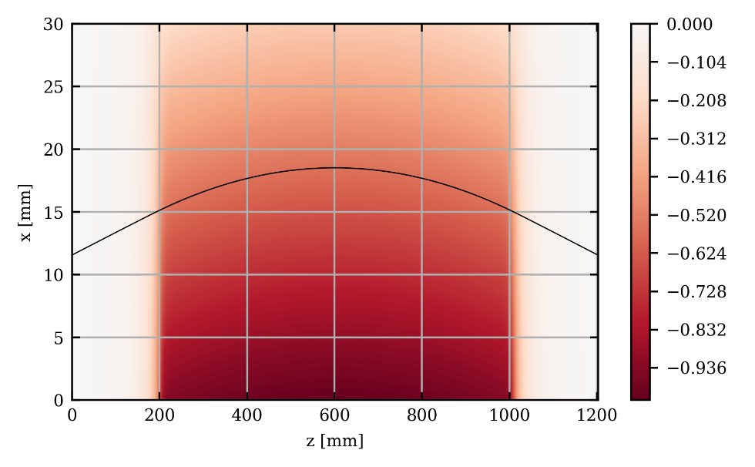
DQ51 Field Map, and Calculated orbit, B, B’ along the orbit
Hall probe map and calculated orbit.
Field profile along the orbit
B’ profile along the orbit.
2D field map at the midplane is measured using Senis integrated Hall probe sensor at the rated current.
Field level is slightly tuned to produce exact design B’ at the magnet center.
Particle is tracked at the offsetted position for the lattice B value.
Major components B, B’ along the orbit meets the BD requirements.
Estimation of multipole along the curved orbit need to be confirmed.

Slide 21
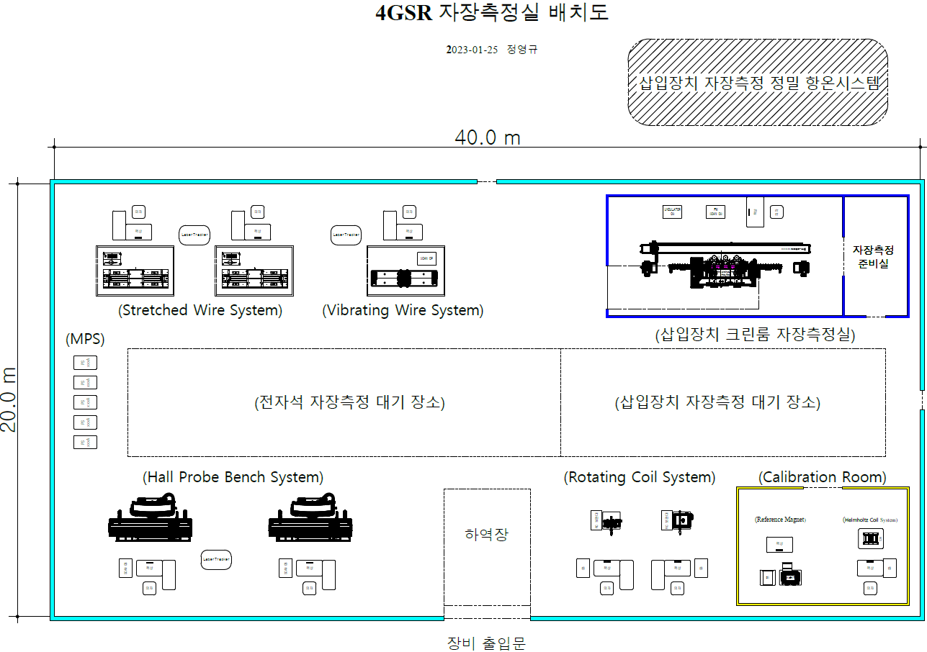
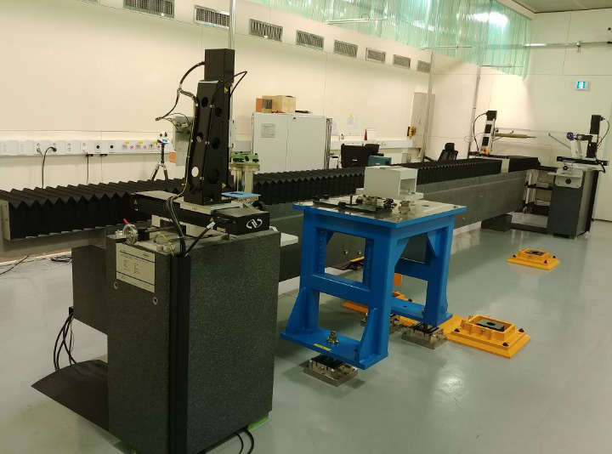
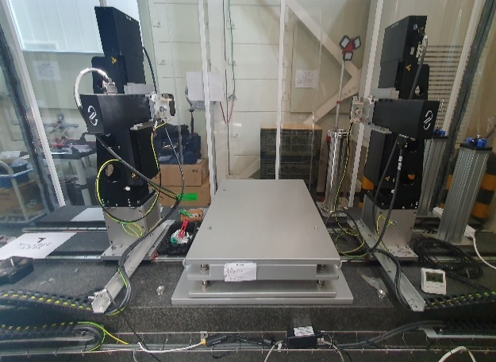
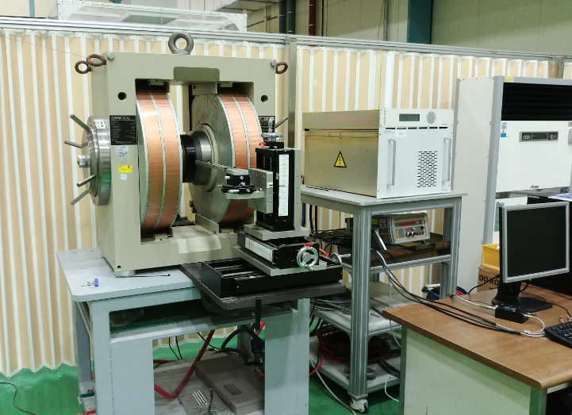
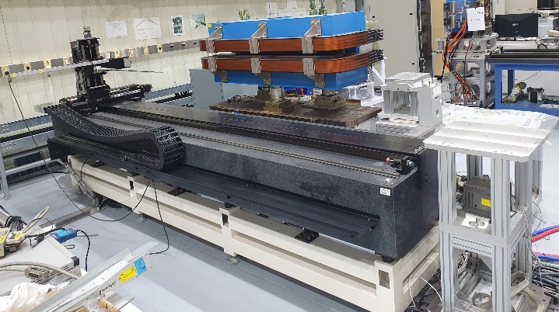
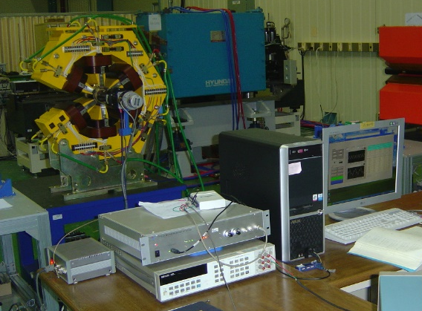
4GSR(오창) Magnetic Measurement LAYOUT
• 4GSR magnet Measurement System: Hall probe, Stretched wire, Vibrating wire, PCB Rotating coil are planned.
• ID clean room magnetic measurement system: SAFALI like in-situ system will be prepared..
• Calibration room : Reference magnet, NMR Probe, Helmholtz Coil will be prepared
< Stretched wire system >
< Undulator measurement system >
< Calibration system >
< Hall probe system >
< Rotating coil system >

Slide 22
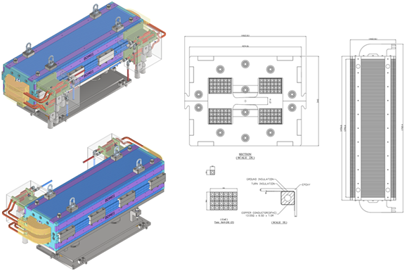
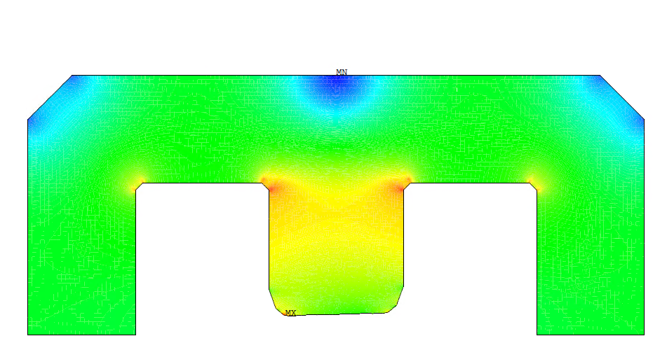
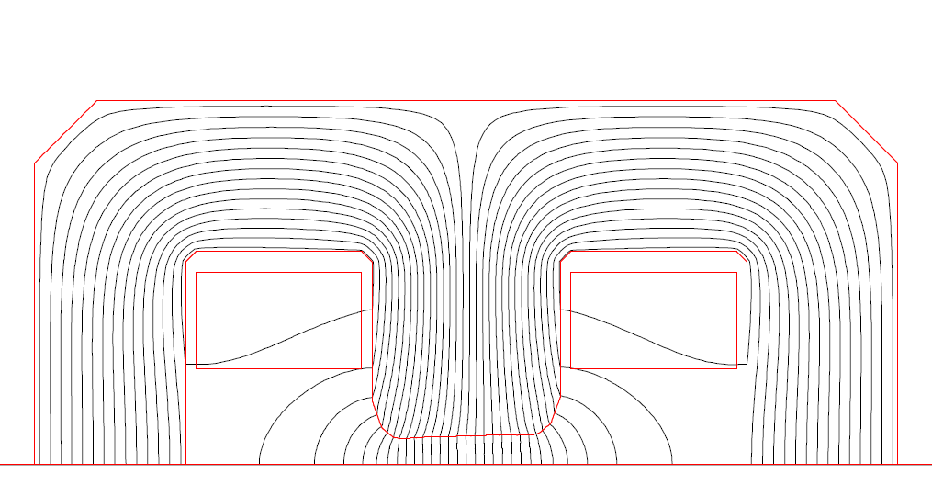
Booster Dipole
Most important dipole magnet design is completed.
Combined magnet with quad components wit 0.5 mm lamination (2 Hz operation)
Straight core to facilitate manufacturing and magnetic measurement (like Sirius)
Pole width became wider due to the sagitta.
22

Slide 23
4GSR: Booster Dipole Parameters
 | BD Weak (Ext) | BD Strong (Ext) | Unit | Remark
Magnet type | parallel face | parallel face
Shape along the beam | straight | straight
Lamination thickness | 0.5 | 0.5 | mm
Number of Magnets | 4 | 56 | EA
bending angle | 5.02 | 6.07 | degree
rc or half gap | 0.0137 | 0.0137 | m
Brho= | 13.3426 | 13.3426 | Tm
BL= | 1.16902 | 1.41353 | Tm
Leff= | 1.42155 | 1.42155 | m
B0= | 0.8224 | 0.9944 | Tesla
B'= | -1.45572 | -1.76019 | T/m
B' Leff = | 2.0694 | 2.5022 | T | B0*tan(theta/2)*2
B' Leff (edge)= | 0.0721 | 0.1054 | T
B' Leff (total)= | 2.1415 | 2.6076 | T (Along orbit)
rho= | 16.225 | 13.418 | m
sagitta= | 0.0156 | 0.0188 | m
L_core= | 1.3960 | 1.3960 | m
Efficiency= | 0.97 | 0.97
Ampere turns/coil= | 9,242.7 | 11,175.9 | Aturn
Total Power (1 magnet)= | 3,386 | 4,951 | Watts
Conductor Geometry | 13 mmx 13 mm with 6.5 mm hole |  | mm
Number of Turns= | 24 | 24 |  | might change to 23
Number of cooling channel= | 2 | 2
Inom= | 385.1 | 465.7 | A
jeff= | 2.85 | 3.45 | A/mm2
Voltage Drop/magnet= | 8.79 | 10.63 | Volt
Resistance/magnet= | 0.023 | 0.023 | Ohm
Coolant DT= | 2.3 | 3.4 | K
Resistive Voltage Drop Total= | 17.6 | 148.8 | Volts
Inductive Voltage | 54.0 | 457.4 | Volts
Duty (Power)= | 0.321 | 0.321
DI/DT (Max)= | 1463.4 | 1769.5 | A/sec
Inductance (3D) (All coils)= | 0.0185 | 0.0185 | Henry | 95%Inom in 0.25 sec
Dipole (Weak, Strong) parameters are listed.
There are 4 slightly weaker magnet for racetrack positions. (Parameters are similar). Total required magnets is 60.
Magnet has 2 independent coils and 14 magnets are connected in alternating sequence (4 MPSs for 56 magnets, additional two MPSs for 4 weak dipoles).
Inductances (Number of turns) are tuned for MPS requirements to limit the maximum voltages.
Lamination is 0.5 mm thick Silicon steel with low coercivity to minimize the remanence fields. 98% packing factor is assumed. IHEP supplied actual BH table for the material.
Conductor size 13 mm x 13 mm square with 6.5 mm cooling hole.
2 in/out terminals for each magnet.
23

Slide 24



Pole optimization using conformation map: Jack Tanabe
(U, V) plane
(X,Y) plane
Uniformity for several shims
Instead of optimizing in (u,v) plane, after introducing shims, real geometry is calculated with real BH curve evaluating the uniformities.

Slide 25


Booster Dipole : B and B’ along the orbit (Based on the 3D calculations)
B’ [T/m] along the orbit. The B’ has a steep drop at the edge. The effective length for quadrupole component is shorter than the dipole component.
Also edge contribution is clearly shown.
The total integrated B, and B’ should match the lattice specifications instead of center value.
B [T] along the orbit. At z=0 electron is located in the weaker region. (Magnet is straight, orbit is curved)

Slide 26





Reference orbit change due to the combined bending magnet
Based on the real orbit
Pure Arc Version
Reference orbit of the booster is redrawn based on the orbit calculated from the 3D field.
The orbit differs from the previous pure arc version by 0.106 mm~0.109 mm. (Real orbit is outside of the old arc based orbit).
These change is reflected in the location of all booster magnet position.

Slide 27

Booster Quadrupole
Booster Quadrupole is rather simple magnet, with aperture radius 18.0 mm, effective length 200 mm, B’max=29 T/m, 66 are required.
A small number of weak skew quadrupoles are also required. It will be 45degree rotated version of a normal quadrupole magnet.
27

Slide 28




10 Undulator Sources are assumed for 1st phase beamline
2 EPU (EPU78, EPU98) : out-sourced
8 IVU : period 16~24 mm, min gap=5.0 mm, magnetic Length=~ 3.0 m.
Major upgrade from PLSII IVU20.
-Min operational gap 6.0 mm -> 5.0 mm
-More kinds of period: 20 mm -> 16, 20, 22, 24 mm
-Length change: 1.8 m -> 3.0 m (magnetic length)
-In situ measurement system ready
-Parabolic gap deformation designed to be < ±3 μm to meet δφ <5º for all working gaps.
-Contract awarded for 8 IVUs to a domestic company.

Slide 29



2 conventional EPU undulator, an EPU98, and an EPU78. We already have a contract.
Main parameters | EPU78 | EPU98
Undulator type | APPLE-II type Elliptically Polarized Undulator (EPU) | APPLE-II type Elliptically Polarized Undulator (EPU)
Longitudinal Symmetry | Anti Symmetric | Anti Symmetric
Entrance/Exit Sequence | +-1/4,-+3/4,+-1,-+1,… | +-1/4,-+3/4,+-1,-+1,…
Control System | EPICS Ready | EPICS Ready
Possible Operation Mode | Parallel/Anti Parallel | Parallel/Anti Parallel
Up/Downstream Correctors | H/V correctors at the UP/Down stream with MPS | H/V correctors at the UP/Down stream with MPS
Magnet block material | VACODYM 863 or Equivalent B_{r >} 1.25 T , H_{cJ >} 2000 kA/m | VACODYM 863 or Equivalent B_{r >} 1.25 T , H_{cJ >} 2000 kA/m
Period length λ_{u} | 78.0 mm | 98.0 mm
Block Dimension (W/H/T) 5 mm recess for clamping | 35.0 mm (W) /30.0 mm (H)/19.5 mm (T) | 35.0 mm (W) /30.0 mm (H)/22.5 mm (T)
Number of full field Period | 23 (For Pure Vertical field planar mode) | 36 (For Pure Vertical field planar mode)
Number of full field poles | ≈46 | ≈72
Total number of poles | ≈46+transition sequence | ≈72+transition sequence
Undulator length at zero phase (planar mode) | ≈1794 mm + transition sequences | ≈3528 mm + transition sequences
Operating Gap range | 15~100 mm | 15~100 mm
Max Maintenance Gap | 260 mm | 260 mm
Effective field for vertical field polarization (B_{yeff} ) | >0.954 T (Array Phase=0) | > 1.009 T (Array Phase=0)
Effective field for circular mode (B_{yeff}=B_{xeff}) | >0.602 T | > 0.663 T
Effective field for horizontal polarization (B_{xeff}) | >0.776 T (Array Phase= λ_{u} /2) | > 0.880 T (Array Phase= λ_{u} /2)
Phase error for all working gaps | < 5° rms | < 5° rms
Key Parameters of the EPUs

Slide 30

Design Concept of MPS for SR
Magnet Power Supply optimization:
3 types of reverse-bends, 5 types of quadrupoles, and 3 types of sextupoles use the same type of power supply. (U,140A / 40V, UNIDC MPS)
Among them, 1 type of center-band and 1 type of quad-bend are connected in parallel to increase current capacity.
the embedded correctors, fast correctors, skew sextupoles, octupoles, trims of quad-bands use the same type of power supply. (B, 20A / 20V, BIDC MPS)
In total, we have only 2 kinds of PS for the Storage Ring machine
Goal:
Minimize the number of power supply types for many different magnets and use a modular structure to enable parallel operation, increasing current capacity.
Makes maintenance and spare parts management easier.
Lower costs through mass production of same type modular MPS.
Fewer types of MPS also allow us to focus on design optimization.

Slide 31
SR MPS Specification
Specifications | UNIDC MPS | BIDC MPS
Maximum Current | + 140 A | ± 20 A
Maximum Voltage | + 40 V | ± 20 V
Maximum Power | 5.6 kW | 400 W
Topology | Unipolar | Bipolar (Full-Bridge)
Small Signal Bandwidth (-3dB) | > 1 kHz | > 10 kHz
Current Accuracy | < 100 ppm_{P-P} / FS | < 100 ppm_{P-P} / FS
Stability | ≤ 10 ppm_{RMS} (8 hr) / FS | ≤ 30 ppm_{RMS} (8 hr) / FS
Line & Load Regulation | < ± 40 ppm_{P-P} | < ± 50 ppm_{P-P}
Cooling | Air (front-to-rear) | Air (front-to-rear)
Efficiency | > 85% @full load
Power Factor | > 0.98 @full load (with Active Power Factor Correction)
PARALLELING | Up to 4 modules | No Parallel Required
Input Ratings | Three-phase : 380 V_{AC} /60 Hz (±10%) | Single-phase : 220 V_{AC} /60 Hz (±10%)
Remark:
Two supplier developed prototypes independently and finished test.
The procurement scope includes 2700+ MPS (SR, Booster, Septum, LTB, BTS), with installation.
The procurement will be in RFP format, and 3 domestic companies and one foreign companies are expected to participate.

Slide 32





Booster Ring Bending Magnet Wiring Scheme
Two hollow conductor forms one terminal. (Bifilar connection)
Instead of old 4 parallel connection, changed to series connection.
Practically, one supply powers 14 dipoles in an alternate position.
Alternate connection was selected because the location of the power supplies are located in the same position.
Symmetric wiring to reduce common mode noise. (U-U...-D-D...) (JPARC and experiences in other labs)

Slide 33


Slide 34
Summary
Most of the K-4GSR SR magnets contracts will be done within this year.
(Only DQ51, DQ52, LGBM1 remains to be contracted within this year).
Booster magnets design complete, and expected to be contracted early next year.
Thick septum short version prototype successful.
Procurement for LTB, BTS, Septum magnets will follow soon.
8 In Vacuum Undulators are already awarded to domestic company.
We have an additional contract for 2 EPUs to foreign company (Kyma).
MPS system is targeting modular structure for a productive serial production, and a easier maintenance.
Prototyping for a unipolar module MPS was successful (including parallel operation).
Procurement for the whole MPS system (including installation) is in progress and is expected to be finished within 2025.

Slide 35

Thank You

Slide 36
Backup Slides

Slide 37













Dipole Magnets
1. Center Bending Magnet (CBM)
BEAM
Representative results are presented for CBM and LGBM2-M5 among five simulated dipole cases (CBM, LGBM1–M1/M5, LGBM2–M1/M5).
In the tracking plots, the black line indicates the beam trajectory.
$$y$$
$$x$$
$$z$$
Opera 3D Modeling
Tracking and field map
Multipoles
2. Longitudinal Gradient Bending Magnet 2 Module 5 (LGBM2-M5)
BEAM
$$y$$
$$x$$
$$z$$
Multipoles
Opera 3D Modeling
Tracking and field map
Key Quantities | CBM-Q52 | L1(M1)-Q12 | L1(M5)-32 | L2(M1)-Q32 | L2(M5)- Q51
$$∫ΔB_{1}∙dl_{dipole} [T∙m]$$ | $$−2.30×{10}^{−3} \\ (−0.62\%)$$ | $$−1.00×{10}^{−3} \\ (−0.61\%)$$ | $$−0.08×{10}^{−3} \\ (−0.09\%)$$ | $$−0.20×{10}^{−3} \\ (−0.34\%)$$ | $$−0.17×{10}^{−3} \\ (−0.08\%)$$
$$∫ΔB_{2}∙dl_{other}[T∙m]$$ | $$−0.08×{10}^{−3} \\ (−0.13\%)$$ | $$−0.10×{10}^{−3} \\ (−0.08\%)$$ | $$−0.60×{10}^{−3} \\ (−0.71\%)$$ | $$−0.12×{10}^{−3} \\ (−0.14\%)$$ | $$0.02×{10}^{−3} \\ (0.01\%)$$
L1 and L2 denote LGBM1 and LGBM2, respectively.

Slide 38









Other Magnets
DQ32 – Octupole (O31)
BEAM
$$y$$
$$x$$
$$z$$
Opera 3D Modeling
Tracking and field map
Multipoles
Representative results are presented for DQ32–O31 among other cases.
Cross-talk effects—such as penetration of $B_{n}$ into neighboring magnet, off-centering caused by the quadrupole fringe field, sextupole-induced $B_{1}$—are negligible in most cases.
However, for O31, a quadrupole component $B_{2}$ appears at O31 due to DQ32 and is significant (${∫B_{2,O31}}/{∫B_{2,DQ32}}=2.01\%$).
$B_{2}$ at O31

Slide 39
Photon Sources
Photon Source | Ty. | Periods length [mm] | Total Length [m] | Photon Energy(keV) | # | Applicable BL | Beam Port
Bending Magnet | BM |  |  | 5 ~ 100 | 1 | #09. HEMicroscopy | BM10
Out-vacuum Undulator | EPU | 78 | 2 | 0.1 ~ 3.2 | 1 | #03. Soft X-ray NanoProbe | ID26-2
 |  | 98 | 3.6 | 0.05 ~ 2 | 1 | #04. NanoARPES | ID25
In-Vacuum Undulator | IVU | 20 | 3 | 5 ~ 40 | 2 | #06. CoSXAS | ID04
 |  |  |  |  |  | #08. BioNX | ID22
 |  | 22 | 3 | 3 ~ 40 | 1 | #05. CoXRS(CDI) | ID03
 |  | 24 | 3 | 3 ~ 40 | 4 | #01. BioPharma. | ID21
 |  |  |  |  |  | #02. Mat. Structure | ID24
 |  |  |  |  |  | #07. Realtime XAFS | ID23
 |  |  |  |  |  | #10. NanoProbe | ID10
 |  |  | 1.5 | 2 ~7 | 1 | #03. Soft X-ray NanoProbe | ID26-1
9 ID BL + 1 BM bL, 1 ID BL is canted ID line and requires an IVU and EPU. Total ID required is 2 EPU+ 8 IVU, Period can change

Slide 40


SR MPS Topology
Topology of SR magnet power supplies :
Fig. BIDC MPS (B,20A/20V)
Fig. UNIDC MPS (U,140A/40V)
Input part: The input stage uses SMPS or PFC with a DC/DC converter for isolation and a power factor of 0.98 or higher.
Inverter part:
Used SiC FET main switches
Output filter part:
To suppress high frequency ripple, Composed of Preag low-pass filter.
Control part:
Used FPGA(ZYNQ) & DSP(28337)
ZYNQ(ARM core & FPGA): Web server & ADC signal processing & Faults
DSP(TI 28337D): PI control & HR-PWM functionality

Slide 41
Sm2Co17 Block Measurements
4 types of PM delivered. (Full Top, Quarter Top, Full side, Quarter Side: FT, QT, FS, FQ)
For example, block measurement results for Full Top (FT) blocks are shown.
There is a difference between batches.
For the prototype, magnets from MagSound is used. For serial production, HPMG Magsound are both considered.
Costs are comparable, but infrastructure looks better for HPMG (Thanks for the recommendation).
Main component (μ₀Mz)
Different Batch
X angle, vs Y angle [degree]

Slide 42


LGBM2 3D FEM Calculation and Analysis
Black line is ideal field profile from Beam Dynamics, and red line is the 3D calculated By profile.
Opera 3D FEM Model
Matching of the 1st integral, 2nd integral (Apex Point) are important, and a marginal difference in the ideal/real profile has very small impact in the beam dynamics according to BD group study, and APS-U Study.

Slide 43


Photograph of the Final Assembled of LGBM2 Magnet

Slide 44

3 D FEM Modelling
Impact of separation between the modules DZ=5,10,15,20 mm.
Single Module vs 5 module field profiles showing cross talk between the modules. (DZ=5mm).
Cross talk between the module are significant.
Tuning using FeSi Shunt is always decreasing direction (design should be higher than the rated value).
Final Field profile is also decreased by FeNi plate application (impact smaller than FeSi).
Additional tunable shunting using Steel Bolt is also assumed (implemented in the design) (Results of HEPS visit).
The final field profiles should have desired bend angle, apex positions, minimal deviation from the ideal orbit (~80 μm).
44

Slide 45

LGBM– PM Version: Sm2Co17 ΔT Compensation, For Sm2Co17 Δ B/B/ Δ T=-3.3E-4/K

Slide 46


PM Block Assembly Jig
Installing strong Sm2Co17 magnets in the ferromagnetic pole, yoke assembly was a risky procedure
Special tooling for installation of the magnets are designed/implemented successfully.

Slide 47
Comparison of EM version of LGBM and PM based LGBM
Parameters | Electric Excitation |  | Permanent Magnet Version | Remark
 | LGBM1 | LGBM2
Magnet Type | LGBM1U/LGBM1D | LGBM2U/LGBM2D | Same | －
Required number | 28/28 | 28/28 | Same | －
B range | 0.7343 T~0.1504 T | 0.3121 T~0.1535 T | Same | －
Uniformity | < 1.0E-3 | < 1.0E-3 | Same | < ±13.0 mm
Min pole gap | 26.0 mm | 24.4 mm | Changed | 25 mm
Magnetic Length | 2.0505 m | 1.9847 m | Same | －
Trim winding | Yes | Yes | NA | -
Max Ampere Turns | 8.45 | 3.17 | NA | kA (per pole)
Conductor | 7.5 × 7.5 × 4.0𝜙 | 8.0 × 8.0 × 5.0𝜙 | NA | unit in mm
Num. Turns | 8, 2, 4, 8, 18 | 7, 1, 1, 2, 3 | NA | high field → low field
I_{max} | 211.2 | 226.1 | NA | A, 개별 powering
J_{s} | 4.932 | 5.198 | NA | A/mm²
V | 12.7 | 8.83 | NA | V (per magnet)
Power | 2.70 | 2.00 | NA | kW (per magnet)
Pressure drop | 6.0 | 6.0 | NA | bar
Number of Cooling Circuit | 4 | 2 | NA | per magnet
Flow rate | 3.09 | 2.42 | NA | liter/min
ΔT | 8.3 | 6.5 | NA | K (for Δp=6.0 bar)

Slide 48



1 Module CAD Modelling and Assembled Photo
1 pair (LGBM1, LGBM2) prototype worth quantities of Sm2Co17 already delivered
All modules have same cross section, but different PM distributions.
4 Types of PM(Full size Top :FT, Full Size Side : FS, Quarter size Top: QT, Quarter size Side : QS) will be used depending on the module.

Slide 49




LGBM1– PM Version: Full 3D Modeling
M5
M4
M3
M2
M1
Current status: Sm2Co17 block delivered, prototyping in progress.

Slide 50
(SR Magnet Overall Summary)
Magnet Type | Magnet Name | Qty/Sec | Total | Half Gap Or Radius [mm] | Good Field Rc [mm] | Mag Len. [mm] | Core Lengh [mm] | Max Strength, B,B',B",B''' | Mult or Uniformity [1E-4] | Photon V. Fan | Lam. Or Solid | Trim Winding | Trim Winding Strength | I[A] | V[V] | Remark | Status
Longitudinal Gradient Bending Magnet | LGBM1U | 1 | 28 | 13.9 | ±13mm |  |  | 0.7343~ | 10 | C-type | Sol. | 2nd Int | Yes | 211.2 | 12.75 | Parallel face. Wedged spacer
 | LGBM2U | 1 | 28 | 12.2 | ±13mm |  |  | 0.3051~ | 10 | C-type | Sol. | 2nd Int | Yes | 226.1 | 8.83 | Parallel face. Wedged spacer | 본제품 구매완료
 | LGBM2D | 1 | 28 | 12.2 | ±13mm |  |  | 0.3051~ | 10 | C-type | Sol. | 2nd Int | Yes | 226.1 | 8.83 | Parallel face. Wedged spacer | 본제품 구매완료
 | LGBM1D | 1 | 28 | 13.9 | ±13mm |  |  | 0.7343~ | 10 | C-type | Sol. | 2nd Int | Yes | 211.2 | 12.75 | Parallel face. Wedged spacer
Center Bend | CB | 1 | 28 | 7.0 | ±13mm | 186.0 | 187.0 | 1.9942 | 10 |  | Sol. | None |  | 228.5 | 7.15 | Parallel faced. | 본제품 구매완료
Quad-Bend and Reverse Bend | DQ31U | 1 | 28 | 15.0 | 7.0 | 200.0 | 189.3 | 58.1 | 10 |  | Sol. | V-Dipole | 3.42A/2.57V | 119.1 | 8.1 | Straight Magnet | 장검위 자료작성중
 | DQ32U | 1 | 28 | 20.0 | 7.0 | 145.0 |  | 26.1 | 10 |  | Sol. | V-Dipole | 3.02A/1.87V | 119.8 | 5.26 | Straight Magnet
 | DQ51U | 1 | 28 | 30.0 | 15.0 | 820.0 |  | 26.4 | 10 |  | Sol. | V-Dipole |  | 225 | 28.7 | Curved Pole Tip | 시제품 추진중
 | DQ52U | 1 | 28 | 15.0 | 7.0 | 626.0 |  | 52.0 | 10 |  | Sol. | V-Dipole |  | 102.4 | 17.31 | Curved Pole Tip | 시제품 추진중
 | DQ52D | 1 | 28 | 15.0 | 7.0 | 626.0 |  | 52.0 | 10 |  | Sol. | V-Dipole |  | 102.4 | 17.31 | Curved Pole Tip | 시제품 추진중
 | DQ51D | 1 | 28 | 30.0 | 15.0 | 820.0 |  | 26.4 | 10 |  | Sol. | V-Dipole |  | 225 | 28.7 | Curved Pole Tip | 시제품 추진중
 | DQ32D | 1 | 28 | 20.0 | 7.0 | 145.0 |  | 26.1 | 10 |  | Sol. | V-Dipole | 3.02A/1.87V | 119.8 | 5.26 | Straight Magnet
 | DQ31D | 1 | 28 | 15.0 | 7.0 | 200.0 | 189.3 | 58.1 | 10 |  | Sol. | V-Dipole | 3.42A/2.57V | 119.1 | 8.1 | Straight Magnet | 장검위 자료작성중
Quadrupole | QH1U | 1 | 2 | 15.0 | 10.0 | 200.0 | 189.3 | 16.3 | 10 |  | Sol. | None |  | 34.90 | 2.50 | 145 mm: 112 | 장검위 자료작성중
 | QH2U | 1 | 2 | 15.0 | 10.0 | 200.0 | 189.3 | 28.0 | 10 |  | Sol. | None |  | 59.89 | 4.30 | 200 mm: 124+56 (DQ31) | 장검위 자료작성중
 | QH3U | 1 | 2 | 15.0 | 10.0 | 200.0 | 189.3 | 44.5 | 10 |  | Sol. | None |  | 95.25 | 6.84 | 250 mm: 52 | 장검위 자료작성중
 | QH4U | 1 | 2 | 15.0 | 10.0 | 200.0 | 189.3 | 18.0 | 10 |  | Sol. | None |  | 38.55 | 2.77 | 384 mm: 56 | 장검위 자료작성중
 | Q11U | 1 | 26 | 15.0 | 10.0 | 250.0 | 239.3 | 49.4 | 10 |  | Sol. | None |  | 105.80 | 8.79 | 112 | 장검위 자료작성중
 | Q12U | 1 | 26 | 15.0 | 10.0 | 200.0 | 189.3 | 41.7 | 10 |  | Sol. | None |  | 89.33 | 6.41 | 124 | 장검위 자료작성중
 | Q31U | 1 | 28 | 15.0 | 10.0 | 145.0 | 134.4 | 56.2 | 10 |  | Sol. | None |  | 120.40 | 7.13 | 52 | 장검위 자료작성중
 | Q32U | 1 | 28 | 15.0 | 10.0 | 145.0 | 134.4 | 56.2 | 10 |  | Sol. | None |  | 120.40 | 7.13 | 56 | 장검위 자료작성중
 | Q51U | 1 | 28 | 15.0 | 10.0 | 384.0 | 374.0 | 53.6 | 10 |  | Sol. | H/V-corr | 3.4A/5.8V | 114.80 | 13.04 | Q51 0.6 mrad h/v-kick | 장검위 자료작성중
 | Q52U | 1 | 28 | 15.0 | 10.0 | 200.0 | 189.3 | 57.4 | 10 |  | Sol. | None |  | 122.90 | 8.82 |  | 장검위 자료작성중
 | Q52D | 1 | 28 | 15.0 | 10.0 | 200.0 | 189.3 | 57.4 | 10 |  | Sol. | None |  | 122.90 | 8.82 |  | 장검위 자료작성중
 | Q51D | 1 | 28 | 15.0 | 10.0 | 384.0 | 374.0 | 53.6 | 10 |  | Sol. | H/V-corr | 3.4A/5.8V | 114.80 | 13.04 | Q51 0.6 mrad h/v-kick | 장검위 자료작성중
 | Q32D | 1 | 28 | 15.0 | 10.0 | 145.0 | 134.4 | 56.2 | 10 |  | Sol. | None |  | 120.40 | 7.13 |  | 장검위 자료작성중
 | Q31D | 1 | 28 | 15.0 | 10.0 | 145.0 | 134.4 | 56.2 | 10 |  | Sol. | None |  | 120.40 | 7.13 |  | 장검위 자료작성중
 | Q12D | 1 | 26 | 15.0 | 10.0 | 200.0 | 189.3 | 41.7 | 10 |  | Sol. | None |  | 89.33 | 6.41 |  | 장검위 자료작성중
 | Q11D | 1 | 26 | 15.0 | 10.0 | 250.0 | 239.3 | 49.4 | 10 |  | Sol. | None |  | 105.80 | 8.79 |  | 장검위 자료작성중
 | QH4D | 1 | 2 | 15.0 | 10.0 | 200.0 | 189.3 | 18.0 | 10 |  | Sol. | None |  | 38.55 | 2.77 |  | 장검위 자료작성중
 | QH3D | 1 | 2 | 15.0 | 10.0 | 200.0 | 189.3 | 44.5 | 10 |  | Sol. | None |  | 95.25 | 6.84 |  | 장검위 자료작성중
 | QH2D | 1 | 2 | 15.0 | 10.0 | 200.0 | 189.3 | 28.0 | 10 |  | Sol. | None |  | 59.89 | 4.30 |  | 장검위 자료작성중
 | QH1D | 1 | 2 | 15.0 | 10.0 | 200.0 | 189.3 | 16.3 | 10 |  | Sol. | None |  | 34.90 | 2.50 |  | 장검위 자료작성중
Sextupole + Slow corrector | S31U | 1 | 28 | 20.0 | 10.0 | 180.0 |  | 1802.3 | 50 |  | Sol. | H/V/SQ | 8.0A/6.7V | 117.617 | 3.89 | H/V Strength | Solid로 변경 (ESRF, APSU, SLS-II 를 따라서)
 | S32U | 1 | 28 | 20.0 | 10.0 | 200.0 |  | 2083.9 | 50 |  | Sol. | H/V/SQ | 8.0A/7.2V | 117.617 | 4.22
 | S33U | 1 | 28 | 20.0 | 10.0 | 180.0 |  | 1419.6 | 50 |  | Sol. | H/V/SQ | 8.0A/6.7V | 117.617 | 3.89 | Not all sex has all the functions
 | S33D | 1 | 28 | 20.0 | 10.0 | 180.0 |  | 1419.6 | 50 |  | Sol. | H/V/SQ | 8.0A/6.7V | 117.617 | 3.89 | Pole to pole distance +-6.5 mm 이상.
 | S32D | 1 | 28 | 20.0 | 10.0 | 200.0 |  | 2083.9 | 50 |  | Sol. | H/V/SQ | 8.0A/7.2V | 117.617 | 4.22 | independently powered (BD requirements)
 | S31D | 1 | 28 | 20.0 | 10.0 | 180.0 |  | 1802.3 | 50 |  | Sol. | H/V/SQ | 8.0A/6.7V | 117.617 | 3.89
Octupole Magnet | O31U | 1 | 28 | 15.0 | 10.0 | 80.0 | 74.0 | 240,000 | 200 | C-type | Sol. | None | - | 3.6 | 12.1 |  | 장검위 자료작성중
 | O31D | 1 | 28 | 15.0 | 10.0 | 80.0 | 74.0 | 240,000 | 200 | C-type | Sol. | None | - | 3.6 | 12.1 |  | 장검위 자료작성중
Fast-Slow Corrector | C1U | 1 | 28 | 12.5 | ±10mm | 121.0 | 70.0 | 0.6 mrad | 100 | C-type | Lam0.35 |  |  | 3.0/4.0 | 4.9/16.0 | max 0.6 mrad | 본제품 구매완료
 | C2U | 1 | 28 | 12.5 | ±10mm | 121.0 | 70.0 | 0.6 mrad | 100 | C-type | Lam0.35 |  |  | 3.0/4.0 | 4.9/16.0 | 1% uniformity=100 | 본제품 구매완료
 | C2D | 1 | 28 | 12.5 | ±10mm | 121.0 | 70.0 | 0.6 mrad | 100 | C-type | Lam0.35 |  |  | 3.0/4.0 | 4.9/16.0 | Corrector numb count differ in 4 due to high beta section | 본제품 구매완료
 | C1D | 1 | 28 | 12.5 | ±10mm | 121.0 | 70.0 | 0.6 mrad | 100 | C-type | Lam0.35 |  |  | 3.0/4.0 | 4.9/16.0 |  | 본제품 구매완료

Slide 51
Lattice Requirements of LGBM1, LGBM2
Each LGBM has 5 step profile like ESRF-ABS, APS-U, HEPS.
The profile is mirror symmetric with respect to the center bending magnet (one weak->strong, other strong->weak). Therefore, upstream/downstream magnet should be carefully designed/assembled.
Each magnet has 5 modules having flat field profile. Each module is parallel faced and have angle relative to the previous module. Total LGBM1 length is 2.0505 m, while LGBM2 is 1.92306 m.
LGBM1
L [m] | B [T]
0.1649 | 0.7343
0.2061 | 0.4302
0.4662 | 0.2870
0.6441 | 0.1973
0.5690 | 0.1504
LGBM2
L [m] | B [T]
0.5397 | 0.3122
0.3076 | 0.2397
0.4869 | 0.2026
0.3586 | 0.1733
0.2919 | 0.1535

Slide 52
Key Parameters of Electrically Excited LGBM2/LGBM1 Magnets
Parameter | LGBM1 | LGBM2 | Remark
Magnet Type | LGBM1U/LGBM1D | LGBM2U/LGBM2D
Required # | 28/28 | 28/28
B Range | 0.7343T-0.1504T | 0.3121T-0.1535T
Uniformity | < 1.0E-3 | < 1.0E-3 | <± 13.0 mm
Min. pole gap | 26.0 mm | 24.4 mm
Magnetic Length | 2.0505 m | 1.9847 m
Trim winding | Yes | Yes | For 2nd integral control
Max Amper Turns | 8.45 | 3.17 | kA (per pole)
Conductor | 7.5 x7.5 x 4.0𝜙 | 8.0 x 8.0 x 5.0𝜙 | Unit in mm
Num. Turns | 8,2,4,8,18 | 7,1,1,2,3 | From Low F to high F
Imax | 211.2 | 226.1 | A, independent powering
Js | 4.932 | 5.198 | A/mm²
V | 12.7 | 8.83 | V (per magnet)
Power | 2.7 | 2 | kW (per magnet)
Pressure drop | 6 | 6 | bar
Number of Cooling Cir. | 4 | 2 | per magnet
Flow rate | 3.09 | 2.42 | liters/min
ΔT | 8.3 | 6.5 | K (for Δp=6.0 bar)
Staggered coil design following APS-U
Required # : 56+4 (1st article+Spare Magnet)

Slide 53
Photograph of the Final Assembled of LGBM2 Magnet, Measured Uniformity
X [mm]
Measured Uniformity of the EM version.

Slide 54


International Advisory Committee (IAC) (Nov 2023)
Machine Advisory Committee (MAC) Recommendations (Nov 2023)

Slide 55
PM version LGBM Magnet
LGBM has longitudinal field profile ranging from 0.15 T – 0.75 T to minimize beam emittances..
Old design used electric excitation following APS-U for concerns on the long term radiation damage.
But ESRF-EBS operating experience shows no radiation damage after 2 year operation.
2023 MAC (Machine Advisory Committee), IAC recommended to consider PM version also.
PM Version can save energy costs, Assuming, 1 kwh=150 Won, the design change can save 3.0 MWh/year, 7,000 MWon for 20 year operation. (about 4.50 MUSD/20 years)
Also costs for MPS can be saved.
PM version has advantage in designing photon stops due to its smaller physical size
Technical Challenges
No tunability like EM excitation, The final field profile should be met during measurement/tuning stage.
Sm2Co17 PM has a temperature dependence about ΔB/B/ΔT= -3.5E-4/K.
There is cross talk between the modules.
Engineering Solution
Tunability using FeSi (Silicon Steel) shunts. FeSi can be in a sheet form (ESRF), or shunting bolt like HEPS.
(always in decreasing direction).
Weakening of Temperature dependence using FeNi (Ni steel) plate.
Magnetic design taking into account the Cross-talk between the modules.
55

Slide 56
Initial Design of LGBM and Some history
Initial design of LGBM was electromagnet using “staggered” coils like APS-U
The design was rather straight forward, and it’s already adopted by APS-U.
There were concerns on the long term radiation damage of the Sm2Co17 magnets.
PLS-II is operating 9 in vacuum undulators based on the Vacuum Schmelze Sm2Co17 magnets.
Sometimes beamlines complains degradation of the undulator performance and it need deinstall/retuning/reinstallation.
The re-installation period is not so predictable, but approximately about ~ 6-7 years.
The field profile does not follow the lattice specification exactly. It meets the total bending angle (1st field integral), and apex points (2nd field integral).
The exact shape of the field profile does not affect the beam dynamics of the storage ring. (APS-U experience, and 4GSR beam dynamics simulation confirms it)
1st prototype of eclectically excited LGBM2 is produced and confirmed to meet the requirements.
However, 2023 MAC Dr. Gael Le Bec ESRF commented ESRF-EBS experienced no radiation damage after 2 full year operation.
Also, 2023 Nov IAC, MAC recommended to consider PM based LGBM.

Slide 57

Integrated Uniformity of each Modules
Requirement is |DB/B| < 1.0E-3 for |x| < 13.0 mm.
Each segment is mapped standalone to characterize the field quality.
Total integrated field uniformity is not good due to the fringe field contribution.
The fringe field contribution will be minimized when all modules are assembled.
Integrated field uniformity of the body region of the each module agrees very well with design.
Errors mostly depend on the pole face parallelism and tapering.

Slide 58



Field Clamp impact to limit the fringe field
Distance to the next magnet core ranges from 98.0 mm~ 160 mm.
Exact determination of field integral and apex point is affected by the nearby magnet.
To remove these uncertainties, field clamps are installed at the both ends of LGBM1,2.
Field clamp experiment:
Black : Without field clamp
Red: Field with field clamp (showing rapid decay)
Blue: Difference between the two cases

Slide 59


Octupole Magnet
 |  | Octupole
B'''= | T/m3 | 240,000
rc= | m | 1.50E-02
Pole to Pole distance= | m | ±0.005
core_len= | m | 0.0740
Leff= | m | 0.0809
NI/pole= | A | 1086.48
Ac= | m2 (2x1mm2) | 2.000E-06
jmax= | A/mm2 | 1.68
I= | A | 3.35
N/coil= | turns | 324
yoke_th= | m | 0.045
L0= | m | 0.298
Ncoil= |  | 4
P/coil= | Watts | 10.12
P (total)= | Watts | 40.49
V= | Volts | 12.07
R= | Ohm | 3.60
Stored Energy (Full 3D model) | Joule | 3.29
L = | Henry | 0.58
Octupole Parameters
ESRF style
Requried #: : 56 + spare
Status : already contracted

