Slide 1


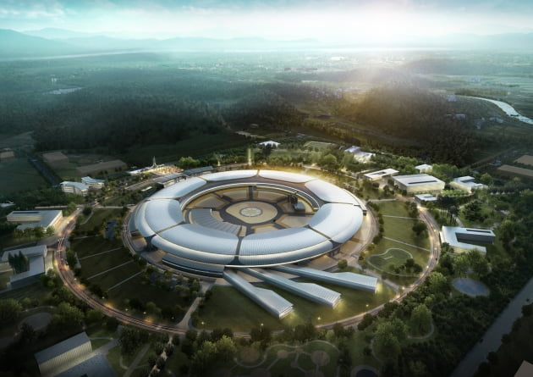


4th International Advisory Committee Meeting (5-6 November 2025, KBSI Ochang Korea)
Current Status and Future Plans of Korea-4GSR
(Multipurpose Synchrotron Radiation Project)
Seunghwan Shin
Project Director
November 5, 2025
Notes:
안녕하십니까 다목적 방사광가속기 구축을 위한 기반시설 구축을 담당하고 있는 건설사업팀 김영찬 Senior Researcher 입니다.
앞서 있었던 가속기 장치에 대한 소개에 이어 건물, 전력 및 가스 등 기반시설 구축과 관련된 내용을 소개해드리겠습니다.

Slide 2

CONTENTS
I. General Overview
II. Site and Building
III. Machine
IV. Plan and Summary
1. User Activities in Korea
2. Overall Project
3. Road Map as User Facility
Site Construction
Building Design
1. Main Parameters
2. Accelerator
3. Phase-I Beamline
4. Prototype testing
1. HR Development
2. Utilization
3. R&D Activities
4. Summary
2
Notes:
목차입니다.
목차는 크게 세가지로 나누었습니다.
먼저 1. Project Outline입니다. 앞서 단장님께서도 소개해주셨지만, 다시 한 번 간략히 말씀드리겠습니다.
두번째로, 2. Architectural Design입니다. 이 장에서는 전체 배치도 및 건물별 도면을 보여드리면서 건물들의 구성 및 기능을 간략히 말씀드리겠습니다.
마지막으로, 3. Construction Plan입니다. 이 장에서는 현재 기반시설 구축을 위한 설계를 진행하고 있으므로, 설계 내용과 관련된, 그 중에서도 건축/구조, 기계, 전기 공종에 대해서 말씀드리겠습니다.

Slide 3
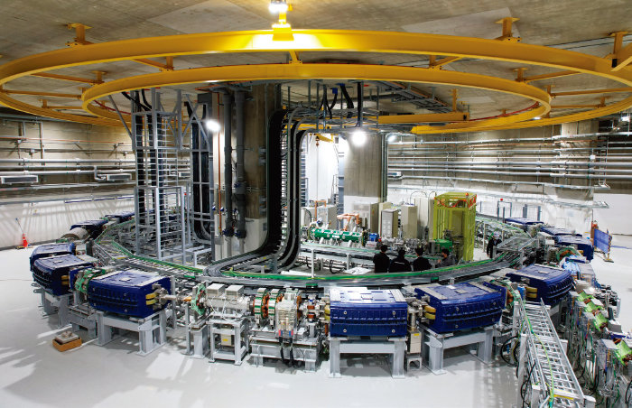
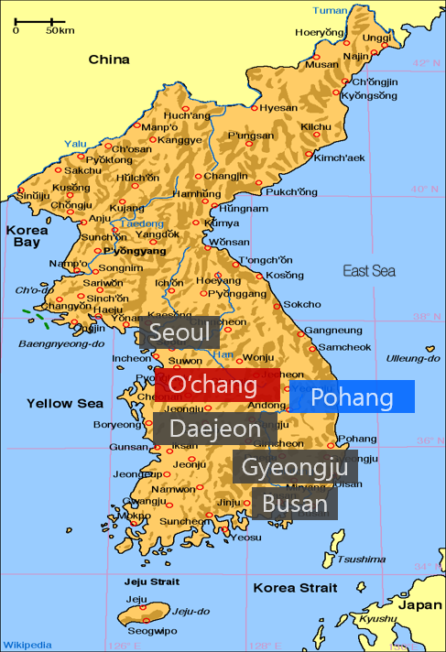
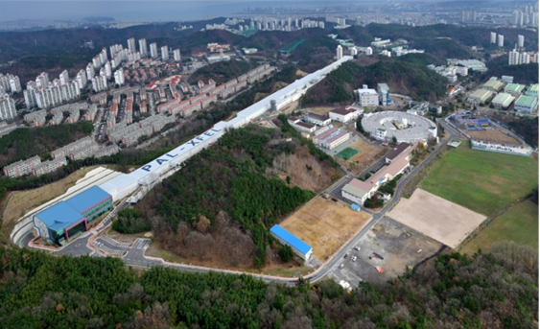
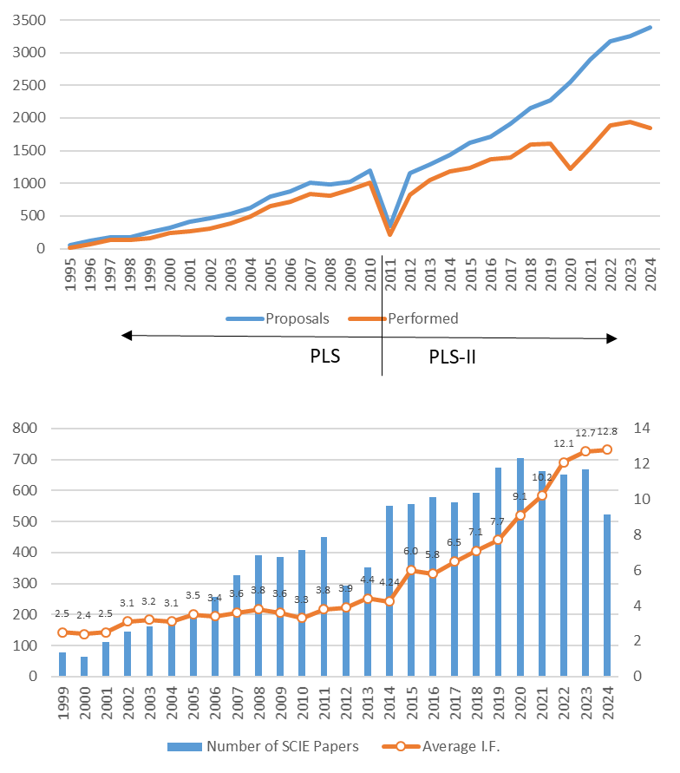
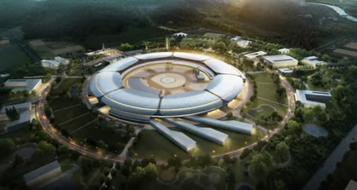
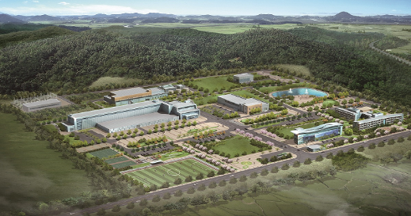
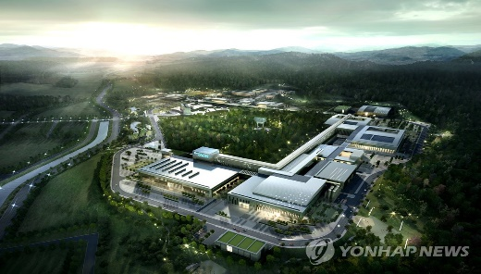
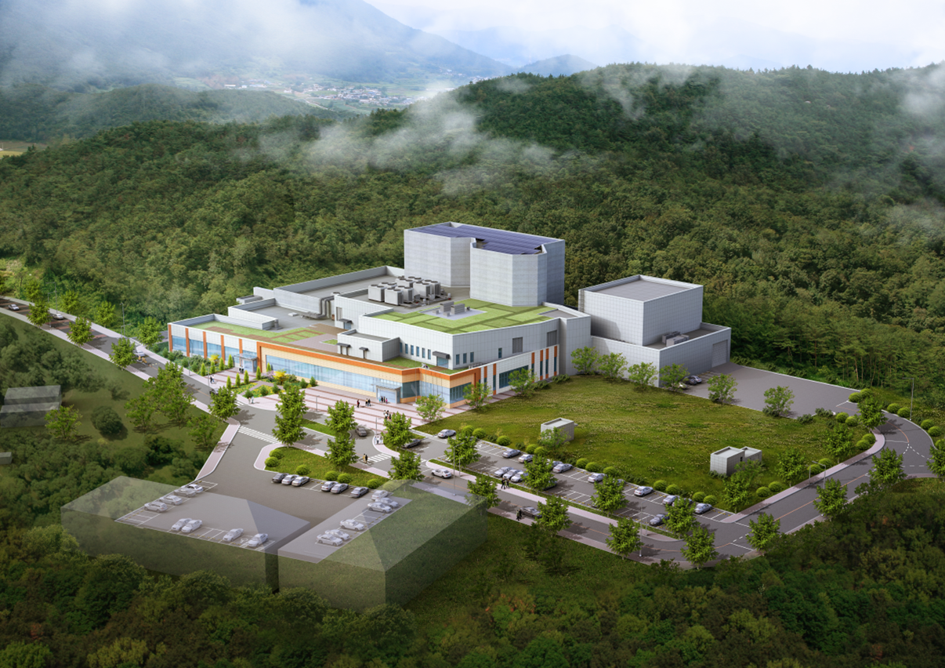
User Activities in Korea
Accelerators in Korea
Achievements of users and PAL
Heavy Ion radiation-therapy
PLS-II & PAL-XFEL
Korea-4GSR (construction)
Proton LINAC
Rare-isotope accelerator
Medical Heavy ion accelerator
3
Notes:
먼저 Project Outline입니다.
(Site Location) 몇시간 전 방문하신 사업현장은 충청북도 청주시 오창읍 후기리에 조성 중인 ‘오창 Technopolis Industrial Complex’ 내에 위치하고 있습니다.
(Facility Area) 다음은 Facility Area입니다. Overall Site Area는 540,000m2이며, 금번사업에서는 이 중 310,000m2에 기반시설 구축사업을 시행합니다.
금번 기반시설 구축사업을 통해 건축되는 Building Overall Area는 약 69,400m2입니다. 자세한 설명은 다음장에서 다시 말씀드리겠습니다.
(Project Period) 다음은 Project Period 입니다. 현재는 2021 ~ 2027로 계획하고있으나, 설계 및 시공 과정에서 사업기간의 불가피한 연장이 있을 수 있습니다.
(Project Entity) Project Entity로는 국가 정부부처인 Ministry of S&ICT와 충청북도 및 청주시가 공동구성 되어있습니다.
(Overall Budget) Overall Budget은 1.120 Trillion KRW이며, Construction Budget은 0.312 T KRW 수준입니다.
(Project Organ.) Project Organization으로는 우리 KBSI가 주관하며, PAL에서 공동수행하고있습니다.
시간관계상 장치의 특성 및 성능 등의 내용은 생략하므로 자료를 참고하시기 바랍니다.

Slide 4
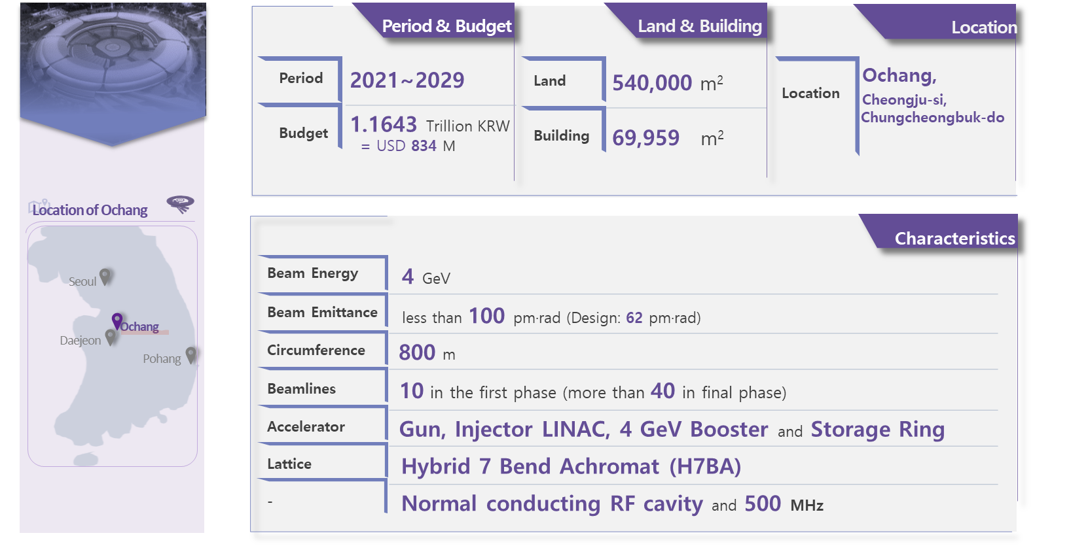
Overview of the Project
4

Slide 5
Project Governance
Ministry of Science and ICT
(Government)
Chungcheongbuk-do
/Cheongju-si
(Local Government)
Project Council
Project Evaluation Council
Korea Basic Science Institute
(KBSI)
Multipurpose Synchrotron Radiation Construction Project
Accelerator
(PAL)
Beamlines
(PAL)
Facility Construction
(KBSI)
Site Preparation
(Local Government)
KBSI, the leading institute to carry out the project
Responsible for Facility Construction and Project management
PAL, the Joint institute as the partner
Responsible for Accelerator and Beamline construction
5

Slide 6
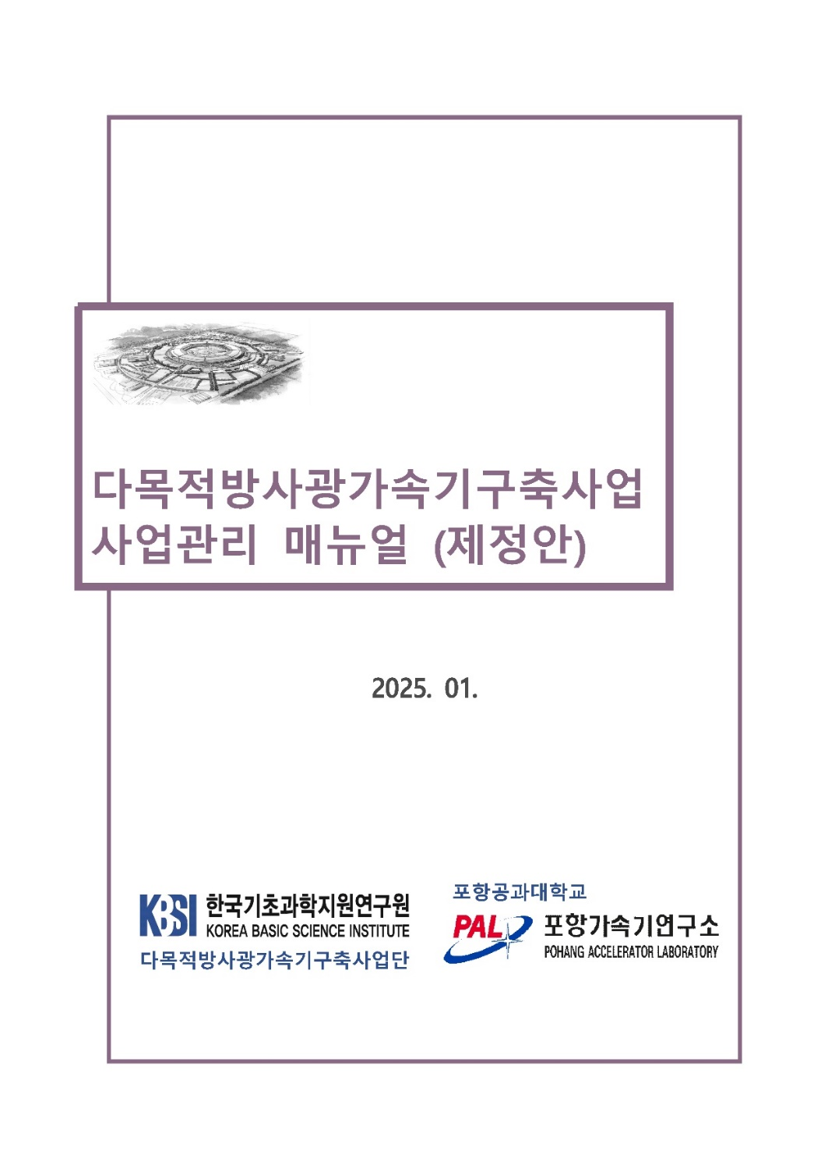
Project Management
• Scope and Schedule managements
- Baseline WBS (included Critical path and Milestones)
is structured into 5 stages
• Risk management
- Minimize the uncertainty of the project through
the risk management system and to secure the visibility
and stability of the project
• Stakeholder management
- Smooth communication and management between
PAL and KBSI through regular progress meeting and
Coordination Council
• Change and Quality management
- Significant changes are discussed and coordination council
6

Slide 7
Project Timeline
Start of CDR
Project Approval
1st Design Review
3rd Design Review
Prototype Completed
2020. 05
2021.07
2024.01
2024.10
2020.02
2021.04
2023.02
2024.07
2025.07
Preparation Phase
Design Phase
Development Phase
Site Section
Start of Project
2nd Design Review
Start of Development
7

Slide 8
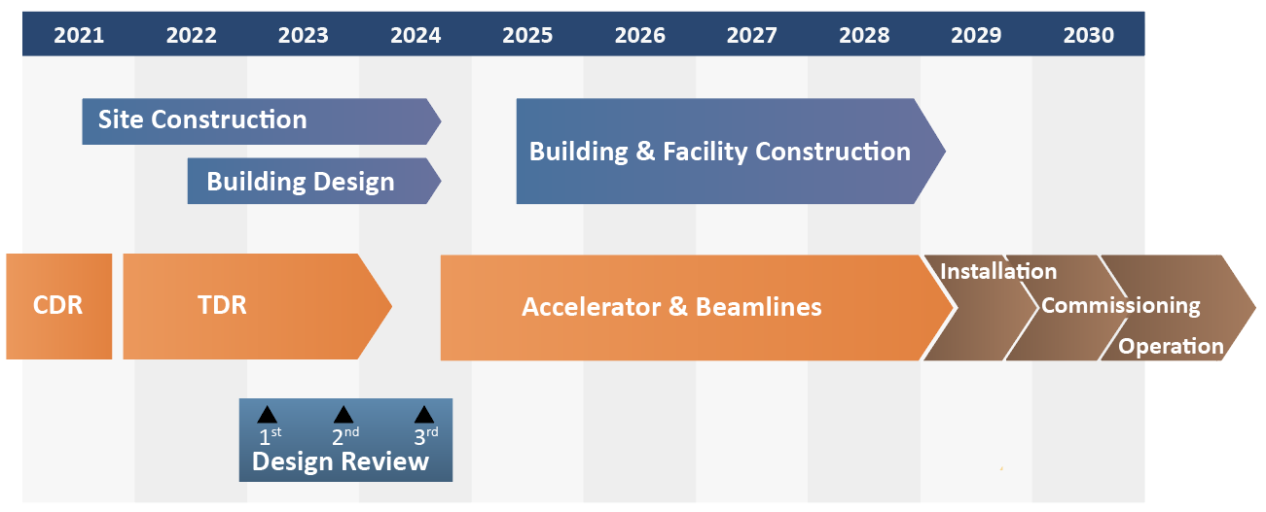
Project Milestones
8

Slide 9
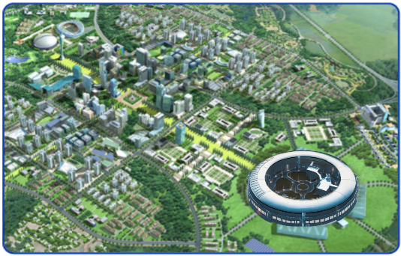
Road Map as User Facility
Vision
World-leading synchrotron radiation for transformative science
▪ 4 GeV, 400 mA, ε < 100 pm·rad e-beam
▪ Cutting-edge beamlines utilizing unprecedented radiation properties
Mission
Achieve Design Performance
▪ Complete accelerator & beamline construction
▪ Ensure on-time development and commissioning
Build Operational &
Scientific Capability
▪ Accumulate next generation R&D team
▪ Establish advanced science programs
2024
2027
2029
2030
Progress without delay
▪ Structuring the organization
▪ Project management setup
Project team-driven
▪ Development and Inspection
▪ Unified operating system
Commissioning
▪ Assemble and Install on time
▪ Performance verification
Operation
▪ Transit to operation mode
▪ Spread into science community
Map
Phase 1 (~2030)
Phase 2 (2031~)
Strategy
Strengthening research capabilities & infrastructure
Establishing core facility infrastructure
Globally competitive photon science platform through innovation and integration
Industry-engaged innovation hub
Integrated science ecosystem
Science-driven future beamline expansion
AI-augmented operations for optimization, diagnostics, and autonomous control
and means.
Collaborative development with KBSI and PAL
Accelerator development with proven technology
Co-development of high-demand, user-prioritized beamlines
Future S&T manpower for operations and Phase 2 expansion
9

Slide 10
CONTENTS
I. General Overview
II. Site and Building
III. Machine
IV. Plan and Summary
1. User Activities in Korea
2. Overall Project
3. Road Map as User Facility
Site Construction
Building Design
1. Main Parameters
2. Accelerator
3. Phase-I Beamline
4. Prototype testing
1. HR Development
2. Utilization
3. R&D Activities
4. Summary
10
Notes:
목차입니다.
목차는 크게 세가지로 나누었습니다.
먼저 1. Project Outline입니다. 앞서 단장님께서도 소개해주셨지만, 다시 한 번 간략히 말씀드리겠습니다.
두번째로, 2. Architectural Design입니다. 이 장에서는 전체 배치도 및 건물별 도면을 보여드리면서 건물들의 구성 및 기능을 간략히 말씀드리겠습니다.
마지막으로, 3. Construction Plan입니다. 이 장에서는 현재 기반시설 구축을 위한 설계를 진행하고 있으므로, 설계 내용과 관련된, 그 중에서도 건축/구조, 기계, 전기 공종에 대해서 말씀드리겠습니다.

Slide 11
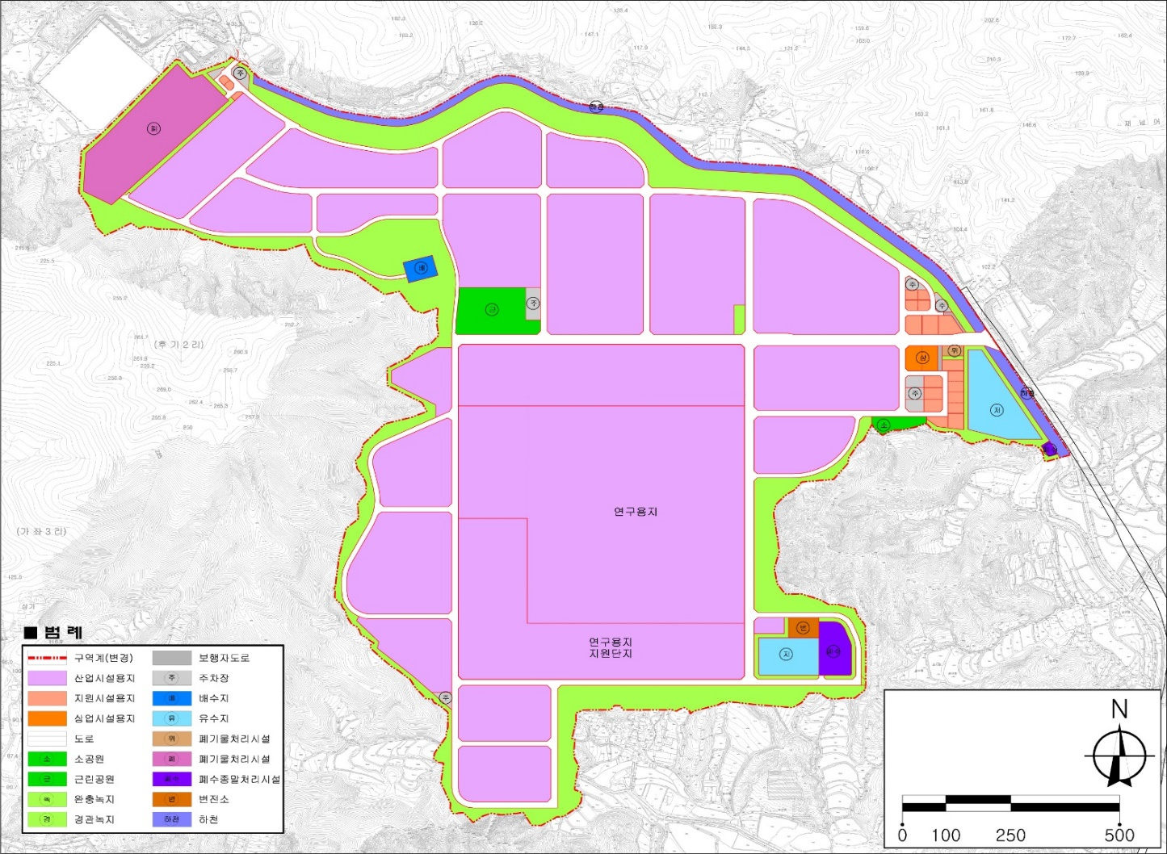
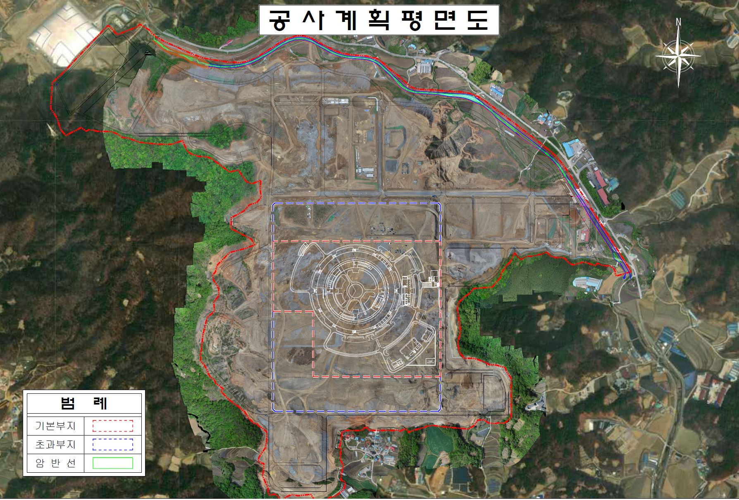
Site Construction
• Site construction for accelerator facility and research center completed
• Discussing the type of research center with government
(e.g., Battery research center, Advanced bio-research center, etc.)
SITE for Industry
Research Center
Accelerator
SITE
Research Center
11

Slide 12
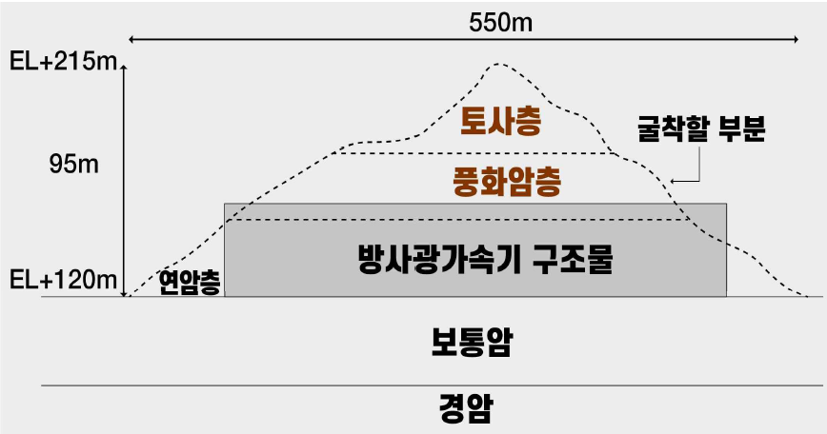
Site Construction
• Site construction for accelerator facility and research center completed
• Discussing the type of research center with government
(e.g., Battery research center, Advanced bio-research center, etc.)
12

Slide 13
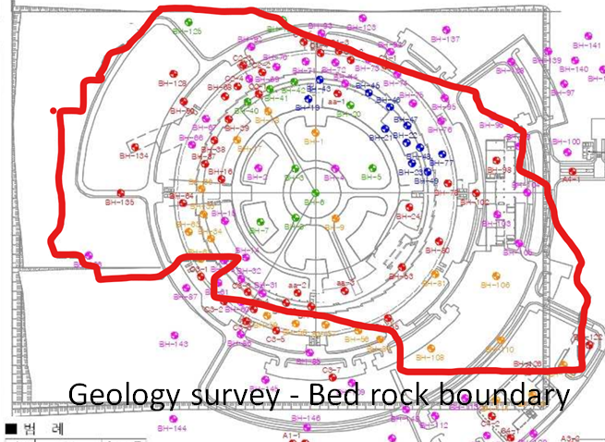
Site Construction
• Site construction for accelerator facility and research center completed
• Discussing the type of research center with government
(e.g., Battery research center, Advanced bio-research center, etc.)
13

Slide 14
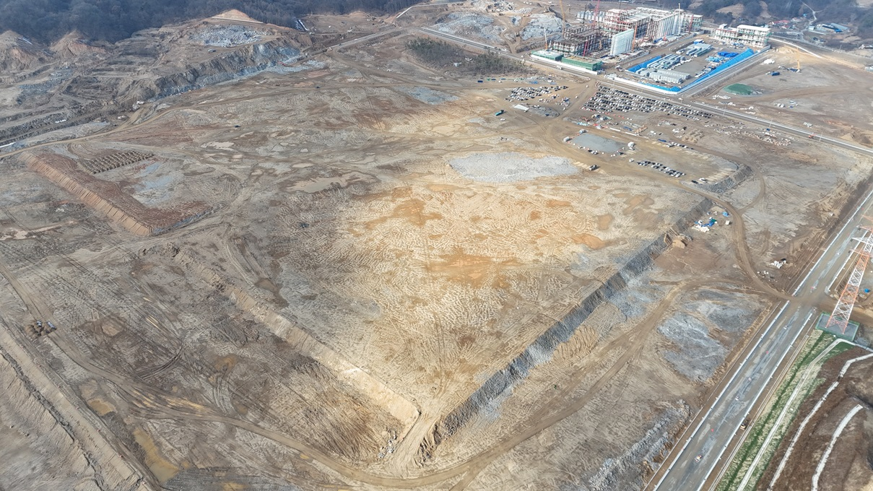
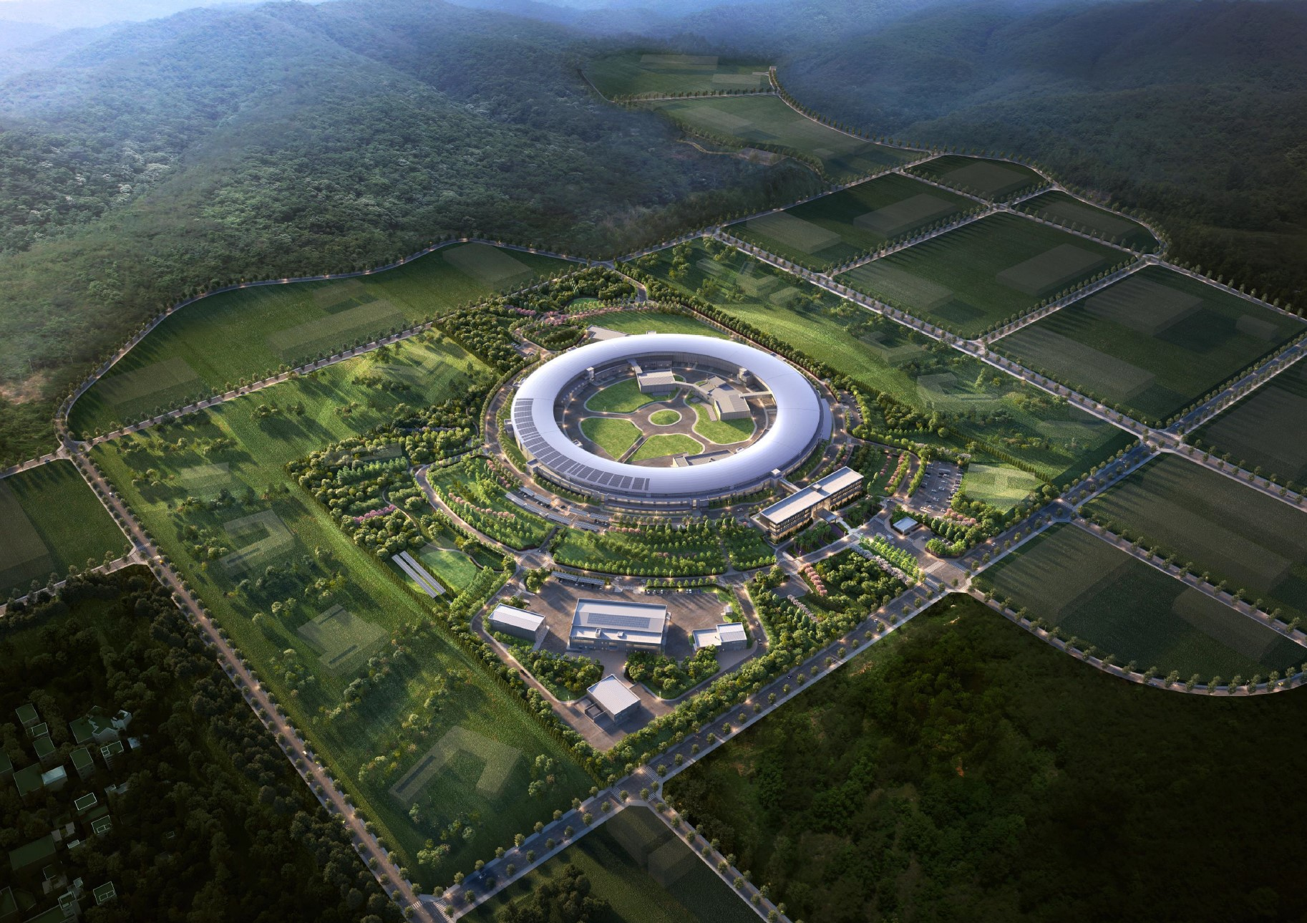
Building Design
• The building design had been
completed and the process for
selecting a constructor is underway
• Construction company selection
has been delayed by a year, but
will be finalized through (if it
occurs) a private contract by April
• Floor vibration will be kept below
100 nm (5 nm) and earth ground
must also be realized carefully
(currently under revision)

Slide 15
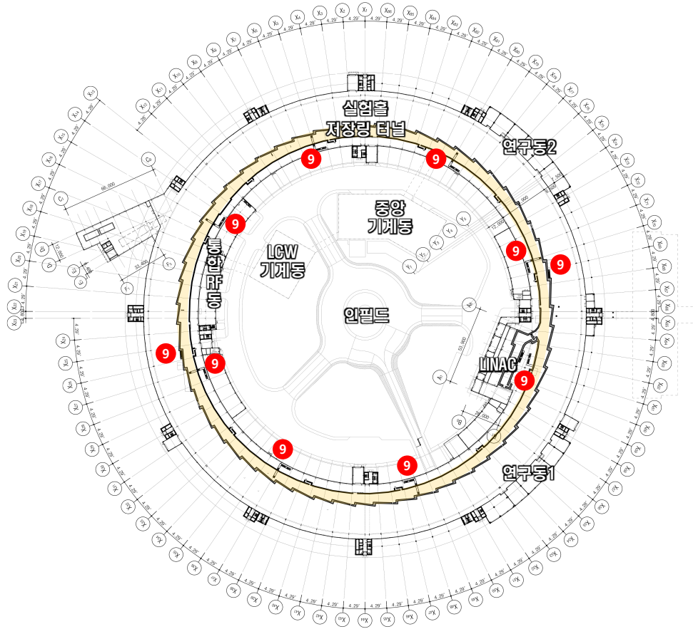
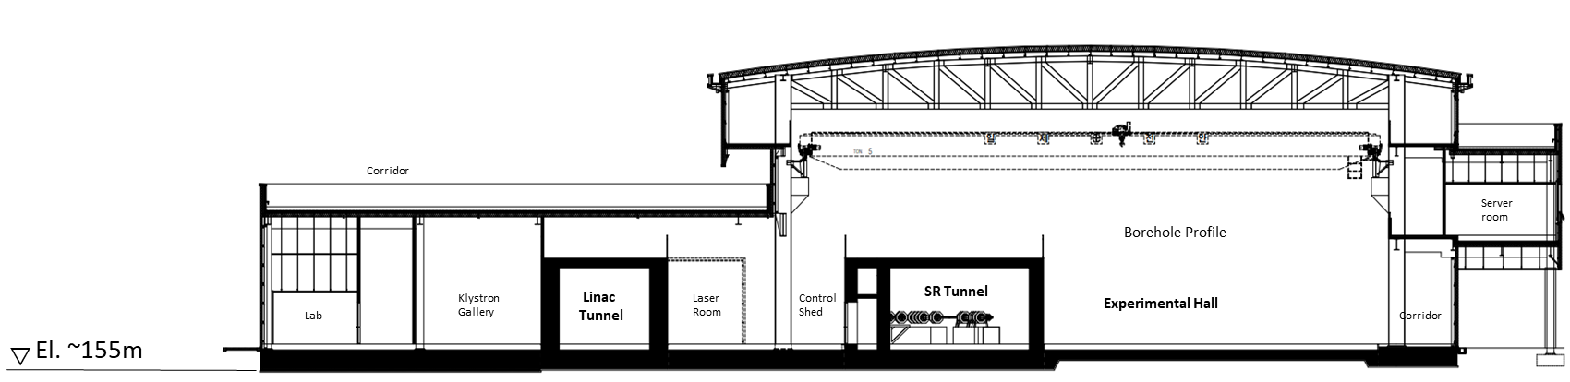


Building Design
Tunnel: 1.3 m thick Reforcered Con’c Slab
Experiment Hall: 0.8 m thick Reforcered Con’c Slab
$$▽$$
Subsoil: Soft Rock (gneiss)

Slide 16
CONTENTS
I. General Overview
II. Site and Building
III. Machine
IV. Plan and Summary
1. User Activities in Korea
2. Overall Project
3. Road Map as User Facility
Site Construction
Building Design
1. Main Parameters
2. Accelerator
3. Phase-I Beamline
4. Prototype testing
1. HR Development
2. Utilization
3. R&D Activities
4. Summary
16
Notes:
목차입니다.
목차는 크게 세가지로 나누었습니다.
먼저 1. Project Outline입니다. 앞서 단장님께서도 소개해주셨지만, 다시 한 번 간략히 말씀드리겠습니다.
두번째로, 2. Architectural Design입니다. 이 장에서는 전체 배치도 및 건물별 도면을 보여드리면서 건물들의 구성 및 기능을 간략히 말씀드리겠습니다.
마지막으로, 3. Construction Plan입니다. 이 장에서는 현재 기반시설 구축을 위한 설계를 진행하고 있으므로, 설계 내용과 관련된, 그 중에서도 건축/구조, 기계, 전기 공종에 대해서 말씀드리겠습니다.

Slide 17
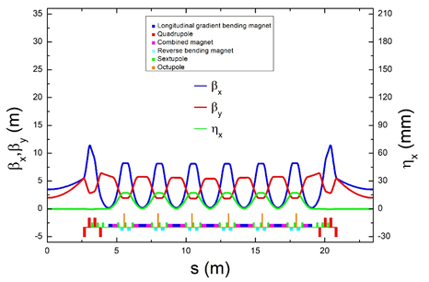
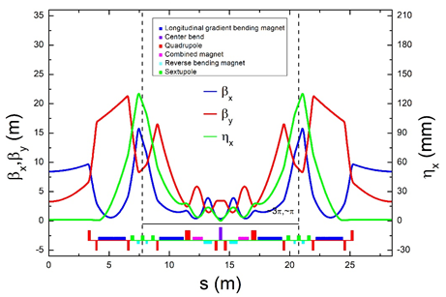
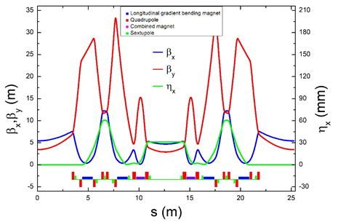
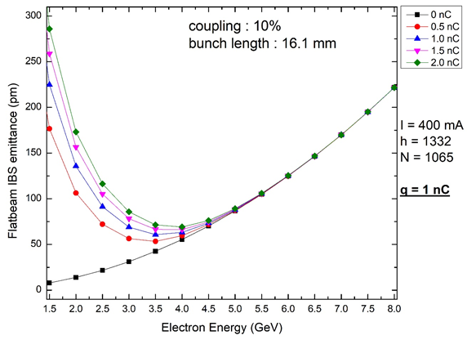
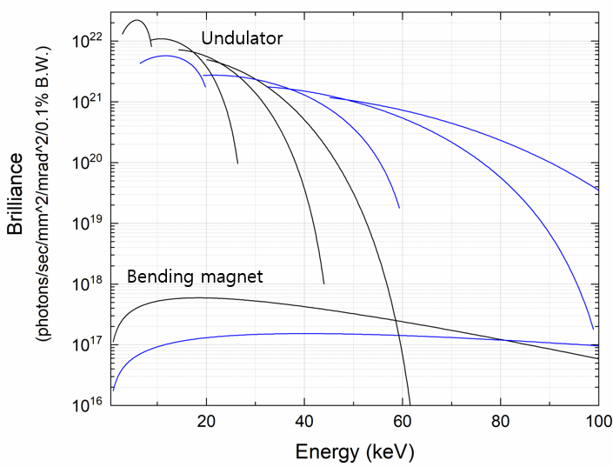
Early Study
Classical 7BA
H7BA
Variated 6BA
e-Energy Scan
Brilliance at each e-Energy
- Modular structure
- With LGB and Reverse B
- 4 GeV, 800 m, and 8 pm
- Nonlinear cancelation
- High dispersion bump
- 4 GeV, 800 m, and 58 pm
- Proper to PLS-III
- Doubling number of ID
- 4 GeV, 800 m, and 77 pm

Slide 18
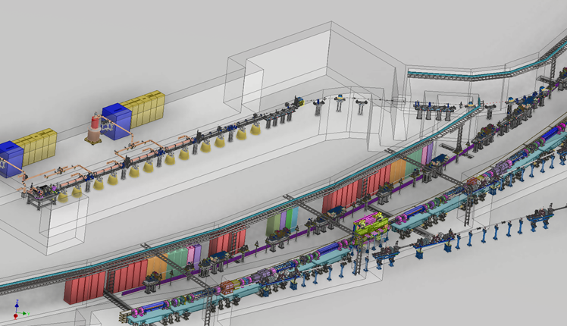
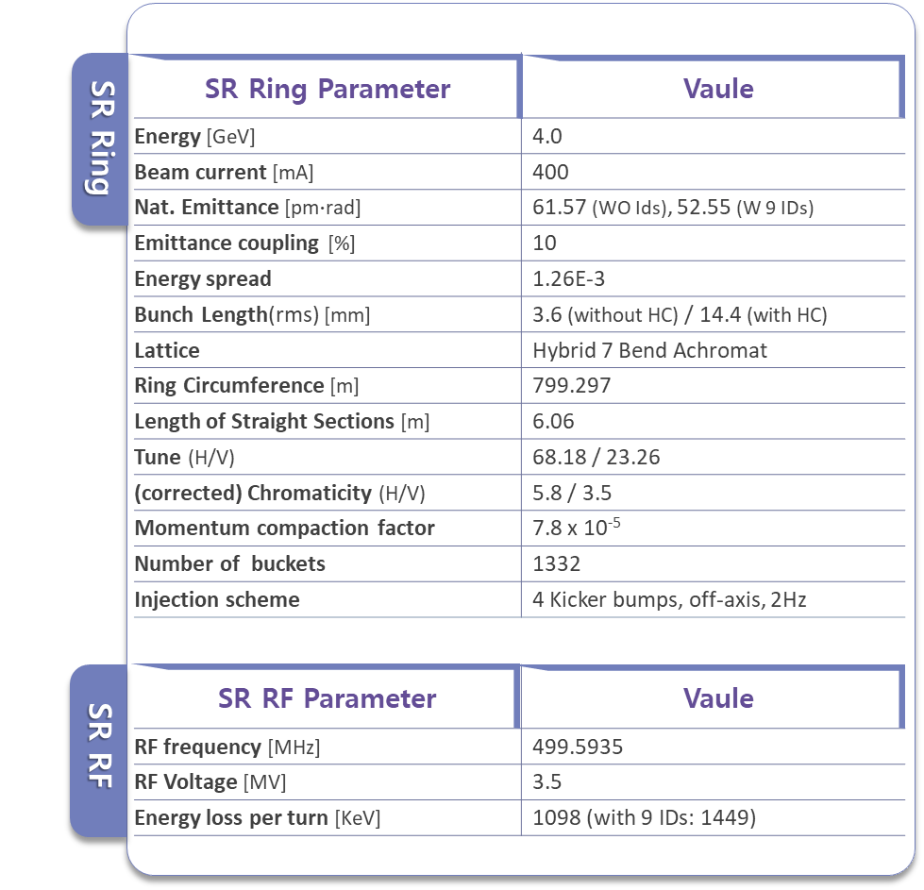
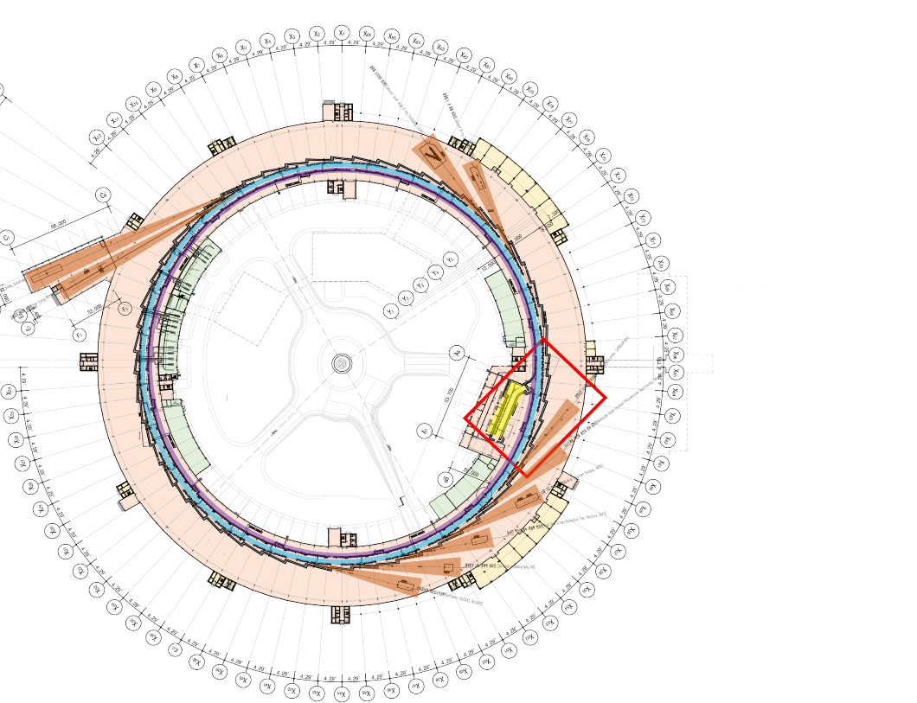
Main Parameters

Slide 19
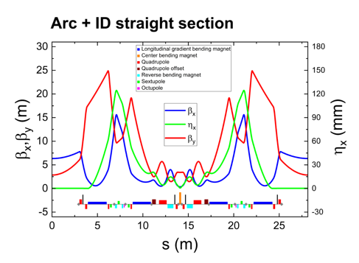
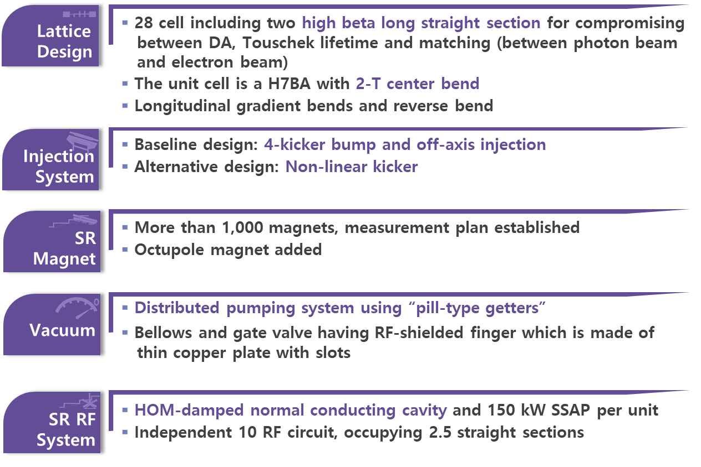
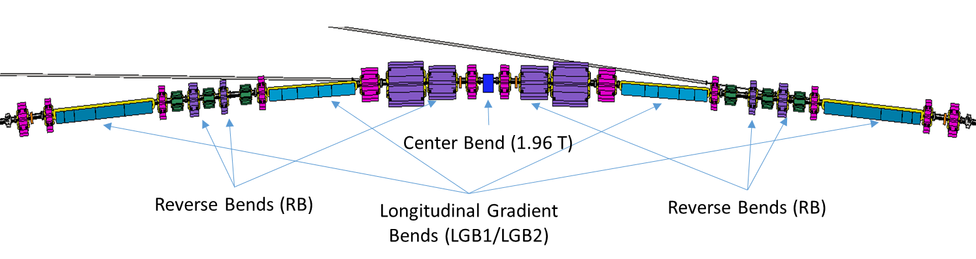
Accelerator Machine

Slide 20
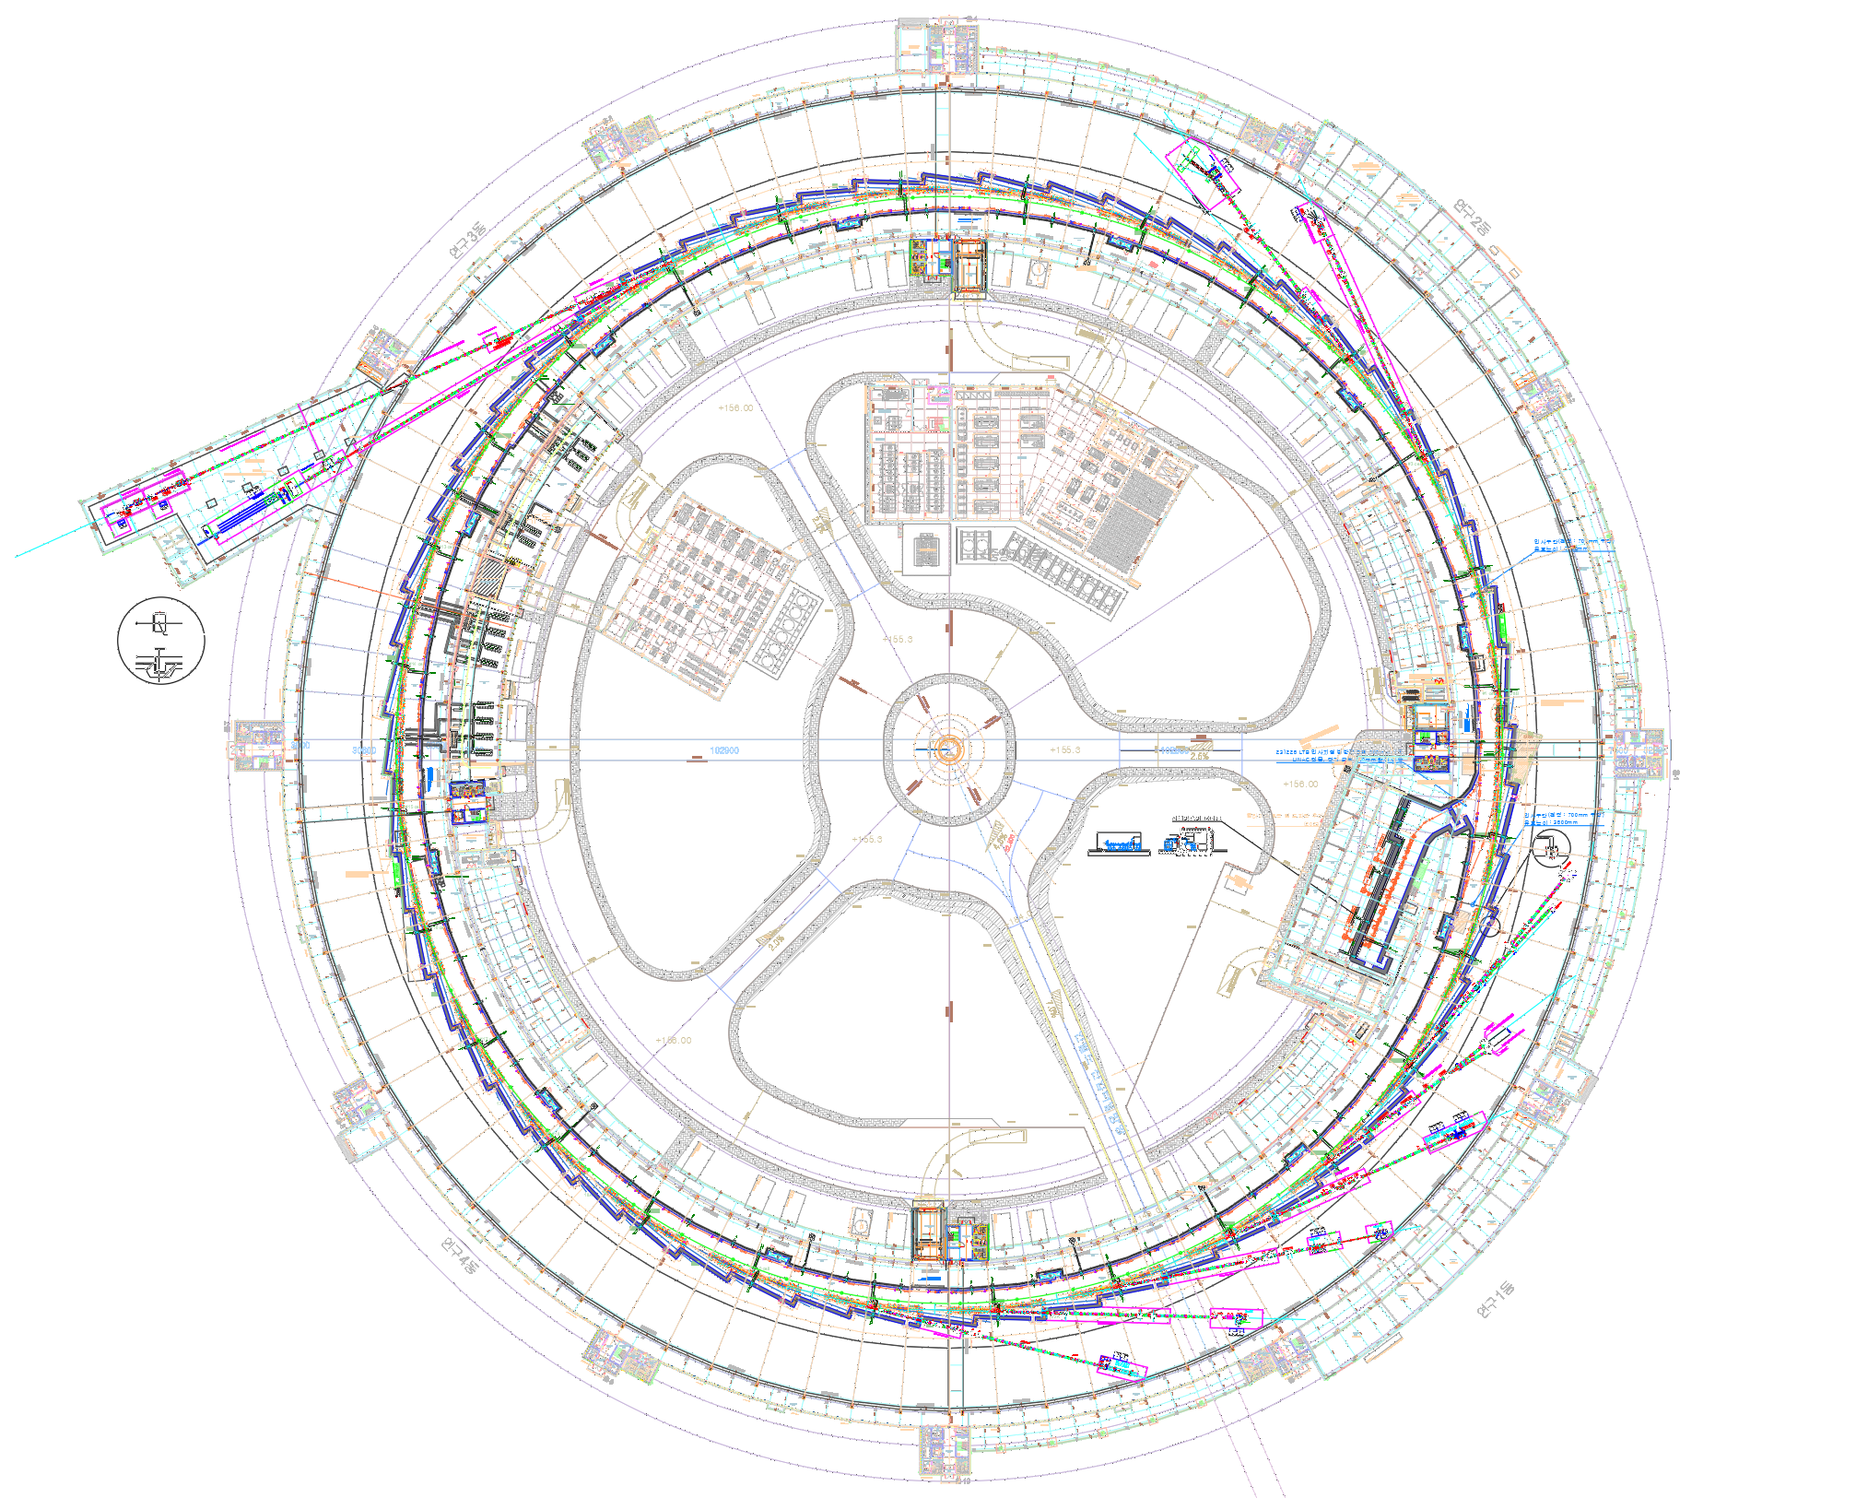
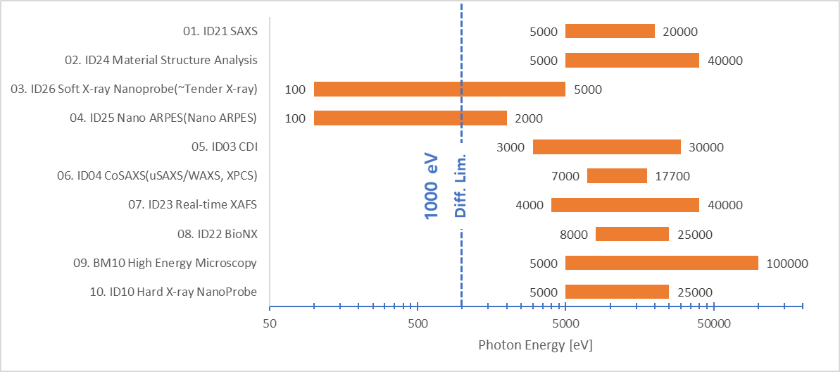
Phase I Beamlines
ID04 : CoSAXS
8 – 30 keV / IVU20
Coherent SAXS (XPCS)
ID03 : CoXRD
5 – 30 keV / IVU22
CDI, Bragg CDI, XRD
Industry Priority Beamline
Public Beamline
ID10 : Hard X-ray Nanoprobe
5 – 25 keV / IVU24
150 m long / nanoscopy
ID26 : Soft x-ray Nanoscopy
0.1 – 5 keV / EPU78 + IVU24
Soft x-ray spectroscopy
ID25 : Nano ARPES
0.1 – 2 keV / EPU98
Nano-ARPES / μ-ARPES
BM10 : High Energy Microscope
20 – 150 keV / BM (H_{C} = 21 keV)
100 m long / phase-contrast
ID24 : Material Structure
6 – 45 keV / IVU16
Diffraction, HRPD
ID23 : Realtime XAFS
4 – 40 keV / IVU24
XAFS (tr-XANES, EXAFS)
Beamline Ports
Total straight Section(SS) |  | 28
Occupied SS for BTL and RF |  | 4
Available ID sections |  | 24
Center band |  | 28
Available ports |  | 52
Beamline of Phase 1 |  | 10
ID22 : Nano MX
5 – 20 keV / IVU20
Molecular Crystallography
ID21 : Bio SAXS
5 – 25 keV / IVU24
Bio / Solution SAXS

Slide 21
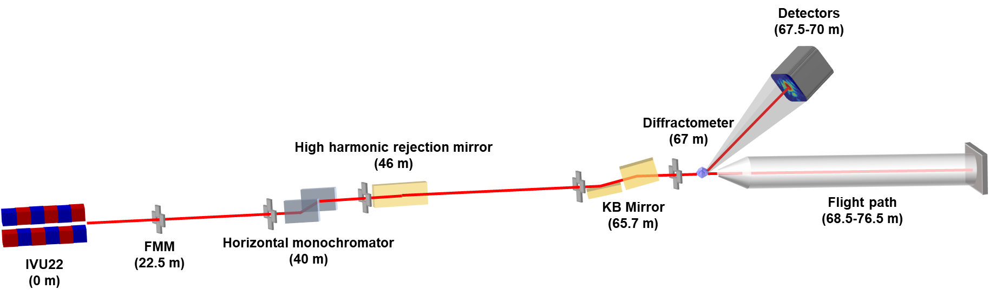
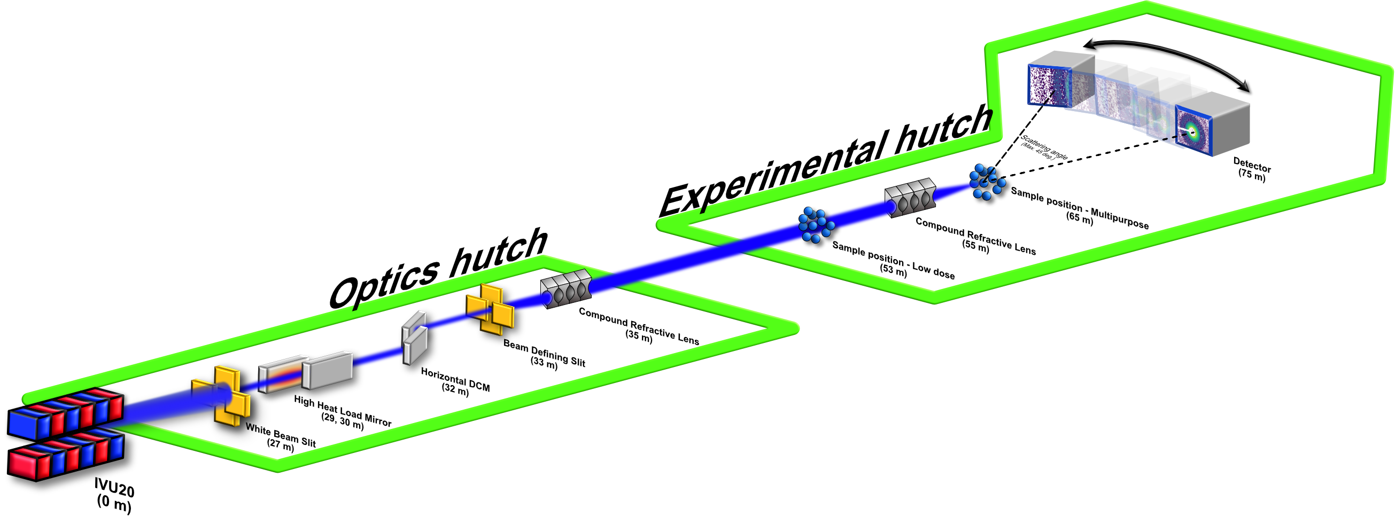
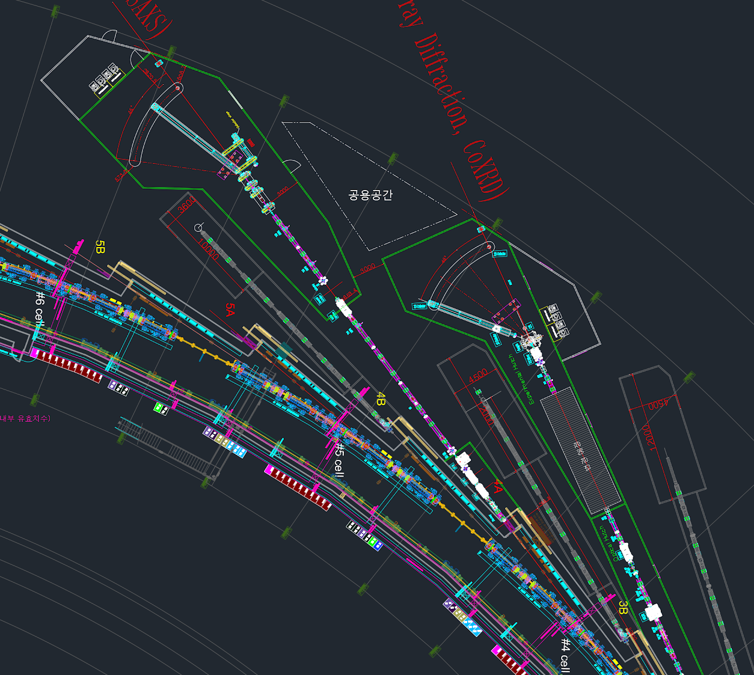
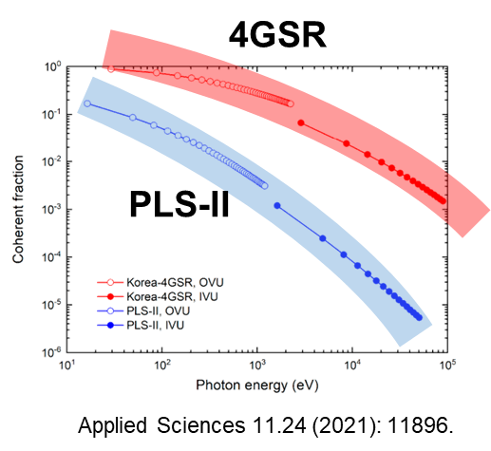
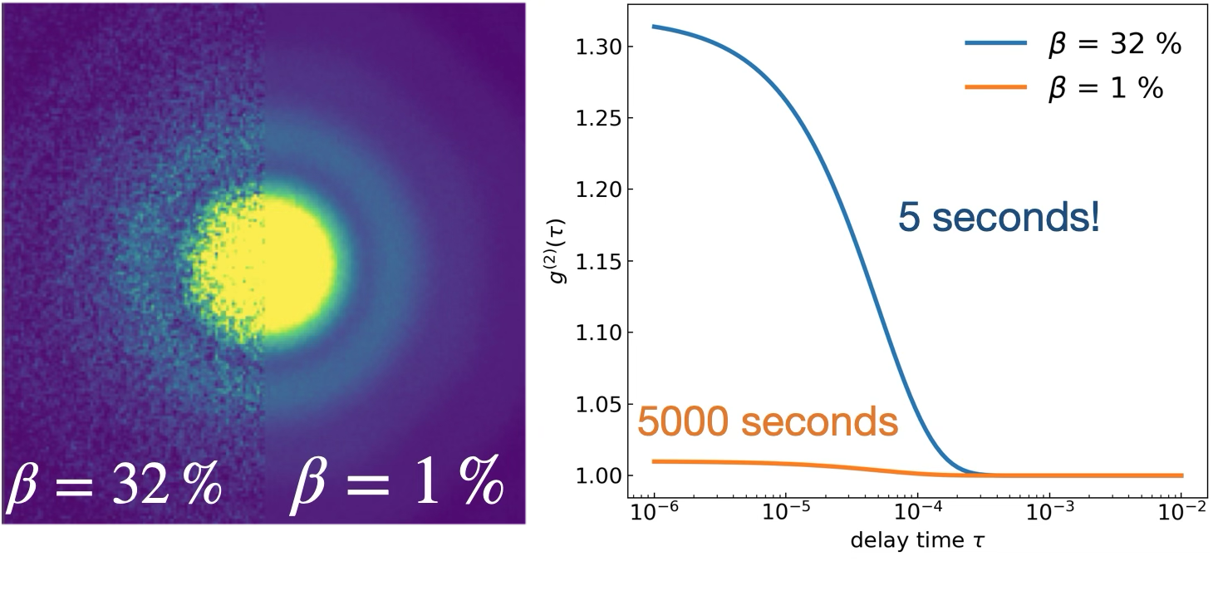
Feature Beamline - Coherent Beamlines
ID03 Coherent XRD
ID04 Coherent SAXS
 | 6 keV (3rd) | 15 keV (5th) | 30 keV (7th)
Coherence (ph/s) | 5.66 x 10¹² | 6.34 x 10¹¹ | 1.43 x 10¹⁰
Flux (ph/s) | 1.77 x 10¹⁴ | 6.62 x 10¹³ | 3.72 x 10¹²
CRL2 : 8.2 x 2.3 μm² @ 20 keV
CRL1 : 14.3 x 17.9 μm² @ 20 keV
Coherent fraction is enhanced by 100~1000 times better
➔ Direct enhancement of experimental efficiency
ID04 - CoSAXS
ID03 - CoXRD

Slide 22
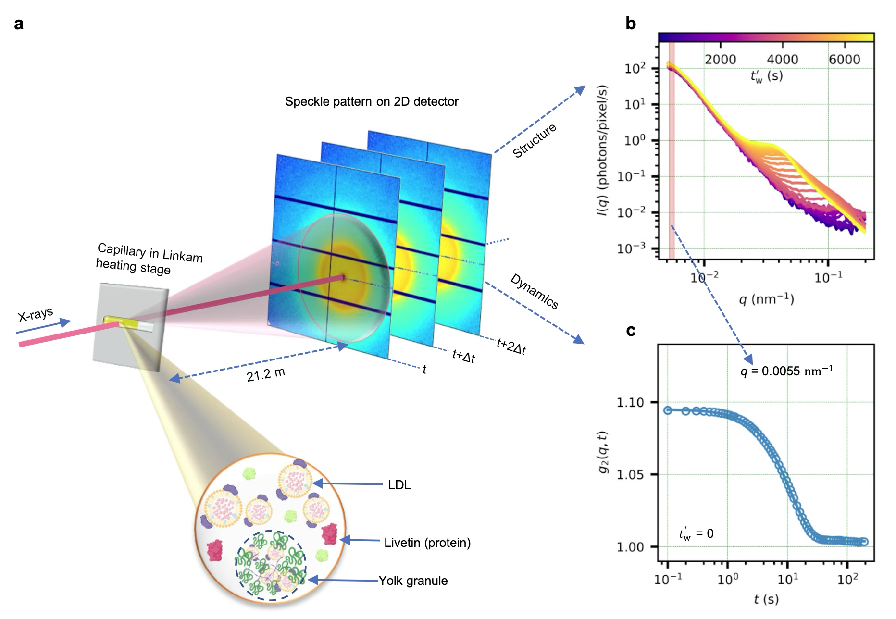
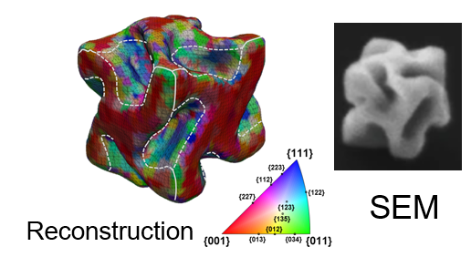
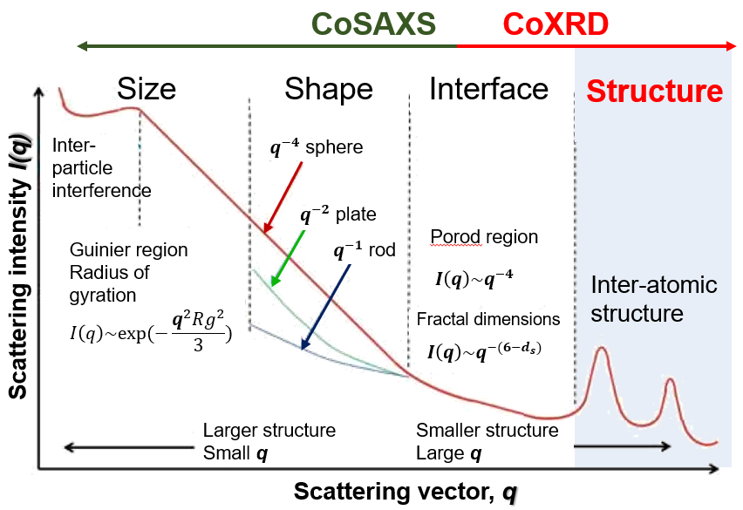
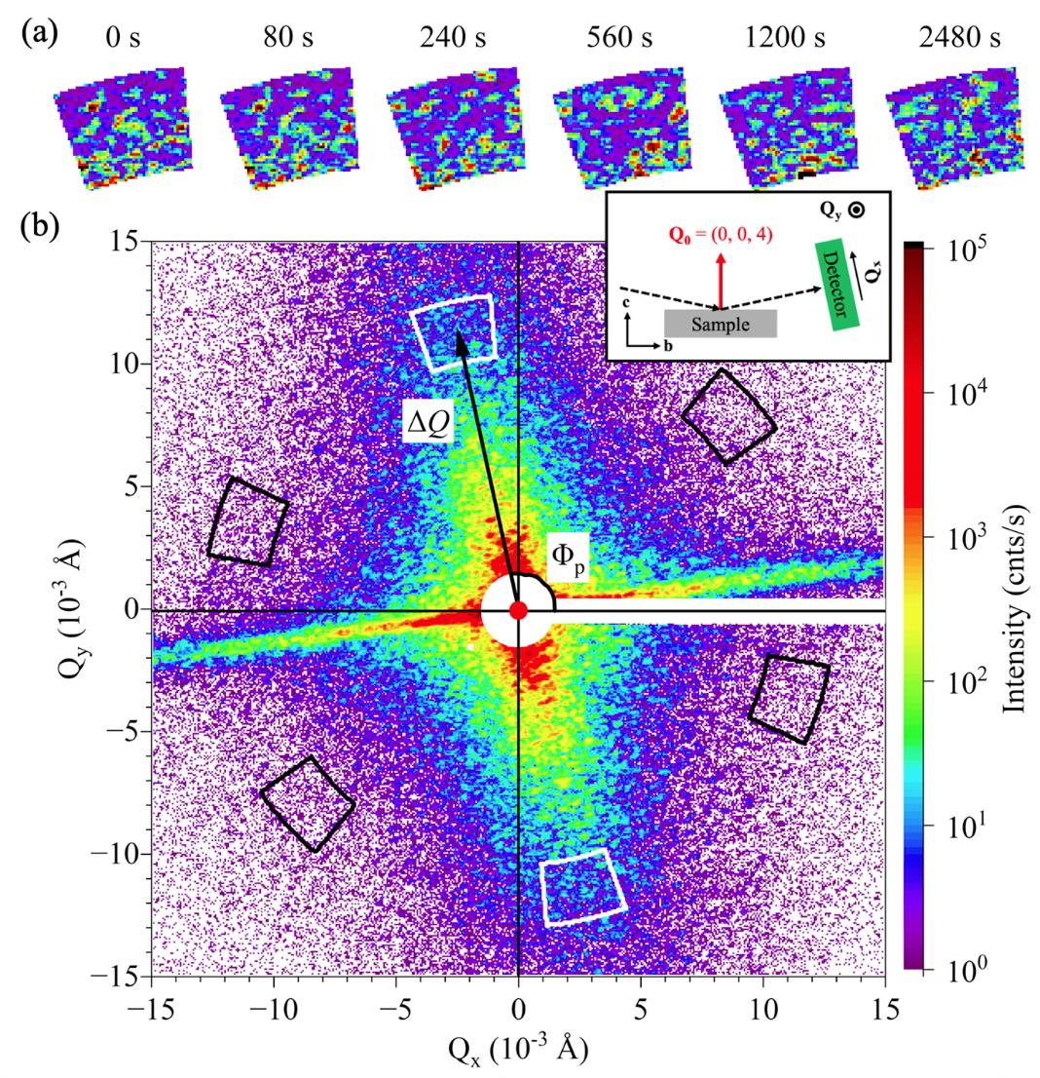
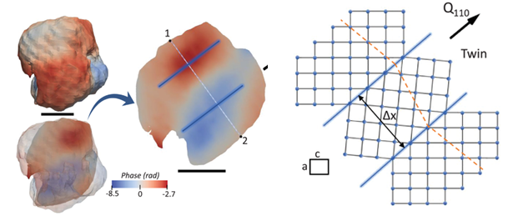
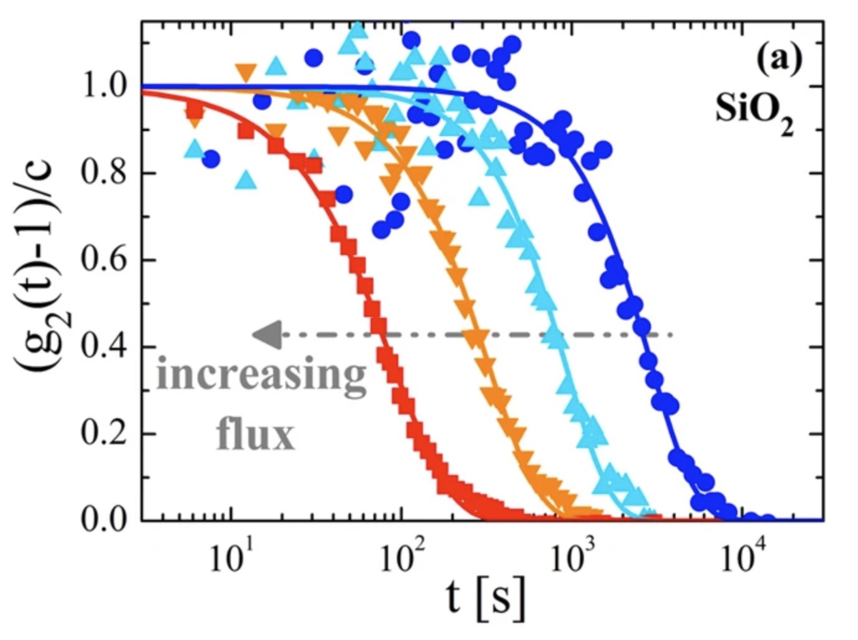
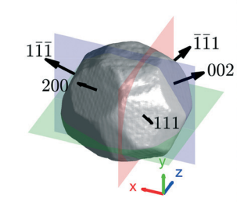
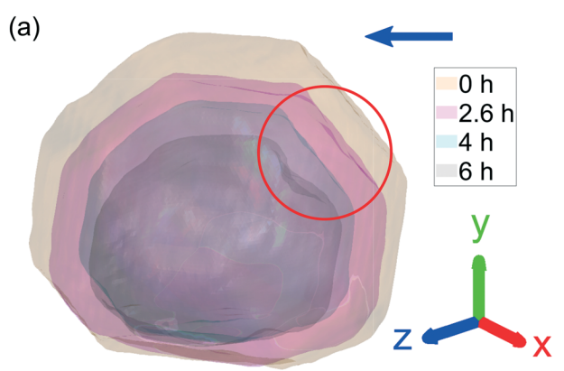
Beamline Application - Coherent Beamlines
Protein dynamics in SAXS
Dynamics
In-situ Operando Strain Imaging
N. D. Anthuparambil et al., Nat. Commun., 14, 5580 (2023)
Nature communications 14.1 (2023): 3615.
Charge Density Wave dynamics in WAXS
Twin boundary Imaging
L. Shen., Phys. Rev. B, 108, L201111 (2023)
Advanced Functional Materials 33.19 (2023): 2208012.
Intensity correlation function
measured in silica NPs in water
Corrosion Chemical Imaging
Inhomogeneity
CrystEngComm 24.7 (2022): 1334-1343.
B. Ruta, Scientific Reports 7, 3962 (2017)

Slide 23
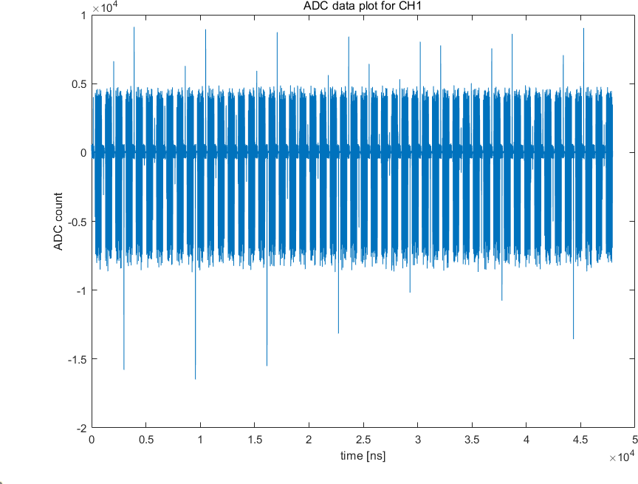
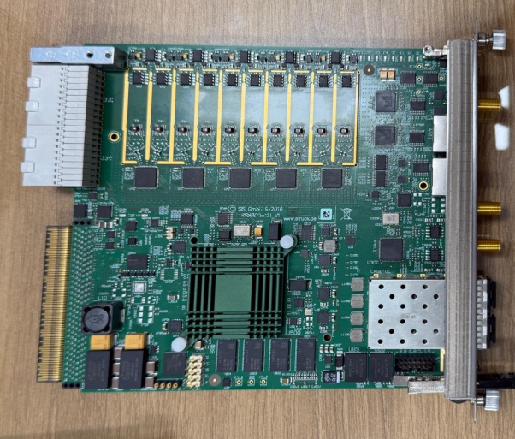
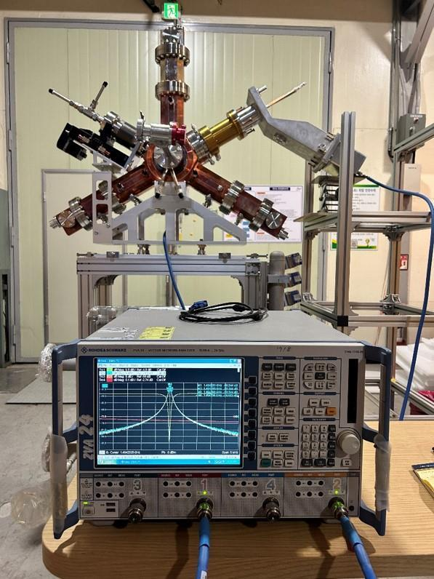









Prototype Development
Electronics
Power Supply
Cavity
Magnet
Vacuum Chamber
DCM / Optics

Slide 24
CONTENTS
I. General Overview
II. Site and Building
III. Machine
IV. Plan and Summary
1. User Activities in Korea
2. Overall Project
3. Road Map as User Facility
Site Construction
Building Design
1. Main Parameters
2. Accelerator
3. Phase-I Beamline
4. Prototype testing
1. HR Development
2. Utilization
3. R&D Activities
4. Summary
24
Notes:
목차입니다.
목차는 크게 세가지로 나누었습니다.
먼저 1. Project Outline입니다. 앞서 단장님께서도 소개해주셨지만, 다시 한 번 간략히 말씀드리겠습니다.
두번째로, 2. Architectural Design입니다. 이 장에서는 전체 배치도 및 건물별 도면을 보여드리면서 건물들의 구성 및 기능을 간략히 말씀드리겠습니다.
마지막으로, 3. Construction Plan입니다. 이 장에서는 현재 기반시설 구축을 위한 설계를 진행하고 있으므로, 설계 내용과 관련된, 그 중에서도 건축/구조, 기계, 전기 공종에 대해서 말씀드리겠습니다.

Slide 25



Human Resource Development
• (Plan) Key Personnel for Construction and Operation
- Officially 150 Personnel
- The justification for increasing the workforce to 214 personnel
has been established through policy research project
• (Execution) Complex Workforce Structure
- Progress on unified recruitment
- Securing and increasing authorized regular positions

Slide 26





Maximization of Beamline Utilization
• Start of Regular Discussions: Science Workshop and SAC (with sub working group)
• Expected Outcome Management (> 100+ papers IF>10) with User Expansion
• Strengthening Data Science and AI capabilities (Initiation of a Separate Study)
* Data workflow
* Physical AI Integrated Auto-
nomous Experimental System
* Science Foundation model
…

Slide 27


Industry Support
• Region with Numerous Industries Including Leading Companies
• Plan for Discovering Industrial Users and Establishing a Support System for
Industrial Experiments and Analyses

Slide 28







R&D activities
• Domestic Collaborative R&D in Beam Dynamics
- Nonlinear Kicker with KU
- EPU research with KU
- Studies of HHC with POSTECH
- Magnet design with GWNU
- AI based study with KAERI
• HTS 3PW
- SNU & PAL collaboration R&D
- 5 T prototype HTS 3PW
• Super-bend
- SNU&KBSI&PAL collaboration R&D
- 4 T (43 keV CE bend) and 6 T option

Slide 29

Collaboration

Slide 30

Keyword Summary
Maximization of Beamline Utilization: Science Development and Industry Support
International Collaboration
Data Science
AI / AX
HR Development
R&D Activities
Project Management

Slide 31
Summary
• We updated the status of Korea-4GSR
• This project entered stable phase from a budget and schedule perspective
- The final design review had been completed last year
- The budget and schedule adjustments had been confirmed by the government
• We discussed the ongoing and planned activities
- Human resource development
- Maximization of beamline utilization
- Industry support
- R&D activities
• We sincerely appreciate your attendance at this IAC. About IAC …

Slide 32



Previous IAC meeting

Slide 33
Response to IAC 2024
The project team was able to reduce the number of cost item categories from 3000 to 25. The IAC considers this a great progress but strongly recommends to keep the overhead for shifting funds between cost item categories at the lowest possible level since experience in the past showed that the best possible cost estimates are often proven inaccurate if major disturbances happen on the market, which may be the case during a project duration of several years. Such situations require sufficient financial flexibility for the project management team.
Ans. by KBSI) Thank you for your advice. The project team is also taking this matter into full consideration. We are working to develop alternative measures against rapid global price fluctuations and sharp exchange rate increases while ensuring sufficient flexibility. Within the 25 key items, we have already secured budgetary flexibility. Moving forward, we will continue our efforts to ensure adequate budgetary flexibility.
The project team clearly recognized the importance of the performance validation of more than 1000 accelerator magnets and plans to build special facility for this purpose. The project could greatly benefit by adopting, and in some cases simply borrowing, the hardware and software developed at recently upgraded SR facilities in Europe and US.
  Ans. by PAL) Most of the hardware and software used are those that have been validated at PAL. Additionally, high-frequency cavities, EPU (Elliptically Polarized Undulator), DCM (Double Crystal Monochromator), and beamline experimental equipment, which have been verified at overseas 4GSR facilities, are currently being procured from international sources. With regard to the advanced experimental system, some systems are now developing in PAL, others are ongoing communication with relevant fields and facilities.
So far 150 FTE are planned for the operation phase with the first 10 beamlines. Considering that by the time Korea-4GSR will become available, the complexity of experimental stations that operate at the nano scale, multi-modal, high frame rate detection systems for in-situ and operando experiments, and new, eventual even KI-based evaluation software, this number of FTEs seems to be too low. Therefore, IAC strongly endorses the proposed increase of additional 30 FTE to a total of 180 FTE at the start of the facility.
Ans. by KBSI) The project team has been making efforts to secure domestic and international experts since last year and is currently planning a [Mid-to-Long-Term Talent Utilization Plan] in the first half of this year. Based on this plan, we will actively request the government for additional personnel needed during the operational phase. We plan to report on this matter at the next IAC meeting.

Slide 34

New IAC Member
• The previous committee members were the same as these from PAL, so XFEL experts
were also included.
• From this meeting, the committee has been composed of experts in the construction,
operation, and utilization of storage ring.
-

Slide 35
Charge of IAC 2025
• Technical status and progress
- Evaluating the overall status of the accelerators and beamlines
(High beam power, Instability, Many discussions on BL, … )
- Identifying potential issues that could become problems in the future
- (If possible) Reviewing the building and utility system (additional documentation can be provided)
• Project direction
- Confirming our long term vision to advance science and development and to establish the
scientific framework, including the beamline portfolio
- Supporting an increase in the planned staffing level during the operational phase
(150 -> 180 -> 214)
- Suggesting the key areas that require more attention at this stage of the project

Slide 36

Meeting Agenda
https://indico.4gsr.re.kr/e/IAC2025
 | 11/5 (WED) | 11/6 (THU)
Breakfast | Hotel | Hotel
Lunch | Lunch Box | Lunch Box
Dinner | Hotel (Banquet) | Korean Restaurant (Cheongju)

Slide 37

4th International Advisory Committee Meeting (5-6 November 2025, KBSI Ochang Korea)
Thank You
Notes:
이것으로 기반시설 구축과 관련된 발표를 마치겠습니다. 감사합니다.
발표내용과 관련하여, 질의사항이나 추가 코멘트가 있을 시 말씀해주시면 감사하겠습니다.

